Slide 1
ELA–Writing: Access Skills
Laura Hines, Education Consultant
Debra Hand, DESE
Kevin Froton, Cognia

Slide 2
Writing to Communicate
Students at a pre-symbolic communication level participate in the creation of written products that reflect the use of access skills (e.g., “Choose from an array of errorless choices related to the creation of a written product”)
For a student working on access skills, the writing sample must be a tangible (i.e., permanent) product created by the teacher, paraprofessional, related service provider, or peer(s) that documents the student’s responses (and percent of independence) during the creation of the writing sample.

Slide 3
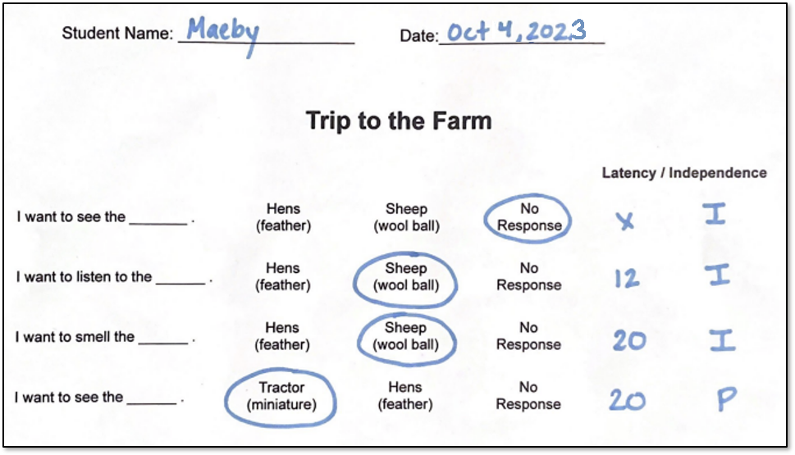
Writing to Communicate

Slide 4
MCAS-Alt ELA−Writing Strand
Develops students’ expressive communication skills.
A writing sample documents the exact context of the student’s response given an expressive communication opportunity.
ELA-Writing does not assess:
the physical act of writing; e.g., physically grasping a pen/pencil, making a mark on paper
keyboarding skills
tracing or copying letters or words

Slide 5
Use one of the following text types:
Select the text type that reflects the expressive communication opportunity being assessed:
Opinion (grades 3−5)/Argument (grades 6−8 and 10): preference
(e.g., All about me: my favorite food is ______)
Informative/Explanatory text: facts
(e.g., Halloween Facts: the pumpkin is ____, )
Narrative: personal experience
(e.g., Dear Mom, today I ____ )
Also including poetry imagery (sounds of words, rhyme, meter, and/or repetition to express emotion)

Slide 6
ELA−Writing Requirements
Access skills are found in the “Text Types and Purposes” cluster heading
Students should use their primary mode of communication to participate in the creation of work samples.
Required: One baseline writing sample and three different final writing samples (topics/pictures)
Teachers will pre-score the 3 final samples, using the state-provided rubrics. All rubric scores for students using access skills will automatically generate a “1” in the Demonstration of Skills and Knowledge (see samples)
No data charts are required.

Slide 7
Work Description Label for the Writing Sample
Includes a description of what the student was asked to do and how the student participated and contributed to the final product
Describes the materials/context of the activity
Indicates the student’s responses (percent independence) to each item/trial using his/her mode of communication
Includes name, date, independence, and self-evaluation

Slide 8
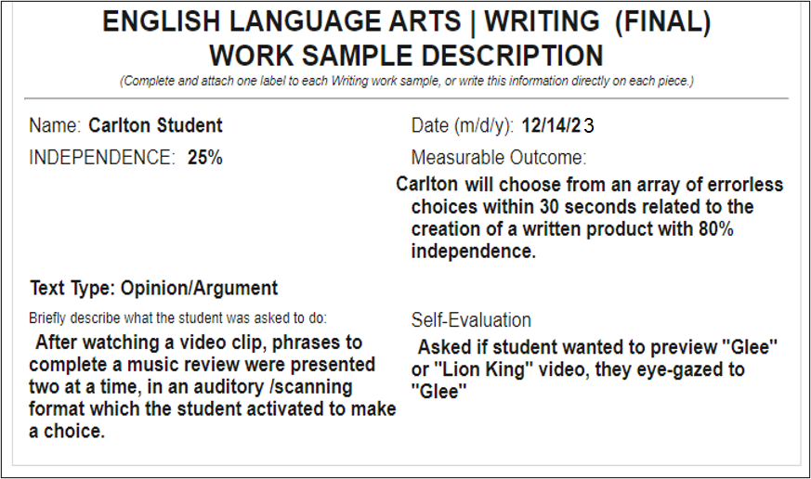
Opinion: Work Description Label

Slide 9
Opinion: Final Writing Sample
Data was collected on the student’s participation, during the creation of the written product.
12/4/23

Slide 10
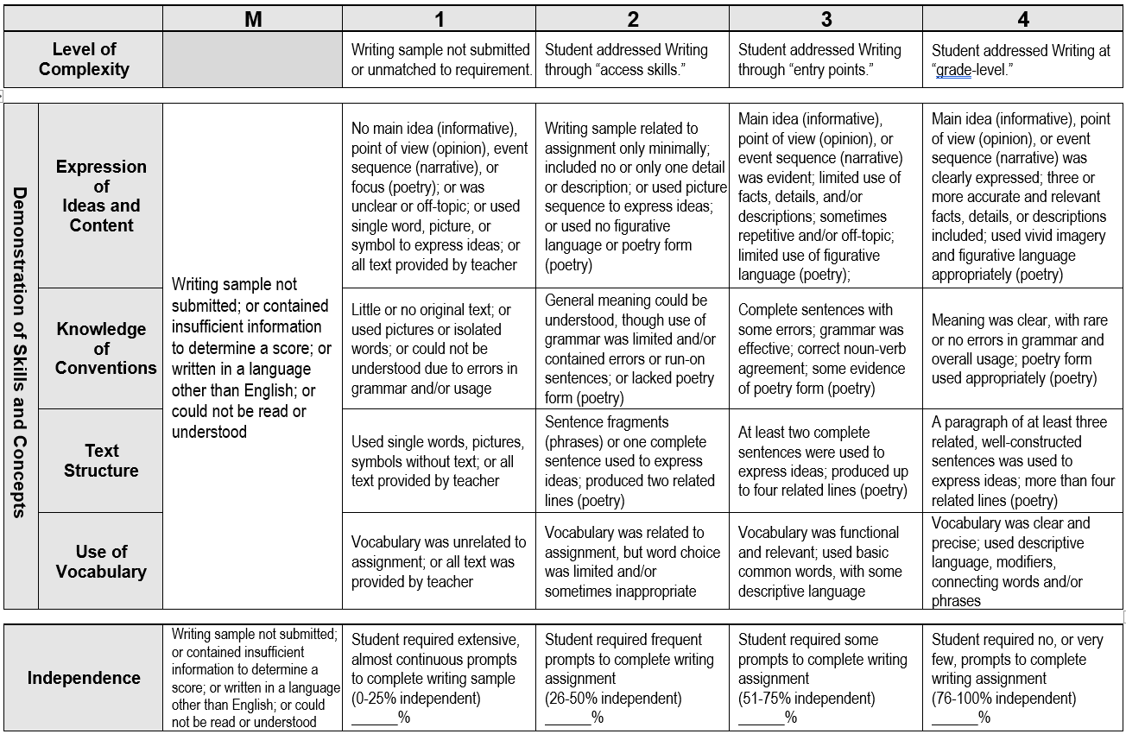
Pre-Scored Final Work Sample: Opinion
25%
25%

Slide 11
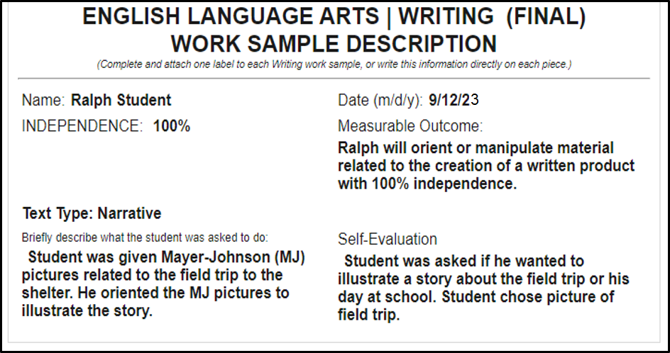
Narrative: Work Description Label
9/12/22

Slide 12
Narrative: Final Work Sample “We are Going to the Shelter”
9/12/23

Slide 13
Pre-Scored Final Sample: Narrative
100%
100%

Slide 14
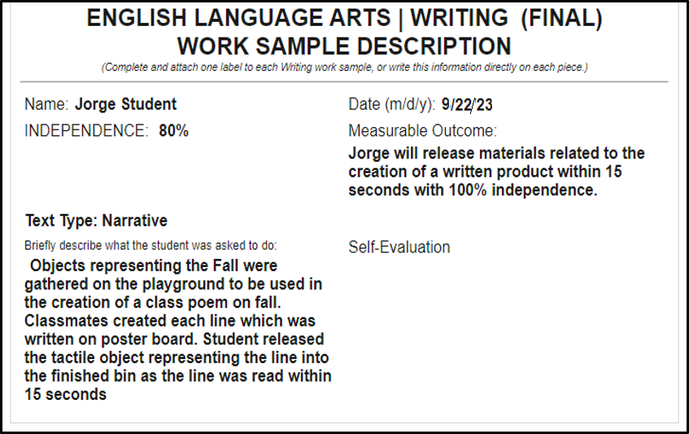
Narrative: Work Description

Slide 15
Narrative: Final Work Sample
9/22/23

Slide 16
Pre-Scored Final Sample: Narrative (Poem)
80%
80%

Slide 17
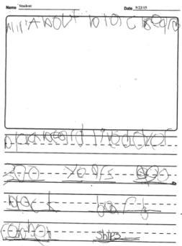
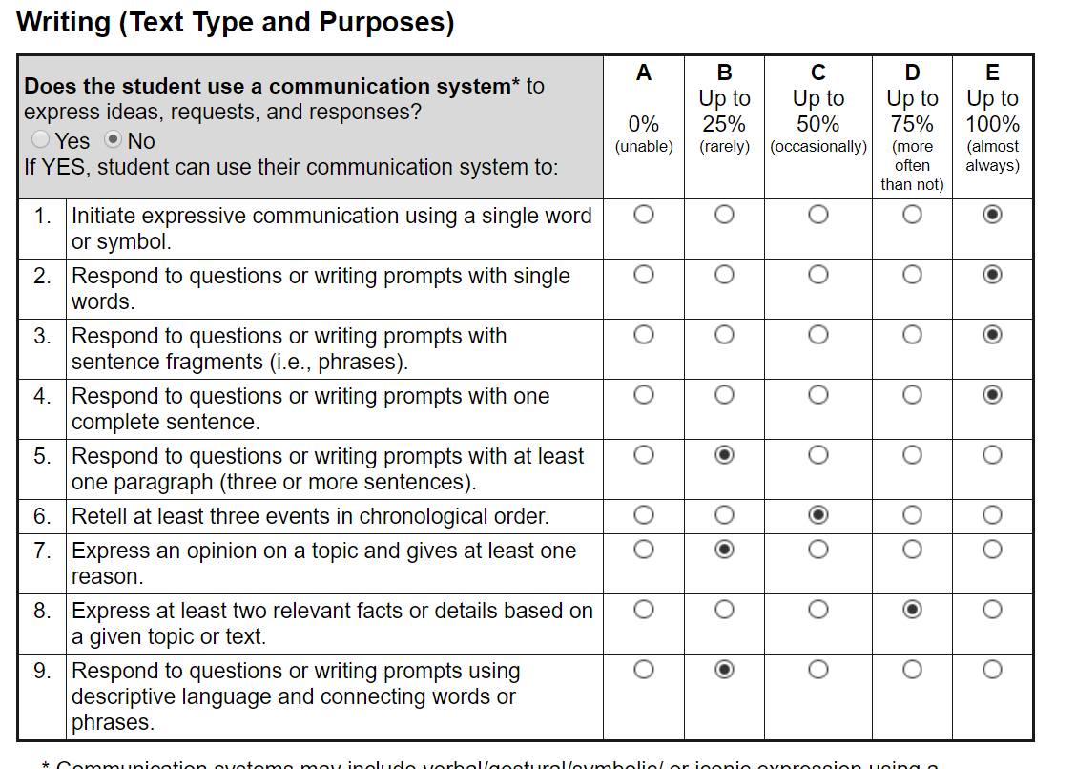
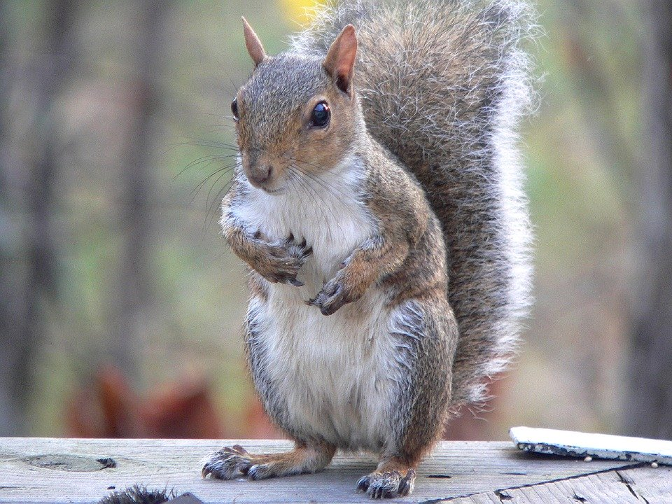
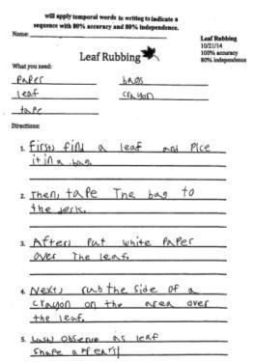
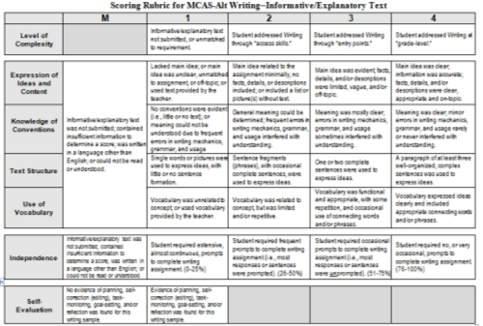
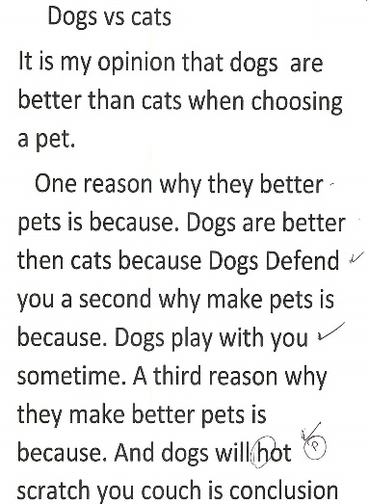
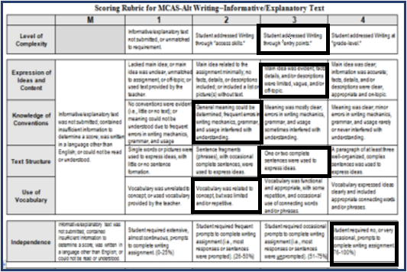
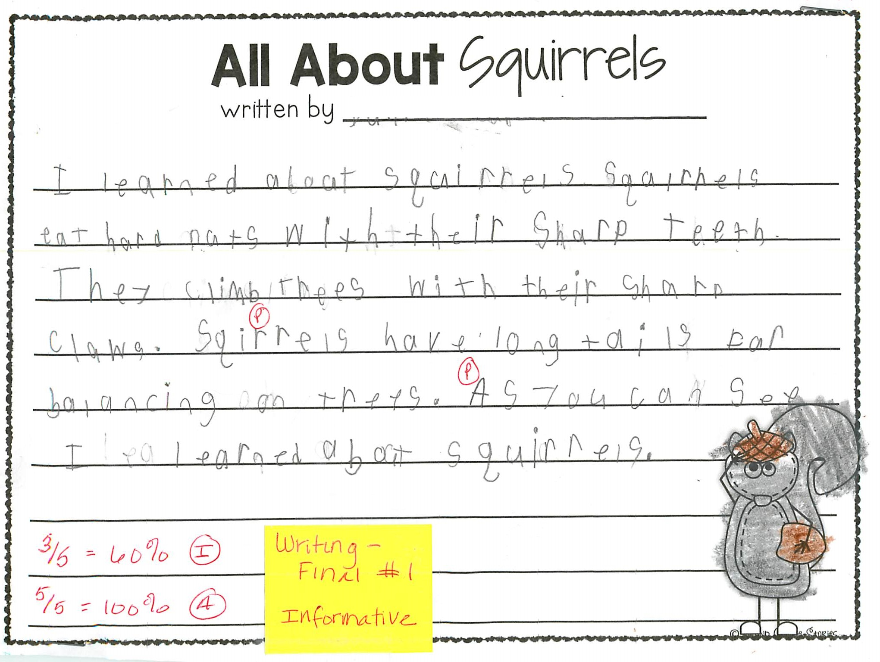
Required Elements for Writing
Educator’s Manual, pp. 34-37
+
10/4/23
+
ELA-Writing skills survey
Work Description for Baseline
Baseline Writing Sample
11/30/23
11/30/23
11/30/23
12/6/23
12/6/23
12/6/23
3/1/24
+
+
3/1/24
3/1/24
3 Work Sample Descriptions (one for each
Final Writing Sample)
3 Distinct Writing Samples
3 Pre-Scored Rubrics (scored)

Slide 18
Thinking about Self-Evaluation
Student choice-making and evaluation of one’s own work are essential components of the concept of self-determination, which is an important predictor of successful post-school outcomes (Wehmeyer& Palmer, 2003; Wehmeyer & Schwartz, 1998).
Kleinert,H.L. & Kearns, J.F. (2010). Alternate Assessment for Students with Significant Cognitive Disabilities. Baltimore: Paul H. Brookes Publishing Co.

Slide 19
Self Evaluation: Students Making Choices
Choices of materials, response format, order of events
Choice of partner
Choice of continuing or terminating the activity
Do you see evidence of the “student’s voice” in the self-evaluation? Is it authentic?

Slide 20
Contact Information
Massachusetts Department of Elementary and Secondary Education
Student Assessment Office –781-338-3625
DESE:
Website: www.doe.mass.edu/mcas/alt/
Debra Hand - Debra.d.hand@mass.gov
General Inquiries – mcas@doe.mass.edu
Cognia:
Kevin Froton– Kevin.Froton@Cognia.org
MCAS-Service Center- www.mcasservicecenter.com

Slide 21
THANK YOU
Debra Hand, MCAS-Alt Coordinator
781.338.3625
Debra.d.hand@mass.gov
www.doe.mass.edu
75 Pleasant Street, Malden, MA 02148

