Slide 1
MCAS-Alt For Students Using Access Skills
Fall 2023
Laura Hines, MCAS-Alt Education Consultant
Debra Hand, DESE
Kevin Froton, Cognia

Slide 2
What are Access Skills?
Entry Points
Access Skills

Slide 3
How the Resource Guide is Organized
“Essence” of the standard: Solve mathematical problems involving 3-D shapes
Standard
Grade 8 – 8.G.9
Know the formulas for the volume of cones, cylinders, and spheres, and use them to solve real-world and mathematical problems.
Calculate the surface area of a cube
Sort two-dimensional shapes by attribute
(e.g., number of sides)
Match the same shapes with different orientations
Visually track geometric shapes
Access Skill
Entry points
Grade Level
Less Complex More Complex

Slide 4
Who is NOT addressing access skills…..
Tenth-grade student who is reading at a first-grade level is NOT addressing the curriculum at an access level
Eighth-grade student with significant behavioral issues who refuses to write, who will “only” shout answers from under a desk is NOT addressing the curriculum at an access level
These students can address the academic content

Slide 5
Who is NOT addressing access skills…..
Sixth-grade student with an emerging communication system who can “only” answer simple questions by eye gazing to the correct response from a field of three icons is NOT addressing the curriculum at an access level
Third-grade student who is being marked inaccurate for grasping the wrong manipulative when asked to match a shape drawn on a paper, is NOT addressing the curriculum at an access level

Slide 6
Who is NOT addressing access skills…..
If you are taking data on the accuracy of the icon or shape chosen that is academic content, a measurable outcome based on a low-level entry point is most likely appropriate.
Examples of low entry points:
  Match words or pictures to objects/icons or symbols
  (Language, p.140)
  Identify the main character in a literary text
  (Reading, p.15)
  Answer yes/no questions related to numbers, quantities, or counting
  (Number and Operations in Base Ten, p. 43)

Slide 7
--Kleinert, H.L. & Kearns, J.F. (2001). Measuring outcomes and supports for students with disabilities. Baltimore: Paul H. Brookes Publishing Co.
The Importance of Access Skills
“Although a student’s IEP objectives may be the overriding learning focus for that student, providing him or her with the opportunity to practice those objectives in the context of the general classroom and to receive instruction on those objectives in the context of general education activities represents one fundamental way of ensuring that students with significant disabilities do participate in the general curriculum.”

Slide 8
IEP Goal (as written)
“Lee will grasp a toothbrush for 2 to 4 seconds.”
(This is not a standards-based activity)
WHAT’S THE CRITICAL SKILL IN THIS GOAL?
“GRASPING”
ReframedGoal: “Given a tool, Lee will be able to grasp it for 2 to 4 seconds without dropping it in 50% of sessions observed.”

Slide 9
Critical Skills Become the Access Skills that Allow Students to be Assessed During a Standards-Based Activity
Grasp materials as they are counted.
(Mathematics − The Number System)
Grasp materials representing a key idea or detail in a story, poem, folktale, or myth. (ELA − Reading-Literature)
Grasp materials in an investigation about living and non-living.
(High School Science and Technology/Engineering − Biology)

Slide 10
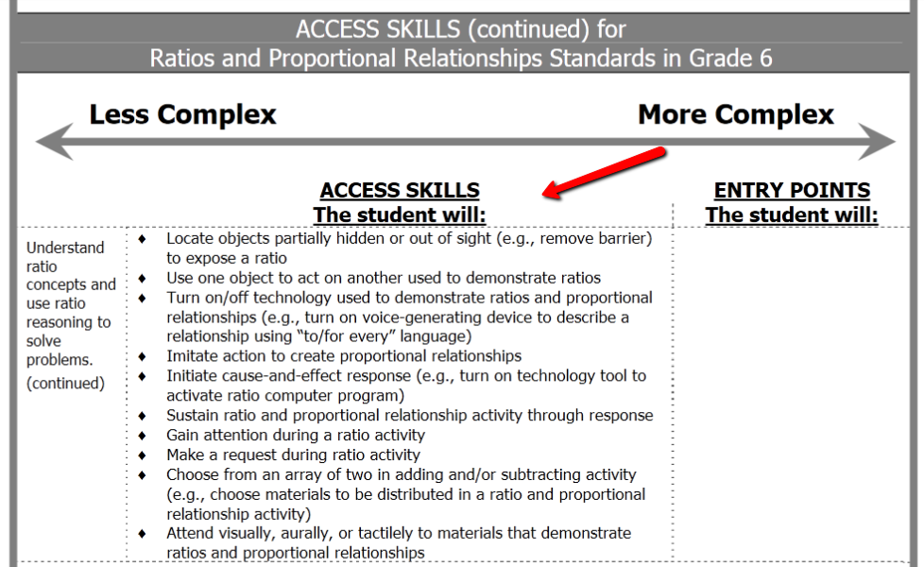
Select an Appropriate Access Skill from the Resource Guide to Create a Measurable Outcome

Slide 11
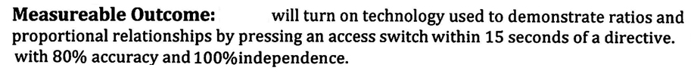
Latency
Mastery for this task
Measurable outcome includes the access skill + criteria that indicate how the observer will know that the student has successfully performed the task (e.g., latency), including criteria for mastery (e.g., in 80% of sessions observed.)

Slide 12
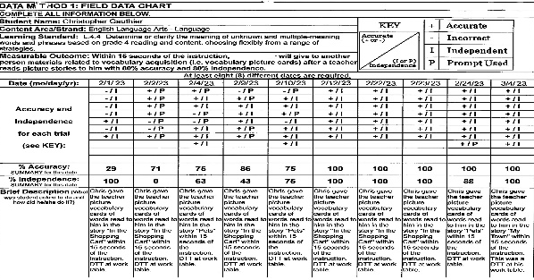
“Core Set of Evidence”
Educators Manual, p. 28
A complete strand must include at least the following “core set of evidence.”
Strand Cover Sheet attached to each strand being submitted
Data Chart
Bar, Line or
Field Data Chart
documenting the measurable outcome on at least 8 different dates
First piece
of
primary evidence
(Teacher-documented work sample, photo, or video)
Second piece of
primary evidence
(Teacher-documented work sample, photo, or video)
Skills
Survey
administered in each strand
+
+
+
+
…Except unique requirements for ELA–Writing
and Science and Tech/Eng (STE)

Slide 13
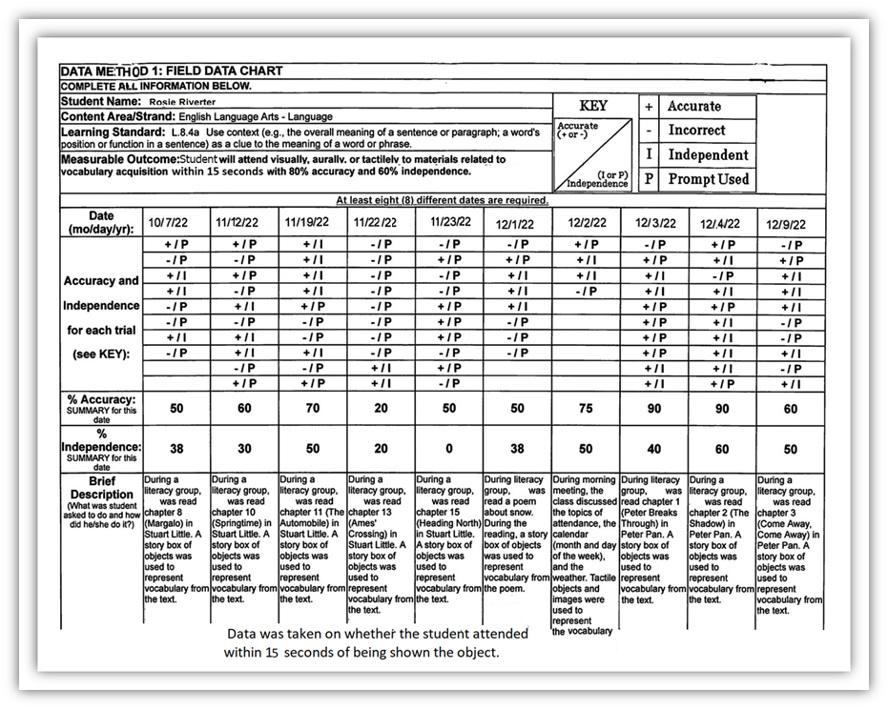
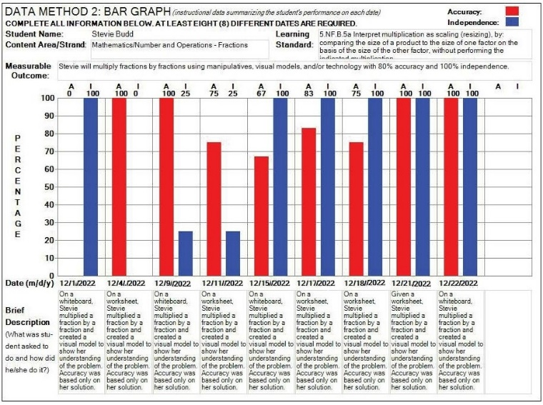
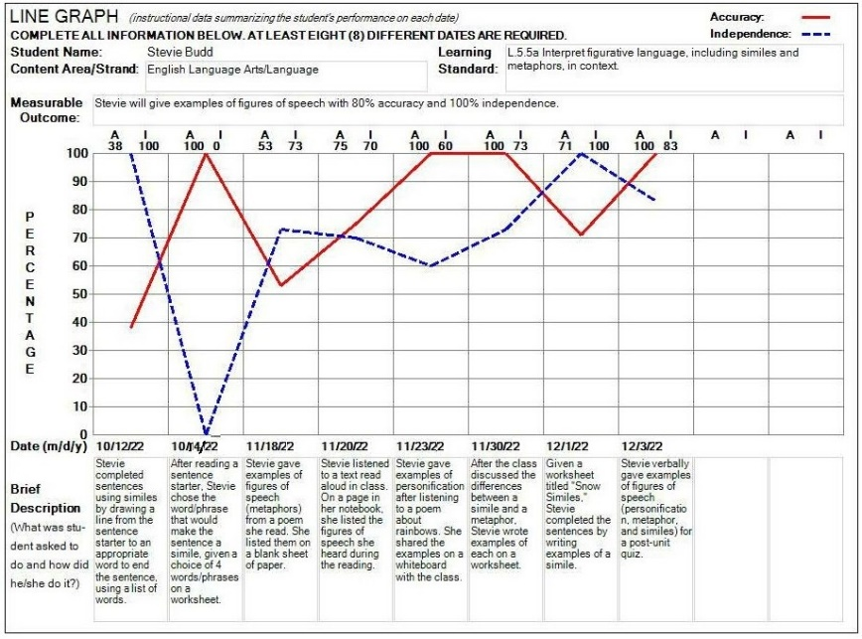
DATA CHARTS
LINE GRAPH
BAR GRAPH
FIELD DATA CHART

Slide 14
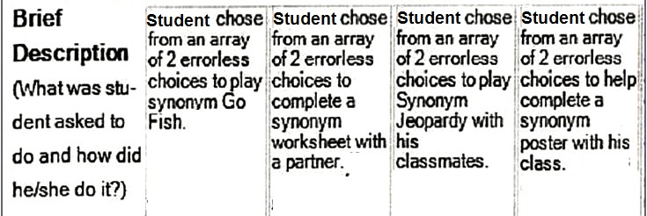
Measurable Outcome …. choose from an array of 2 errorless choices within 15 seconds of a directive related to vocabulary acquisition with 75% accuracy and 100% independence
Brief descriptions on the data chart must reflect the skill (i.e., choose from an array of 2), and the standards-based activity. (i.e., “Synonym Go Fish,” synonym worksheet, synonym Jeopardy, synonym poster).

Slide 15
Poll Question
Are you familiar with the term errorless choices?
  Yes
  No
  Maybe, but I could use a refresher

Slide 16
Errorless Choice
Errorless choice learning ensures that students are always:
  responding correctly,
  building their confidence, and
  increasing their knowledge at the same time.
  Promotes independent responses vs. prompt reliance
  Implies intentionality
  Reinforces response/participation

Slide 17
Teacher-Documented Work Sample
  Label with name, date, overall % accuracy, and % independence.
  Document a series of trials conducted during the same activity.
  Specifically describe the materials and context of the activity
    Expected response (if appropriate), and the student’s actual response (accuracy and independence) clearly show how accuracy and independence were determined on each trial.
  NOTE: Examples of teacher-documented work samples are available on the following slides.

Slide 18
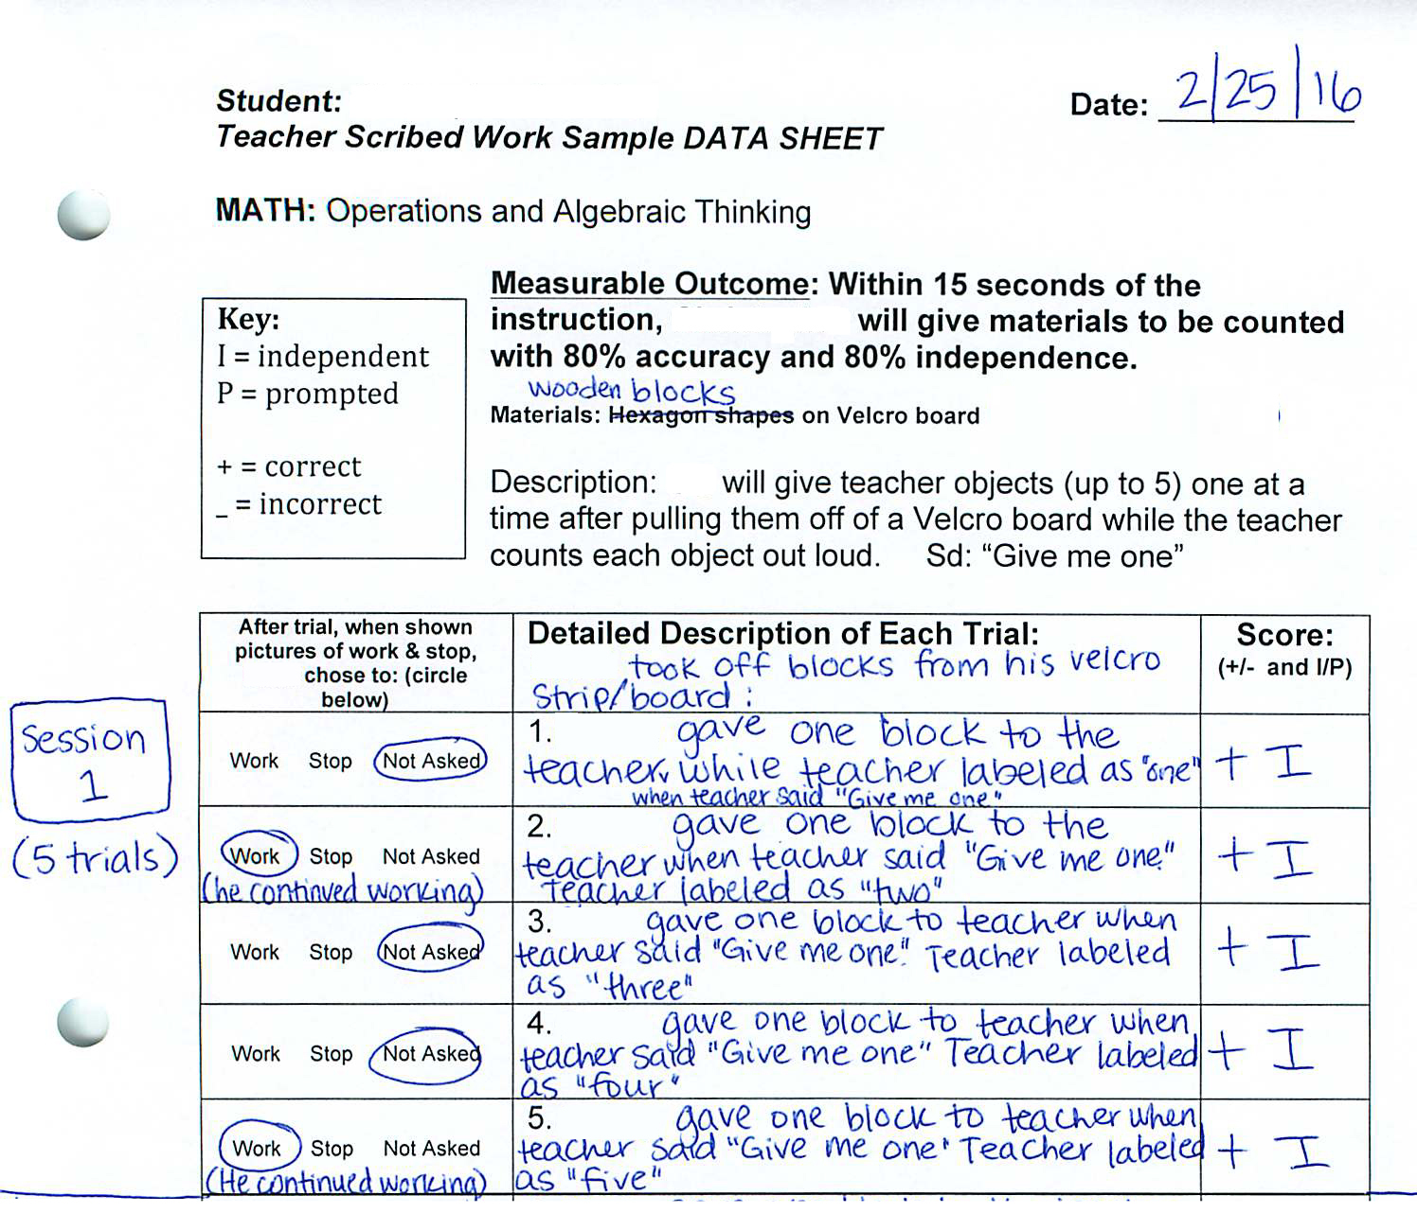
Barry
9/29/23
Teacher-Documented Work Sample
Teacher-documented work samples describe materials, and the context of the activities, and document responses on a series of trials conducted at the same time.
Session 1:
5 Trials
(Continued on page 2)
Student’s responses

Slide 19
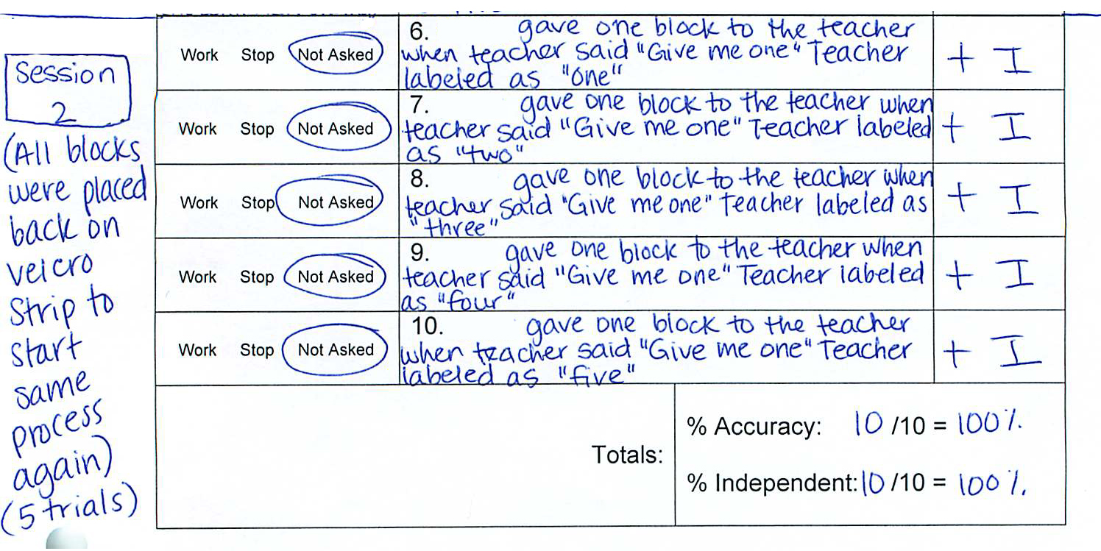
Indicates the student’s response
(Cont’d)
Session 2:
5 Trials
All blocks were placed back on the Velcro strip to start the process again.
9/29/23
Overall accuracy and independence for all trials completed on the same day.

Slide 20
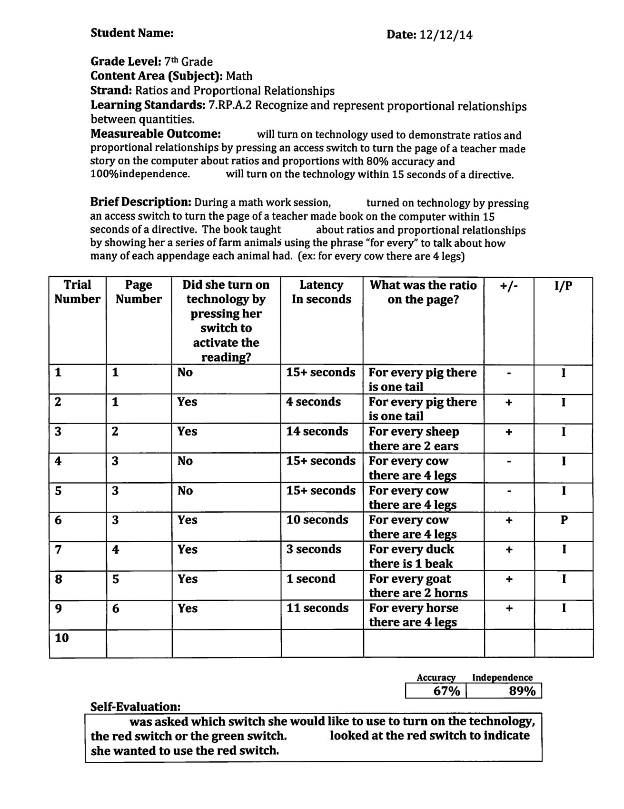
Teacher-Documented Work Sample (example)
Indicates the student’s response
This teacher-documented work sample describes materials, number of trials, and latency for each response.
10/16/23
Overall accuracy and independence

Slide 21
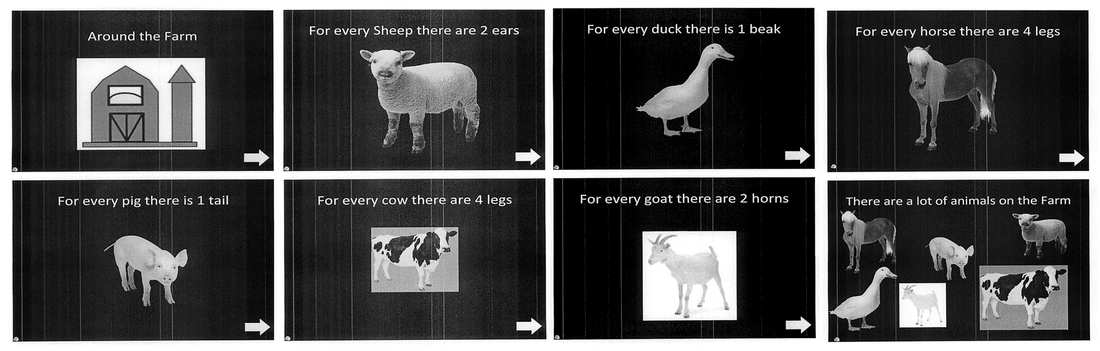
Supporting Documentation for Teacher-Documented Work Sample
Does not show a final product or how the student participated.
Only shows the context of a learning activity
The technology shown above is used by the student to advance a computer program within 15 seconds of a directive on Ratio and Proportional Relationships.

Slide 22
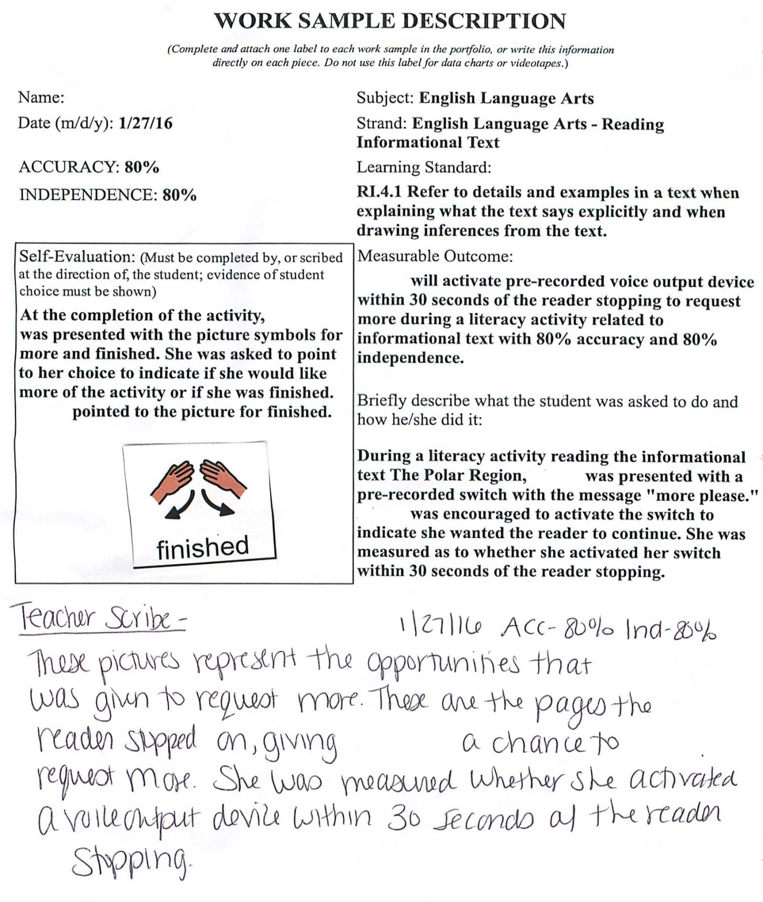
Work Sample Description for Teacher-Documented Sample
After reading an informational text “The Polar Region,” the student was presented with a pre-recorded switch with the message “more please.”
The student’s responses were recorded to determine if the switch was activated within 30 seconds after the reading stopped.
Student
10/6/23

Slide 23
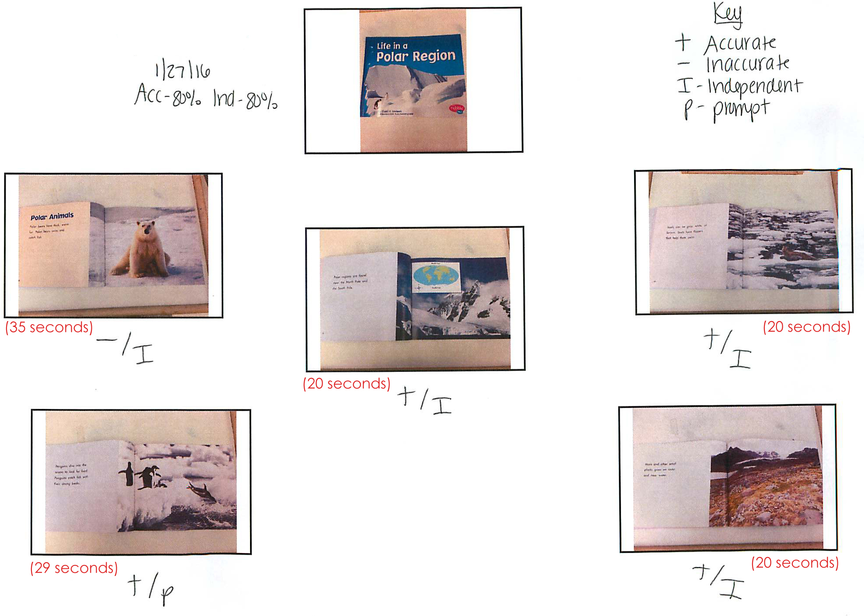
Teacher-Documented Work Sample (example)
Student
10/6/23
Book Cover
A thumbnail picture of each page documenting the accuracy and independence of each trial. (See measurable outcome and description on Work Description label)

Slide 24
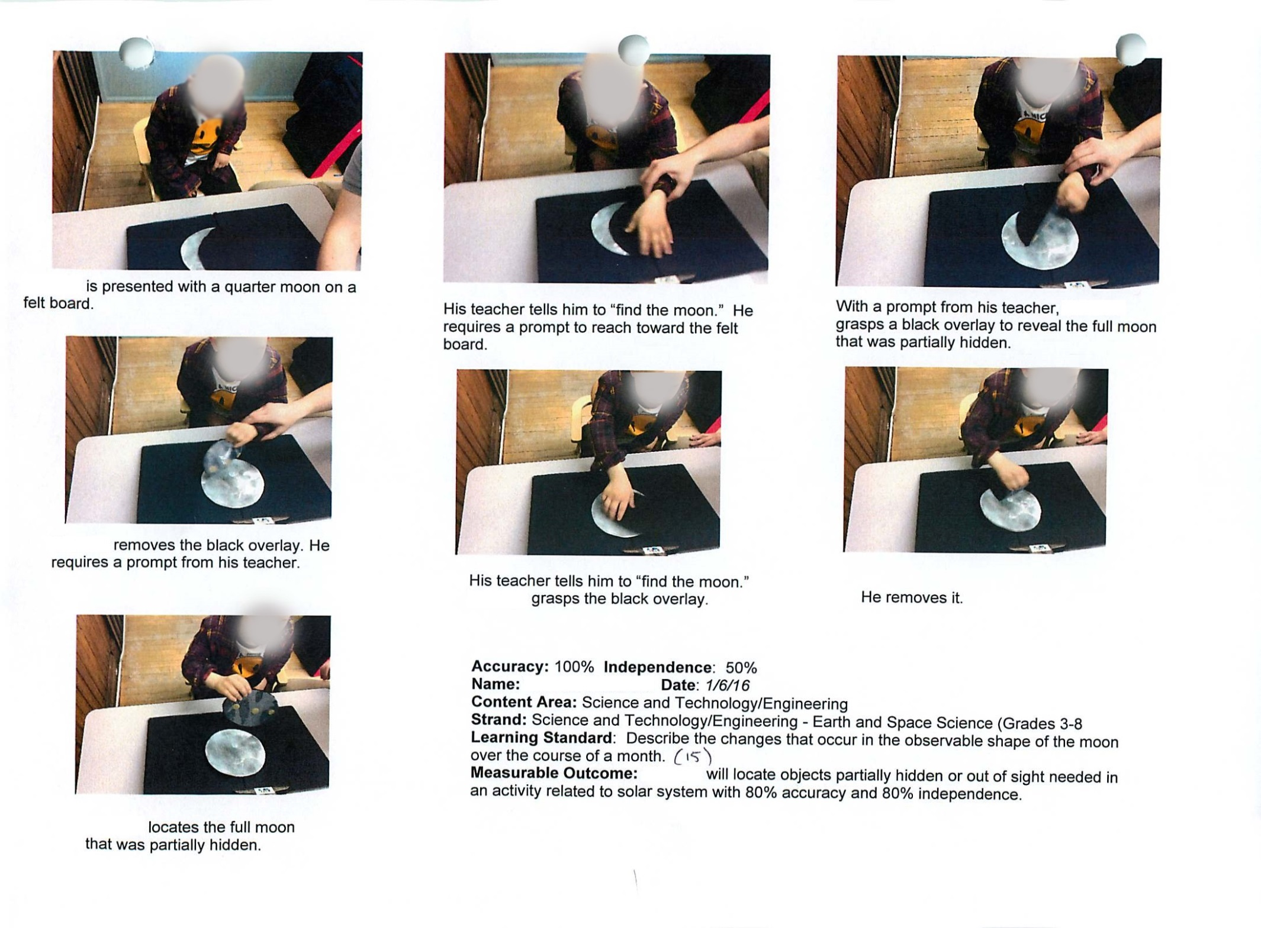
Another Teacher-Documented Work Sample: Using a Series of Pictures
Trial 1
Trial 1
Trial 1
Trial 2
Trial 2
Trial 2
Measurable Outcome: The student will locate objects partially hidden or out of sight of Earth, Moon, Sun, stars, solar system, or seasons activity
with 80% accuracy and 80% independence.
Date: 1/10/24
100% Accuracy 50% Independence
Student
1/18/18

Slide 25
Thinking About Self-Evaluation
“Student choice-making and evaluation of one’s own work are essential components of… self-determination, which is an important predictor of successful post-school outcomes.”
(Wehmeyer & Palmer, 2003; Wehmeyer & Schwartz, 1998)
--Kleinert, H. L. & Kearns, J.F. (2010). Alternate Assessment for students with Significant Cognitive Disabilities. Baltimore: Paul H. Brookes Publishing Co.

Slide 26
Self-Evaluation:
Students Making Choices within a Standards-Based Activity
Choice of:
  materials
  response format
  order of events
  partner
  continuing or terminating the activity
Do you see evidence of the “student’s voice” in the self-evaluation?
Is it authentic?

Slide 27

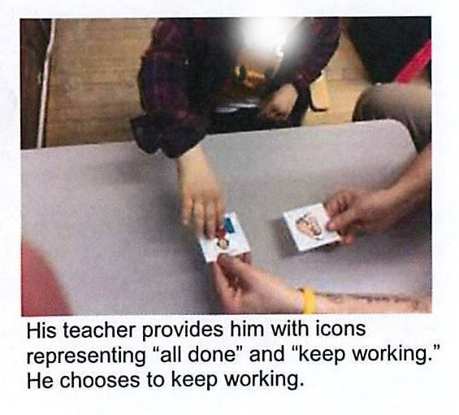
Examples of Self-Evaluation
Student
She
Self -Evaluation
Self -Evaluation

Slide 28

Contact Information
Additional Access Skills Materials: www.doe.mass.edu/mcas/alt/resources
  Debra Hand, MCAS-Alt Coordinator
  Debra.d.hand@mass.gov
  MCAS-Alt Forms and Graphs online: Sign In (measuredprogress.org)

