Slide 1
ELA-Writing for MCAS-Alt
MCAS-Alt 2024
Debra Hand- MCAS-Alt Coordinator, DESE
Kevin Froton-Senior Project Manager, Cognia

Slide 2
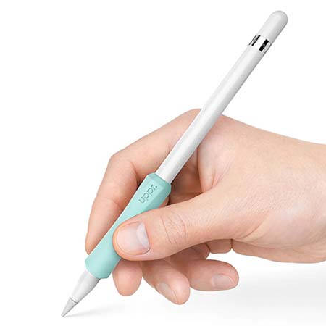
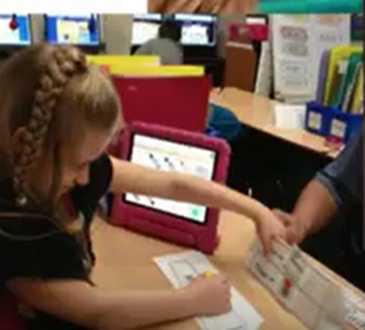
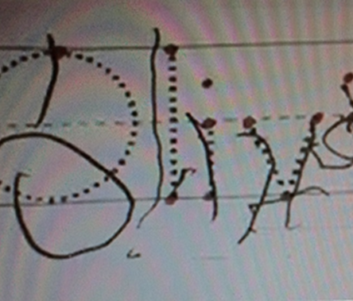
What does ELA-Writing assess?
ELA-Writing does not assess
a student’s ability to:
ELA−Writing assesses expressive communication by the student:
sharing experiences,
opinions, preferences,
ideas, and/or facts
discussing books, articles, stories, videos
poetry, imagery,
sharing knowledge with an audience
hold a writing instrument
copy letters or words
trace letters or words

Slide 3
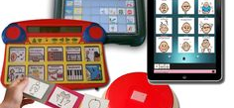
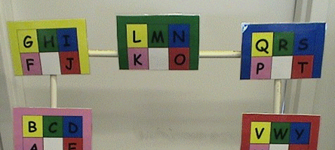
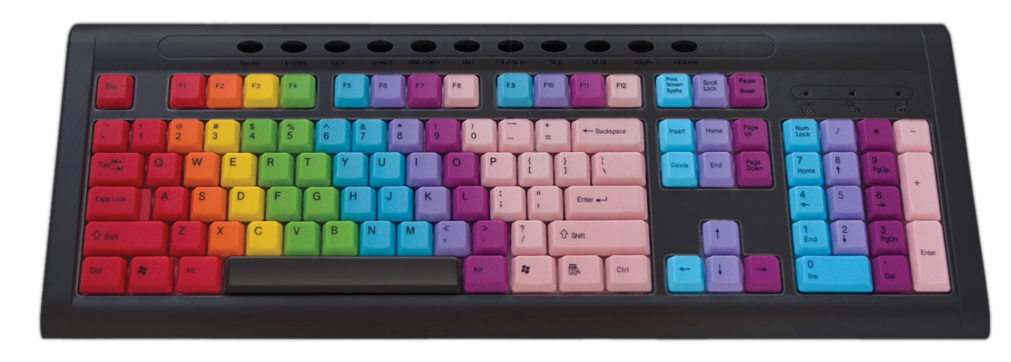
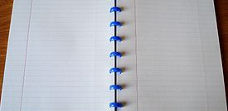
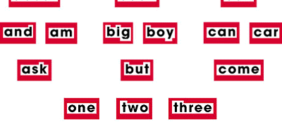
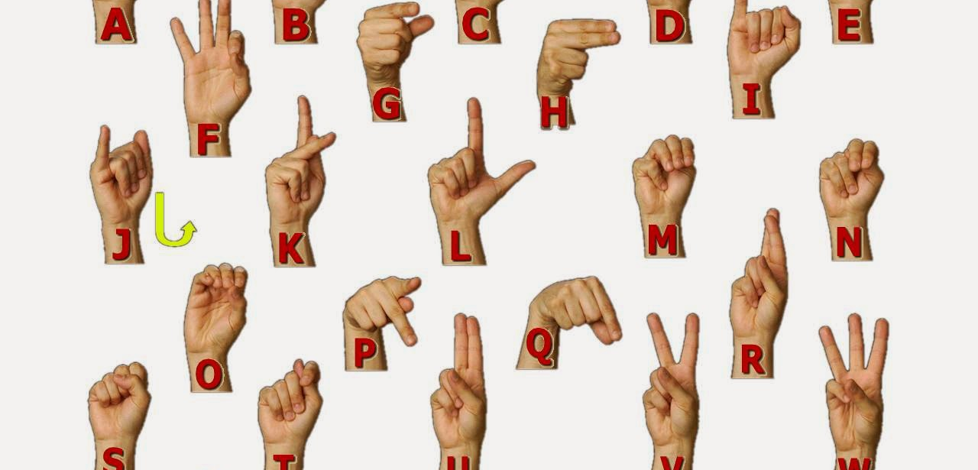
Student’s Primary Mode of Communication

Slide 4
How does your student communicate?
Educator’s Manual, p. 23
Oral language
Hand-writing
Sounds
Symbols (photos, icons)
Objects
Gestures
Sign language
Eye gaze
High-tech device (e.g., Dynavox)
Low-tech device (e.g., communication book)
Other

Slide 5
ELA−Writing: Requirements
Educator’s Manual, p. 24
One completed ELA-Writing skills survey
One baseline writing sample
The baseline should be the student’s first attempt at the writing process and dated prior to the final samples.
Baseline can be a brainstorming activity, graphic organizer, outline, or draft
Three different final writing samples, different topics or pictures
Three pre-scored state-provided rubrics (1 for each final sample)
Final Writing Samples must include student’s name, valid date, and percentage of independence (based on word or sentence).
Final samples for students using access skills will include a written product produced by the teacher or peers, noting student participation.

Slide 6
ELA-Writing Skills Survey

Slide 7
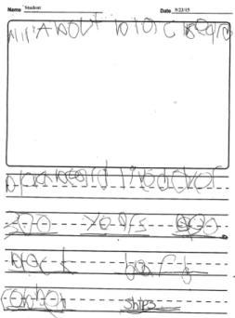
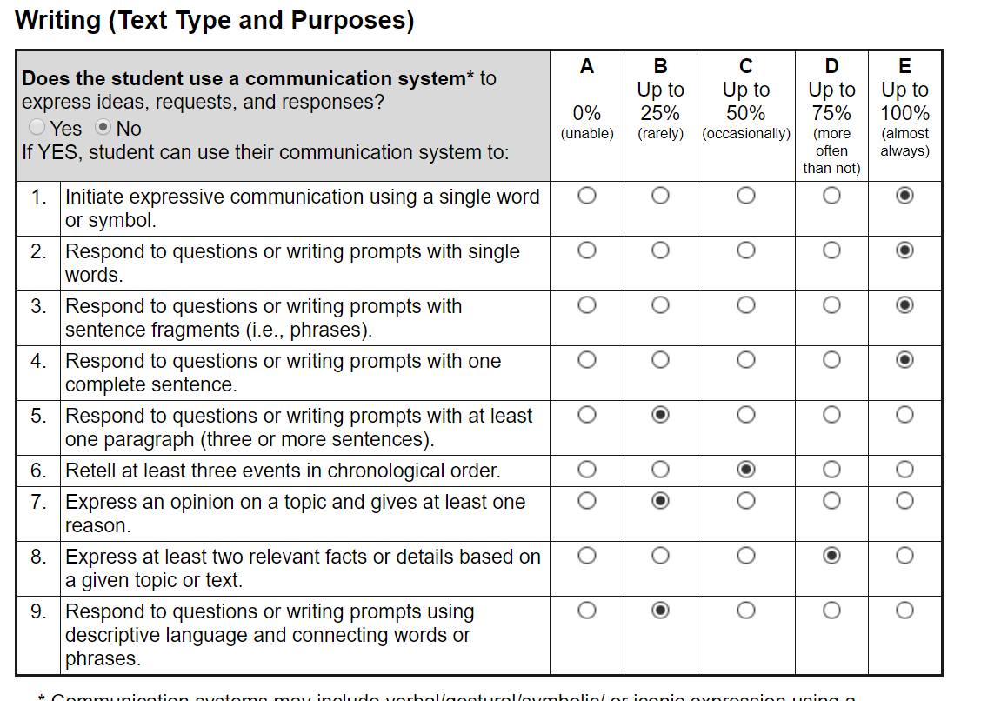
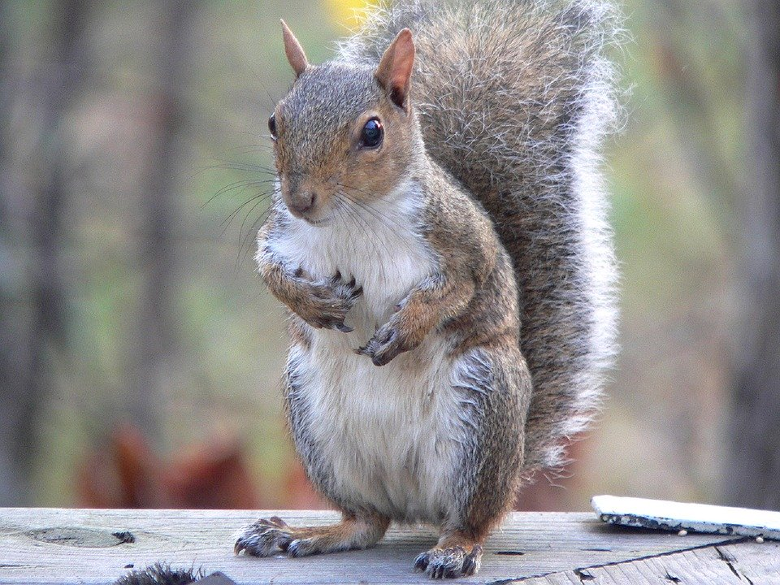
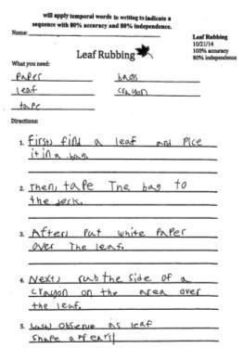
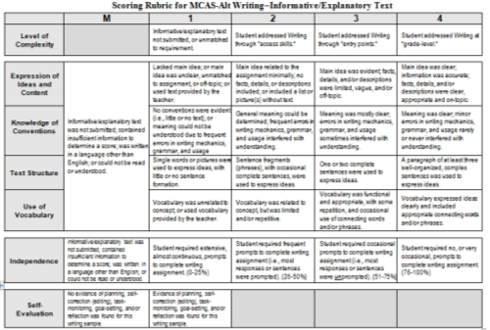
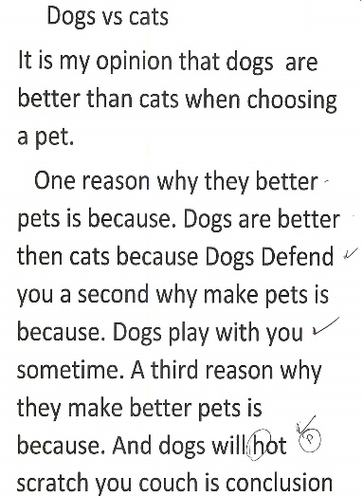
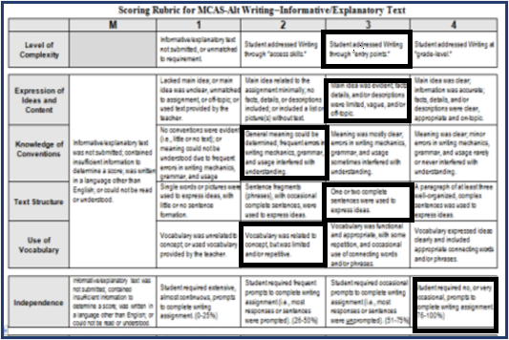
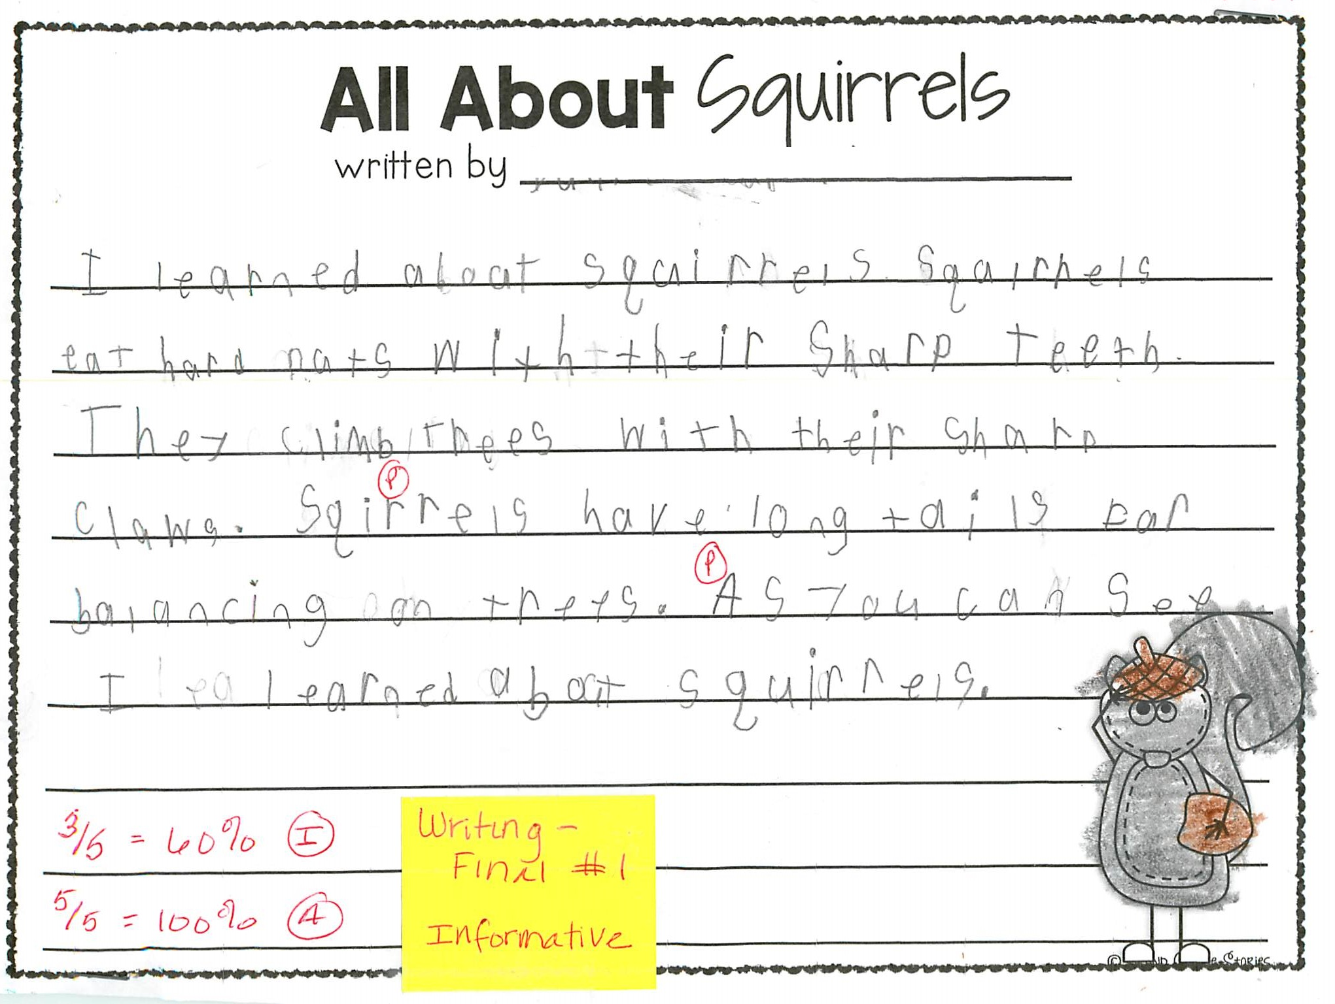
Required Elements for Writing
+
+
ELA-Writing skills survey
Work Description for Baseline
Baseline Writing Sample
3/4/24
3/4/24
+
+
3/4/24
1 Work Description for each Final Writing Sample
3 Distinct Writing Samples
3 Pre-Scored Rubrics (scored)
Final Sample Date +Work Description +Pre-Scored Rubric = Same Date

Slide 8
ELA−Writing: Requirements (cont’d)
Educator’s Manual, p. 24
Three different final writing samples, which may be any combination of the following text types:
Argument/opinion: States a claim or preference, based on a text or topic
Informative/explanatory text: Conveys facts or ideas, based on a text or topic
Narrative: Prose that tells a story, based on real or imagined events; OR poetry that uses figurative language to express emotions or tell a story
Example of Measurable Outcome: “(Student) will use his/her primary mode of communication to express or create a writing sample with 75% independence.”

Slide 9
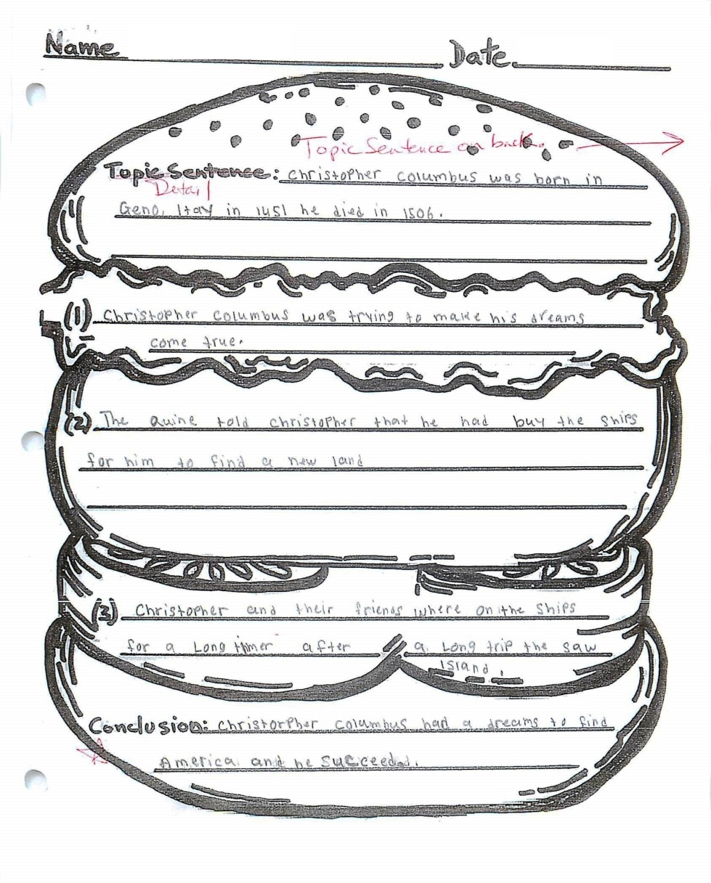
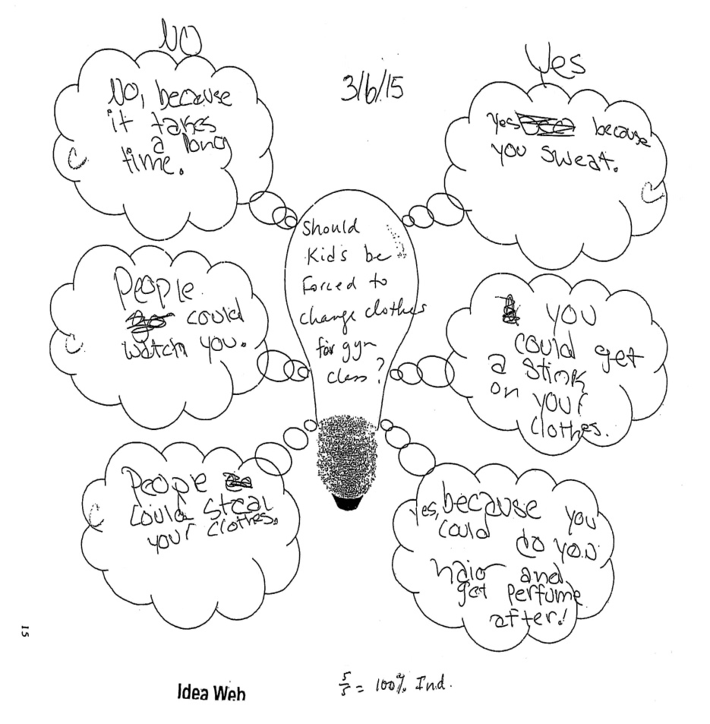
Scoring ELA-Writing Samples
Teachers will pre-score each of their students’ final writing samples, using standardized, state-provided scoring rubrics.
Baseline samples do not need scoring (See samples below)
Do include a completed scoring rubric for each final writing sample.
Scorers will verify the teacher’s scores.
Examples
Graphic Organizers
10/6/23

Slide 10
What Does the Scoring Rubric include?
Scoring rubric includes the following areas:
Level of Complexity (access skills or entry points)
Demonstration of Skills and Concepts
Expression of Ideas and Content
Use of Vocabulary
Text Structure (words, phrases, sentences)
Knowledge of Conventions
Independence (frequency of prompts) by the word or sentence
Self-Evaluation is separate from the rubric and included on the Work Description.

Slide 11
ELA-Writing Rubric

Slide 12
Using the Rubric to Score the Writing Samples
Teachers will pre-score their students’ final writing samples, using the standardized scoring rubric.
Carefully review the criteria on the rubric.
Students working on access skills or if the teacher provides the text and uses a fill-in-the-blank worksheet or if the student uses a single word/picture or list of words, the score will score 1 in Demonstration of Skills and Concepts.
Percent of independence is based on the number of prompts relative to the total number of words or sentences.
Score should be based on the contribution of the student.
Scorers will verify the teacher’s scores and change a score if it does not reflect the evidence.

Slide 13
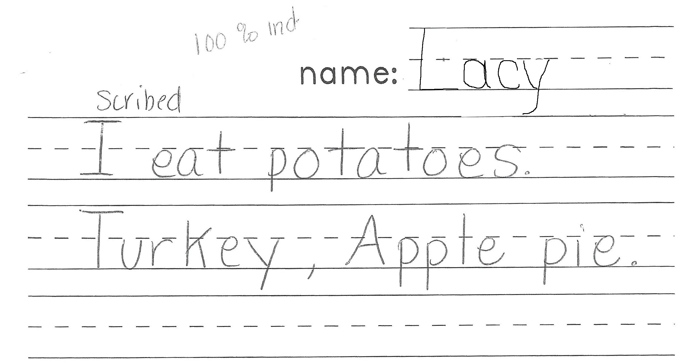
How would you score this final Writing sample?
11/30/23
11/30/23

Slide 14
How did you score the previous Writing sample?
DATE: 11/30/23
 | M | 1 | 2 | 3 | 4
Level of Complexity |  | Writing sample not submitted or unmatched to requirement. | Student addressed Writing through “access skills.” | Student addressed Writing through “entry points.” | Student addressed Writing at “grade-level.”
Demonstration of Skills and Concepts | Expression of Ideas and Content | Writing sample not submitted; or contained insufficient information to determine a score; or written in a language other than English; or could not be read or understood | No main idea (informative), point of view (opinion), event sequence (narrative), or focus (poetry); or was unclear or off-topic; or used single word, picture, or symbol to express ideas; or all text provided by teacher | Writing sample related to assignment only minimally; included no or only one detail or description; or used picture sequence to express ideas; or used no figurative language or poetry form (poetry) | Main idea (informative), point of view (opinion), or event sequence (narrative) was evident; limited use of facts, details, and/or descriptions; sometimes repetitive and/or off-topic; limited use of figurative language (poetry); | Main idea (informative), point of view (opinion), or event sequence (narrative) was clearly expressed; three or more accurate and relevant facts, details, or descriptions included; used vivid imagery and figurative language appropriately (poetry)
 | Knowledge of Conventions |  | Little or no original text; or used pictures or isolated words; or could not be understood due to errors in grammar and/or usage | General meaning could be understood, though use of grammar was limited and/or contained errors or run-on sentences; or lacked poetry form (poetry) | Complete sentences with some errors; grammar was effective; correct noun-verb agreement; some evidence of poetry form (poetry) | Meaning was clear, with rare or no errors in grammar and overall usage; poetry form used appropriately (poetry)
 | Text Structure |  | Used single words, pictures, symbols without text; or all text provided by teacher | Sentence fragments (phrases) or one complete sentence used to express ideas; produced two related lines (poetry) | At least two complete sentences were used to express ideas; produced up to four related lines (poetry) | A paragraph of at least three related, well-constructed sentences was used to express ideas; more than four related lines (poetry)
 | Use of Vocabulary |  | Vocabulary was unrelated to assignment; or all text was provided by teacher | Vocabulary was related to assignment, but word choice was limited and/or sometimes inappropriate | Vocabulary was functional and relevant; used basic common words, with some descriptive language | Vocabulary was clear and precise; used descriptive language, modifiers, connecting words and/or phrases

Slide 15
POLL
Level of Complexity: 2 or 3
Expression of Ideas and Content: 1 2 3 4
Knowledge of Conventions: 1 2 3 4
Text Structure: 1 2 3 4
Use of Vocabulary: 1 2 3 4

Slide 16
ELA–Writing for Students at Access Skill Level
Educator’s Manual, p. 24
1/9/24
Brief Description: Within 15 seconds of the initial cue, the student activated a switch with pre-recorded sentences to compose a narrative on her winter vacation.
Measurable Outcome: Student will activate a device, within 15 seconds of the initial cue, in an activity related to the creation of a written product.

Slide 17
Scoring the Previous Writing Sample for a Student Working at Access Skill Level
 | M | 1 | 2 | 3 | 4
Level of Complexity |  | Writing sample not submitted or unmatched to requirement. | Student addressed Writing through “access skills.” | Student addressed Writing through “entry points.” | Student addressed Writing at “grade-level.”
DATE: 1/9/24
Demonstration of Skills and Concepts | Expression of Ideas and Content | Writing sample not submitted; or contained insufficient information to determine a score; or written in a language other than English; or could not be read or understood | No main idea (informative), point of view (opinion), event sequence (narrative), or focus (poetry); or was unclear or off-topic; or used single word, picture, or symbol to express ideas; or all text provided by teacher | Writing sample related to assignment only minimally; included no or only one detail or description; or used picture sequence to express ideas; or used no figurative language or poetry form (poetry) | Main idea (informative), point of view (opinion), or event sequence (narrative) was evident; limited use of facts, details, and/or descriptions; sometimes repetitive and/or off-topic; limited use of figurative language (poetry); | Main idea (informative), point of view (opinion), or event sequence (narrative) was clearly expressed; three or more accurate and relevant facts, details, or descriptions included; used vivid imagery and figurative language appropriately (poetry)
 | Knowledge of Conventions |  | Little or no original text; or used pictures or isolated words; or could not be understood due to errors in grammar and/or usage | General meaning could be understood, though use of grammar was limited and/or contained errors or run-on sentences; or lacked poetry form (poetry) | Complete sentences with some errors; grammar was effective; correct noun-verb agreement; some evidence of poetry form (poetry) | Meaning was clear, with rare or no errors in grammar and overall usage; poetry form used appropriately (poetry)
 | Text Structure |  | Used single words, pictures, symbols without text; or all text provided by teacher | Sentence fragments (phrases) or one complete sentence used to express ideas; produced two related lines (poetry) | At least two complete sentences were used to express ideas; produced up to four related lines (poetry) | A paragraph of at least three related, well-constructed sentences was used to express ideas; more than four related lines (poetry)
 | Use of Vocabulary |  | Vocabulary was unrelated to assignment; or all text was provided by teacher | Vocabulary was related to assignment, but word choice was limited and/or sometimes inappropriate | Vocabulary was functional and relevant; used basic common words, with some descriptive language | Vocabulary was clear and precise; used descriptive language, modifiers, connecting words and/or phrases

Slide 18
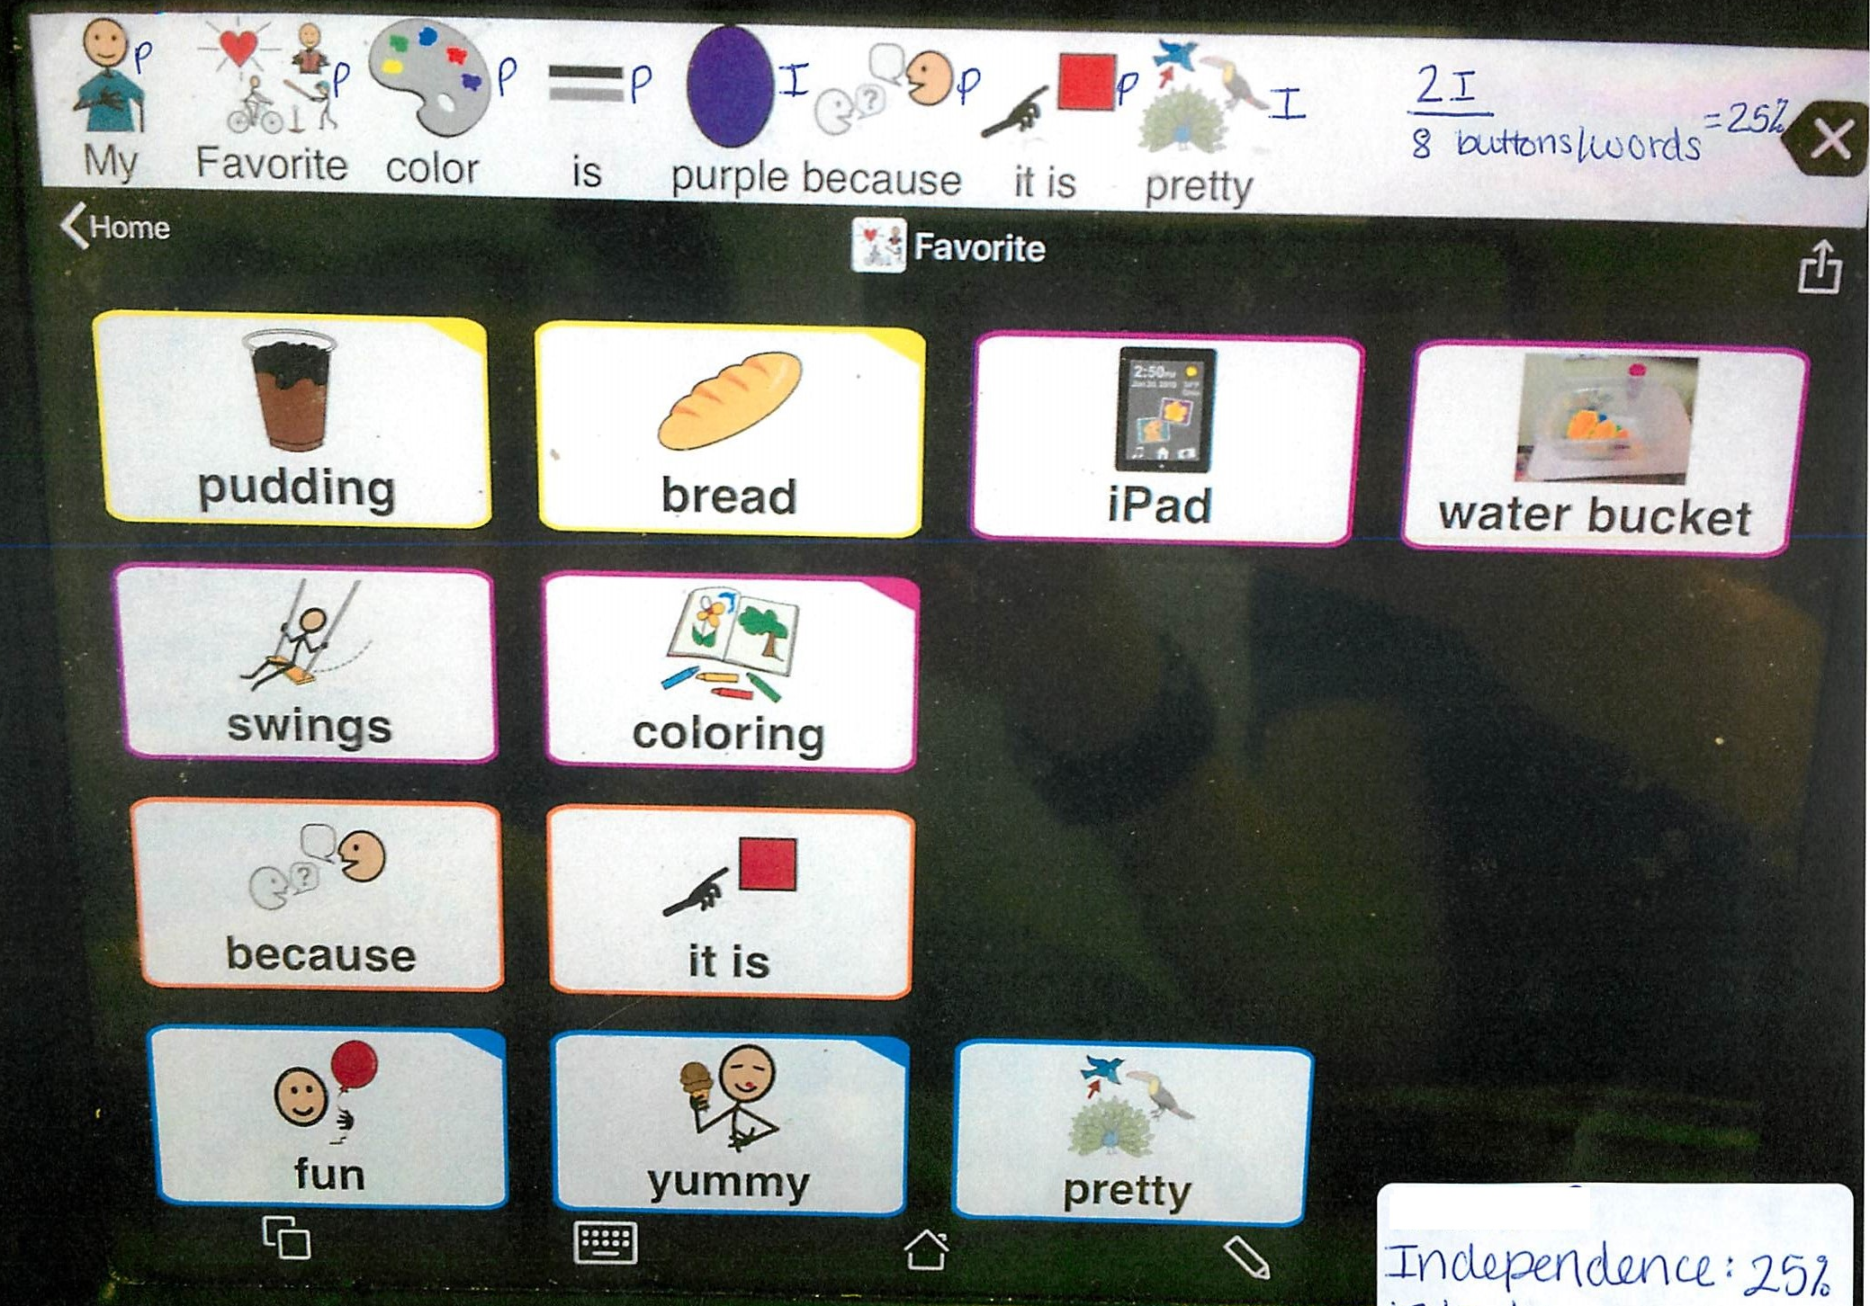
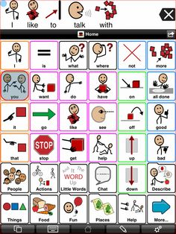
Supporting Documentation
The dynamic display shows the student making choices to put words together. Teacher clearly marks “P” for Prompt “I” for Independence.
I
P
P
I
P

Slide 19
ELA–Writing
No data chart is required.
Include the completed Work Sample Description label for each writing sample.
Final samples should reflect communication generated by the student.
Samples for students at access skill level must include a final written product representing how the student participated in the creation of the sample.
Writing samples that include bathroom-related routines will not be scored nor will they be counted toward the minimum requirement.

Slide 20
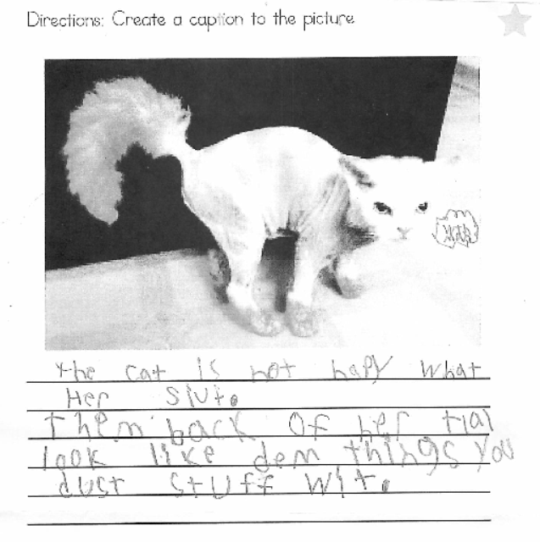
Some Writing Samples Shared with Us…
Directions: Create a caption for each picture
The cat is not happy with her suit. The back of her tail looks like them things you dust stuff with.
Oh no the lunch lady! The kids are going to eat me. And the students are so hungry. I am not like the other cafeteria food.
It’s when I first got potty trained. It didn’t go as planned. I tried to hold myself up and I just literally fell in.

Slide 21
For Grades 5, 8, and High School Science and Technology/Engineering: September 29, 1:00 p.m. October 4, 10:00 a.m.

Slide 22
THANK YOU
Debra Hand, MCAS-Alt Coordinator
781.338.3625
Debra.d.hand@mass.gov
www.doe.mass.edu
75 Pleasant Street, Malden, MA 02148

