Slide 1
Science and Technology/Engineering (STE)
Grades 5, 8, and High School
Debra Hand, DESE
Kevin Froton, Cognia

Slide 2
Features of Science and Technology/Engineering (STE)
Core idea is based on the discipline. (e.g., Energy, Physical Science)
Encourages a range of instructional approaches for each core idea.
Allows educators to teach and assess a cohesive unit of science instruction, rather than assessing single skills in isolation.
Encourages assessment of multiple entry points (or access skills) in a single-strand
Promotes cross-curriculum opportunities.
Includes the use of 8 science practices that promote engagement in scientific inquiry and engineering design skills

Slide 3
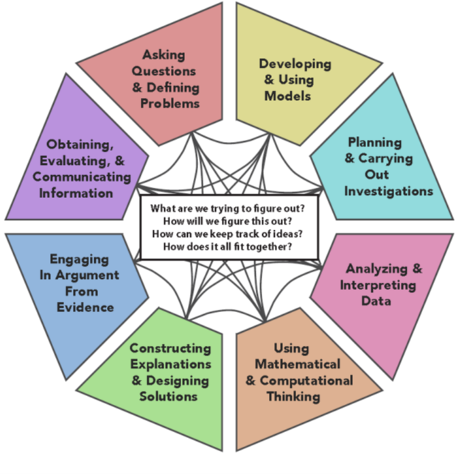

These 8 science practices promote engagement in scientific investigations

Slide 4


The 8 Science Practices
Investigating and Questioning Group:
Asking (Scientific) Questions and Defining Problems
Planning and Carrying Out Investigations to gather data and perform experiments to answer a scientific question
Mathematics and Data Group:
Using Mathematical and Computational Thinking to answer scientific questions
Analyzing and Interpreting Data to recognize patterns and analyze and organize data

Slide 5

Science Practices (cont’d)
Evidence, Modeling, and Reasoning Group:
Developing and Using Models to think about and make sense of an experience, and make predictions, using tangible tools, displays, and illustrations
Constructing Explanations and Designing Solutions to explain phenomena and use evidence to support explanations
Engaging in Argument from Evidence to support a claim and critique competing arguments
Obtaining, Evaluating, and Communicating Information to evaluate and present information from scientific texts from multiple sources

Slide 6
Requirements for STE MCAS-Alt
For STE (grades 5, 8, and high school), each MCAS-Alt strand must include:
  One MCAS-Alt Skills Survey for all STE (all 8 practices)
  A total of three entry points/access skills for each core idea
    Each entry point/access skill reflects a different Science Practice (a total of 3 different Science Practices).
    Each activity from the entry point/access skill must be documented on an STE Summary Sheet (a total of 3 STE Summary Sheets).
    Each activity must reflect the science practice listed in the entry point. (3 pieces of evidence with the corresponding STE Summary Sheets)
  STE data and evidence may be collected during the current and the previous school year.

Slide 7
MCAS-Alt STE Skills Survey
  STE Skills Survey is completed once for each student in all eight science practices.
  Teachers should check boxes to see if a student can perform the practice independently, at least sometimes.
  Then, the teacher will select entry points for assessment in the science practice at the highest grade span in which the checked boxes appear.
  Entry points may be selected from different grade spans for each science practice, as determined by the results of the Skills Survey.
Teachers working with students at the access skill level will check the box, “My student cannot perform any skills in science practice.”

Slide 8
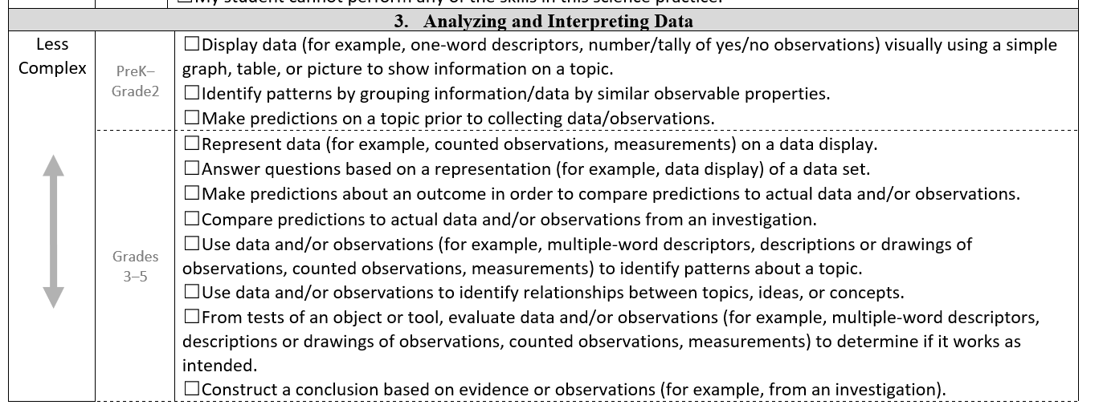
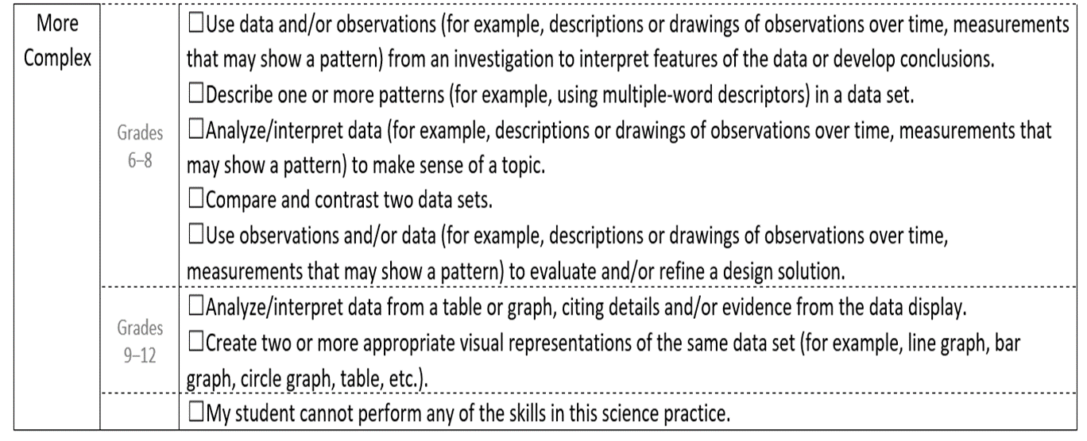
8
MCAS-Alt STE SKILLS SURVEY
Example: Science Practice #3
Directions: Check the boxes below for each task that the student can perform independently, at least some of the time. Then, select an entry point from the highest-grade span in which checked boxes appear. Complete all 8 science practices for the Skills Survey.

Slide 9
MCAS-Alt STE Resource Guide
The STE Resource Guide and Forms and Graphs online lists entry points in grade spans PreK−2, 3−5, 6−8, and High School.
Access skills have their own section at the beginning of each discipline.
Each discipline has core ideas.
Each core idea has a list of related topics.

Slide 10
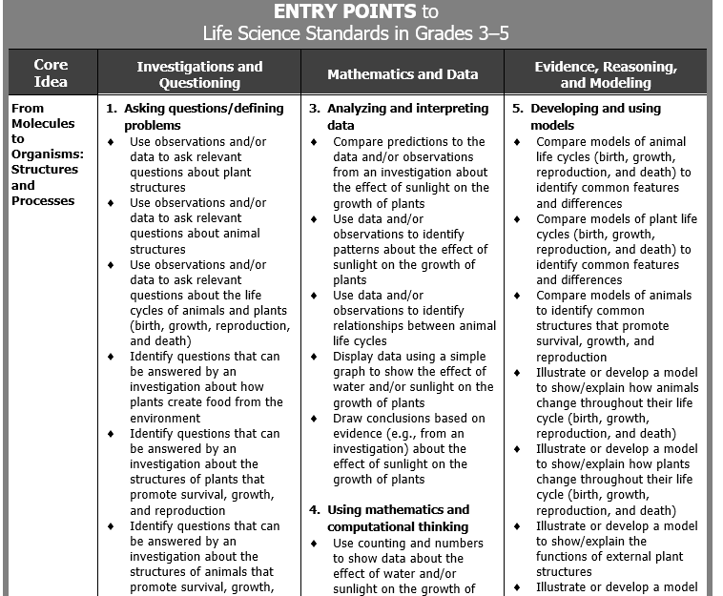
Excerpt from STE Resource Guide: Life Science
Core Idea: From Molecules to Organisms, Grades 3-5
Science Practices
Core Idea
Entry Point

Slide 11
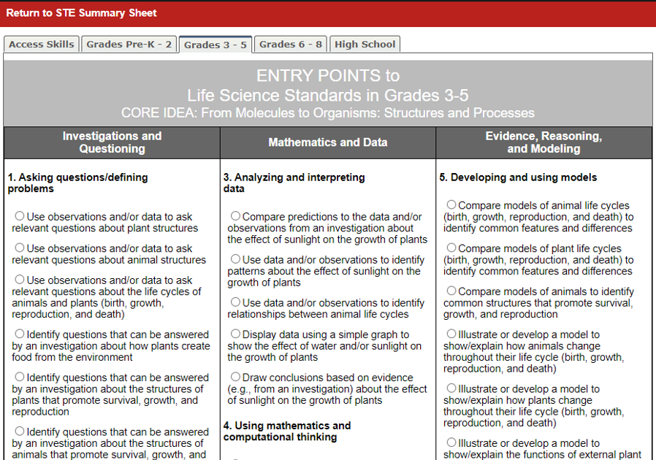
Forms and Graphs
Each tab reveals grade spans from which to choose entry points
Entry points are embedded in each science practice
Science practices are listed under each grouping.
Access Skills has a separate tab.

Slide 12

Requirements for Grades 5 and 8 STE
Educator’s Manual, pp. 35-39
Complete one MCAS-Alt Skills Survey. (One survey for all eight practices)
Select three of the four disciplines to assess:
  Earth and Space,
  Physical Science,
  Life Science,
  Technology/Engineering

Slide 13
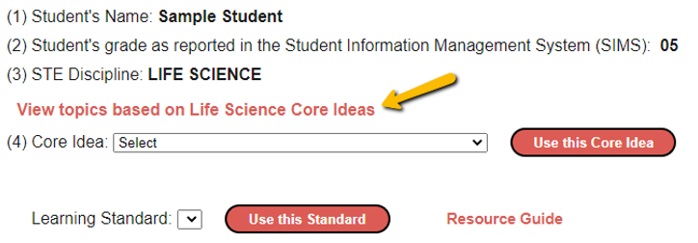
Step-by-Step Requirements for Grades 5 and 8 STE
One Core Idea per discipline.
For each discipline review the list of related topics before selecting a core idea.
13

Slide 14
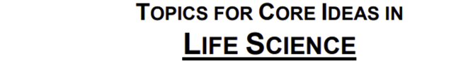

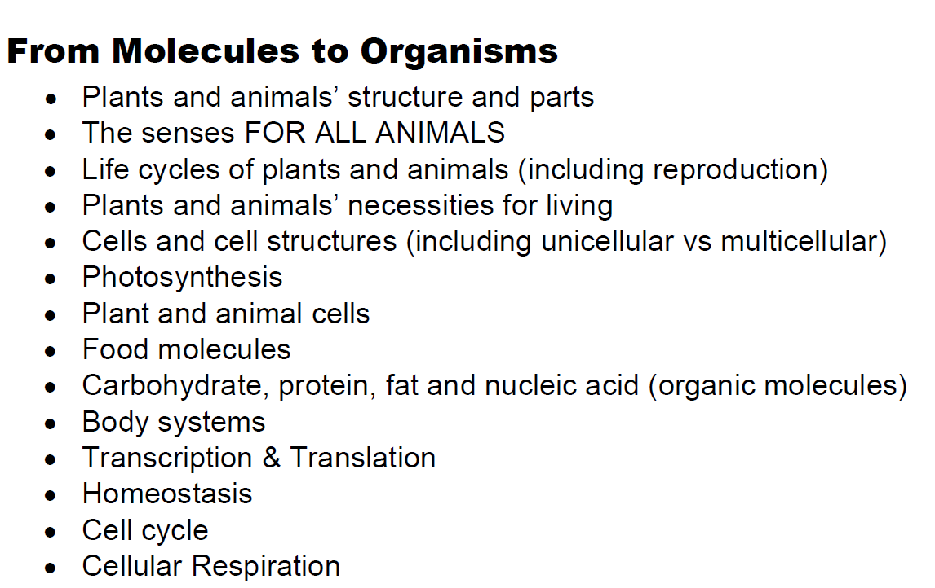

Related Topics for Core Ideas:
Educator’s Manual, pp. 35-39

Slide 15
Step-by-Step Requirements for Grades 5 and 8 STE
Educator’s Manual, pp. 35-39
Select three (3) entry points/access skills aligned with the core idea. Preferably one from each group:
  Investigations and Questioning,
  Mathematics and Data,
  Evidence, Reasoning, and Modeling
  Choose 3 pieces of primary evidence based on the entry point/access skill you chose. Each piece of evidence must reflect a different science practice (#1-8) and complete an STE Summary Sheet to accompany the evidence. (similar to a work description)
  Access skills must be addressed during a standard-based activity.
  Include examples of self-evaluation.

Slide 16
Step-by-Step Requirements for Grades 5 and 8
Select three (3) entry points/access skills aligned with the core idea. Preferably one from each group:
  Investigations and Questioning,
  Mathematics and Data,
  Evidence, Reasoning, and Modeling
  Choose 3 pieces of primary evidence based on the entry point/access skill you chose. Each piece of evidence must reflect a different science practice (#1-8) and have a corresponding completed STE Summary Sheet. (similar to a work sample description)
  Access skills must be addressed during a standard-based activity.
    Include examples of self-evaluation.

Slide 17
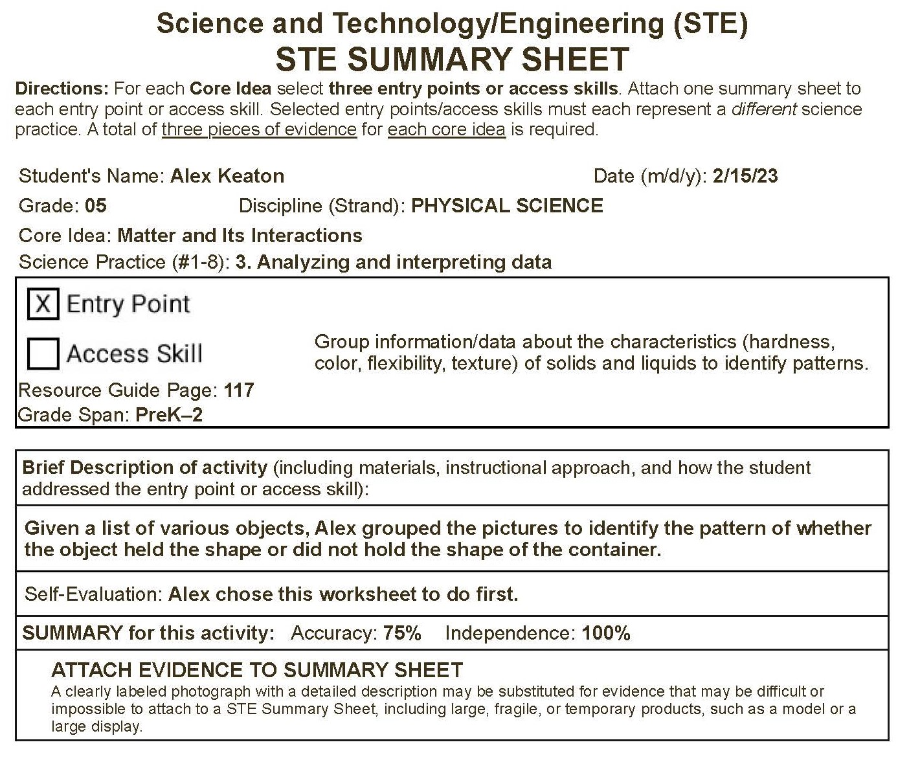
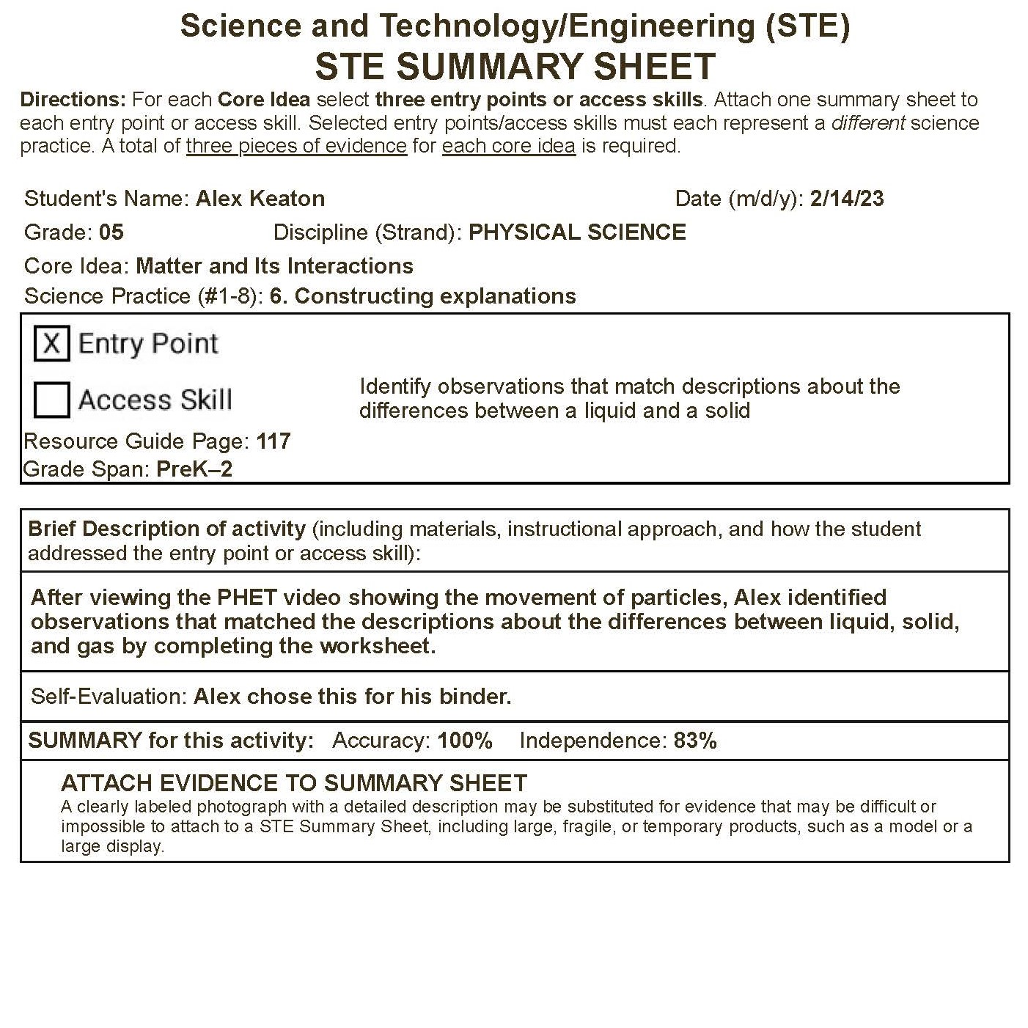
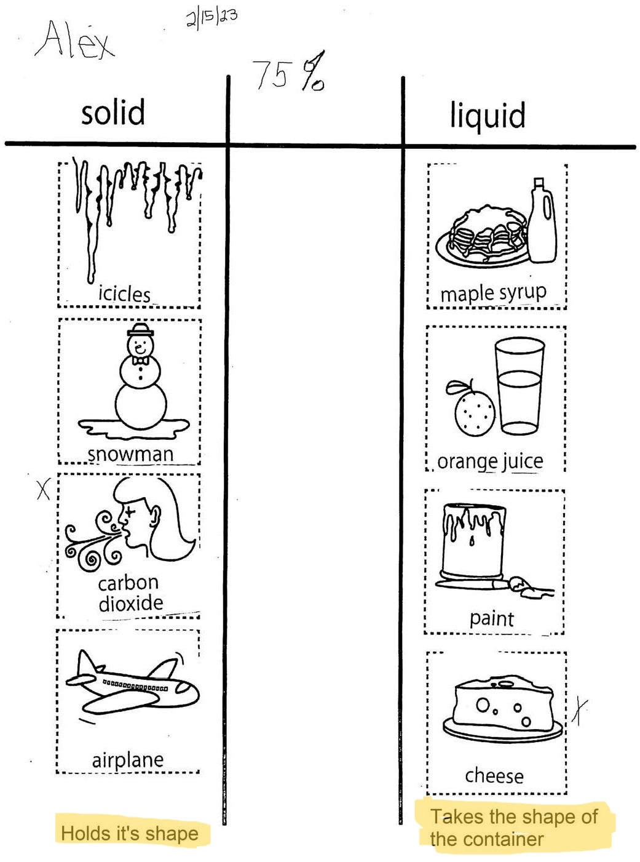
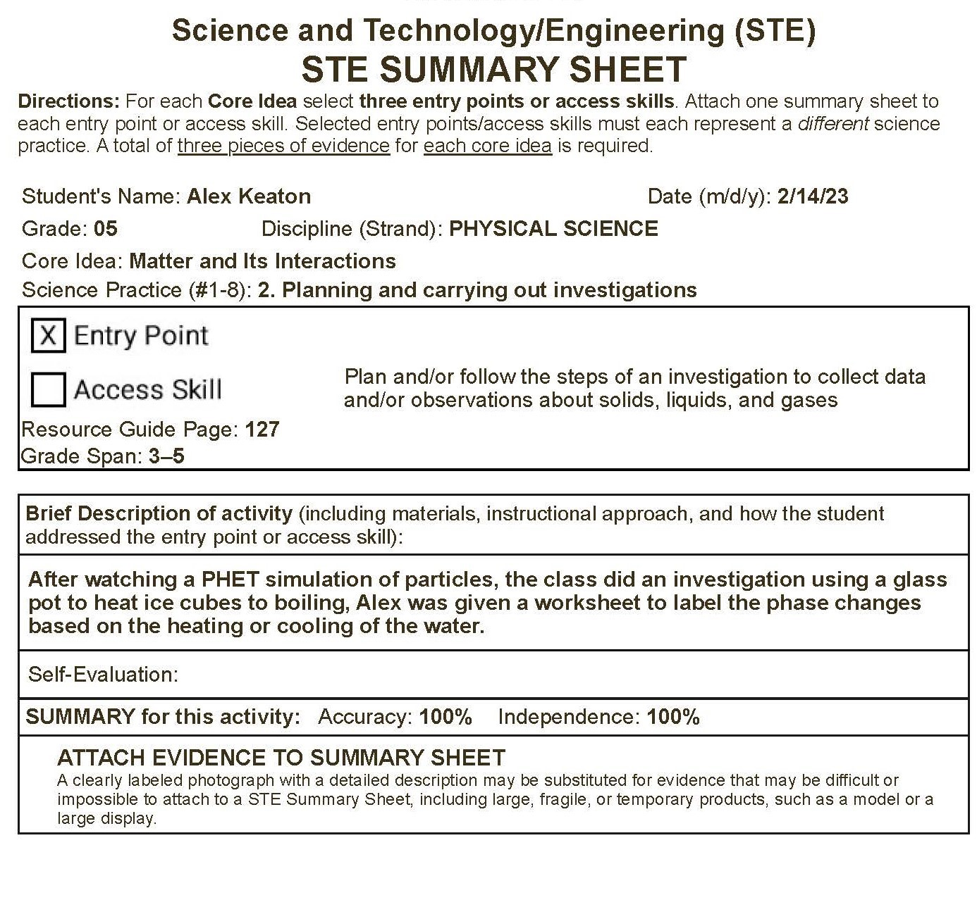
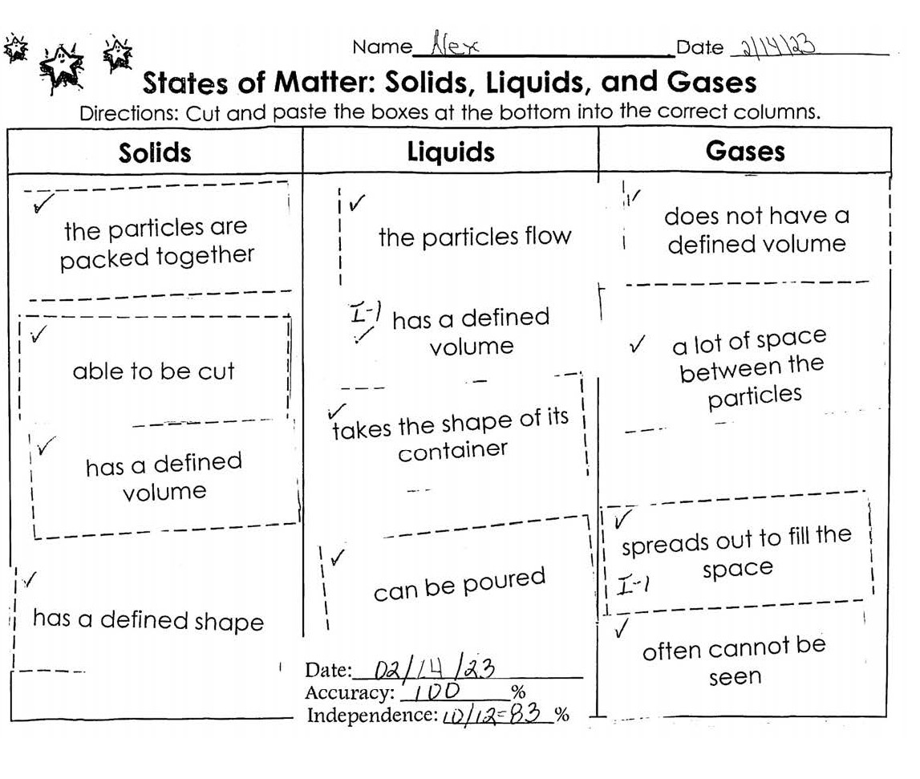
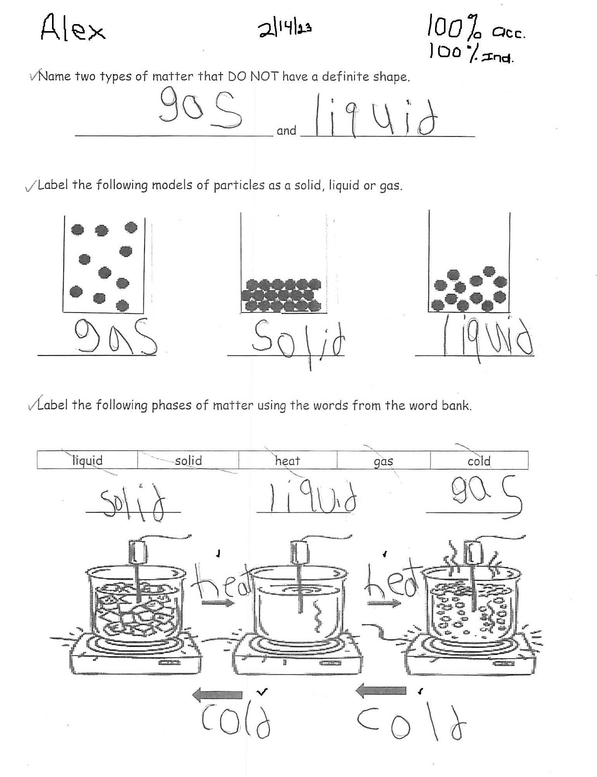
Sample of Requirements for one Core Idea
3 STE Summary Sheets
3 corresponding pieces of evidence
3 different science practices
All based on ONE core idea
Practice 3
Practice 6
Practice 2

Slide 18
Complete One STE Summary Sheet for Each Entry Point or Access Skill
Name, Date, Grade, Discipline, Core Idea, Science Practice #
Entry Point or Access Skill
Summarize students’ percentage of accuracy and independence on responses for the attached work sample.
Activity description
Self-evaluation is a text box

Slide 19
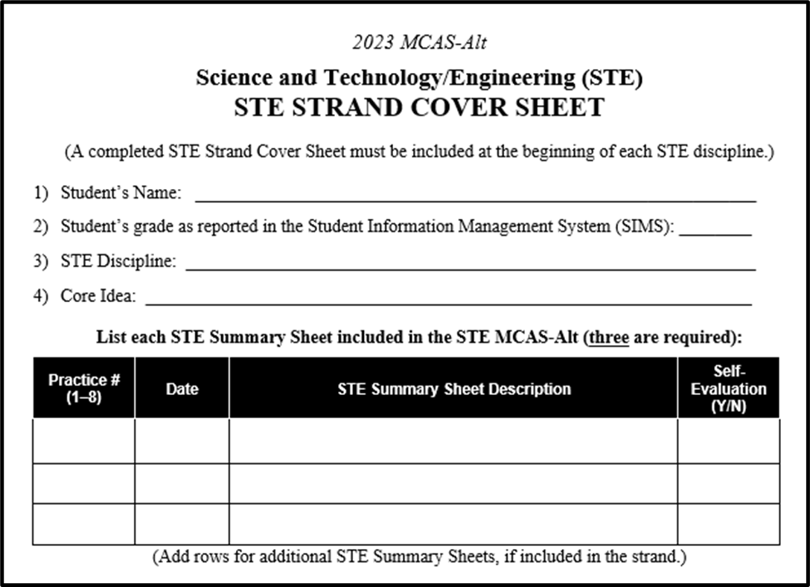

STE Strand Cover Sheet: One for Each Core Idea
Check the Strand Cover Sheet:
3 Summary Sheets
3 Different Practices
3 Pieces of Evidence
2 Self-Evaluations

Slide 20
STE Requirements for High School

Slide 21
High School Science and Technology (STE)
Educator’s Manual, p. 37
STEPS to COMPLETE a STRAND:
Step 1: Complete one Skills Survey (all eight science practices)
Step 2: Choose one discipline:
  Biology OR Introductory Physics
Step 3: Choose 3 different Core Ideas from the chosen discipline.
Step 4: Select three (3) entry points/access skills for each core idea. Review the entry points in the eight different practices.
Each entry point/access skill must represent a different science practice.
(a total of 3)

Slide 22
High School Science and Technology (STE)
Educator’s Manual, p. 37
Step 5: Complete and submit one STE Summary Sheet for each entry point/access skill.
Include:
  Student’s Name and Date of activity
  Core Idea
  Entry Point or Access Skill addressed in the activity
  3 different Science Practices (1−8) documented in the evidence
  % Accuracy and % Independence for each task or response, plus overall percent
  Description of each activity
Step 6: Submit three pieces of primary evidence for each entry point/access skill. Attach to corresponding Summary Sheet and include in the binder.
  Work samples, photos, and/or videos may be submitted.
  Include any examples of self-evaluation.

Slide 23
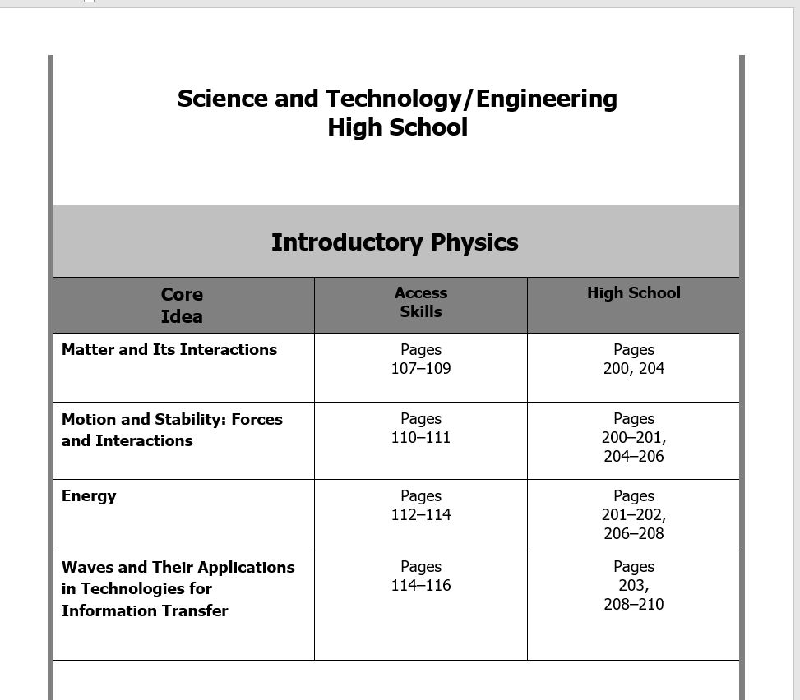
High School: Introductory Physics
Choose 3 of the 4 Core Ideas

Slide 24
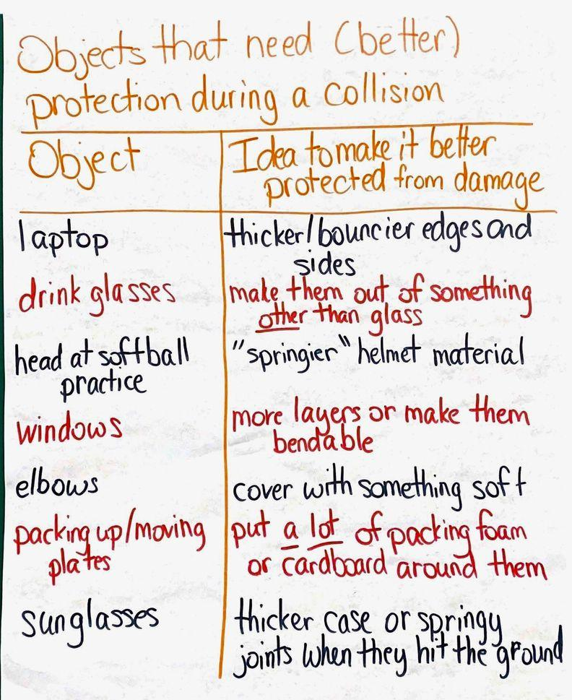
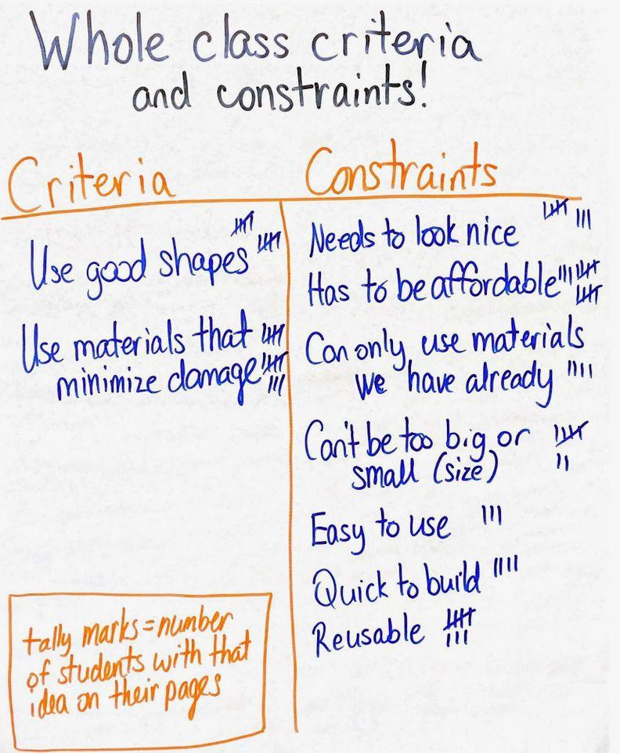
Introductory Physics: What it Could Look Like (Examples)
Core Idea: Motion and Stability
  Science Practice #1: Asking Questions/Defining Problems
Entry Point | What it could look like…
Determine criteria and constraints to define a design problem about minimizing the force of an impact in a collision. (STE Resource Guide, p. 204) | Brainstorm a list of items that need protection from collisions. Select one together and scribe the student’s ideas for criteria and constraints.
Phone case criteria and constraints

Slide 25
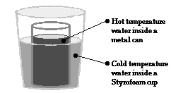
Introductory Physics: What it Could Look Like (Examples cont’d)
Core Idea: Energy
Science Practice #3: Analyzing and Interpreting Data
Entry Point | What it could look like…
Analyze data from a table or graph that includes the temperatures of two substances in thermal contact over time (STE Resource Guide, p. 207) | Students make observations of a system where a small cup of hot water is placed inside a larger cup of hot water. They measure the temperature at least twice. They describe what they see. Sentence frames/stems may be appropriate.
 |  | 0 min | 5 min | Temp change
Inside | Hot | 43.0 | 23.0 | -20.0
Outside | Cold | 8.0 | 23.0 | +15.0
When the hot and cold cups are touching, the temperature of the hot water decreases, and the temperature of the cold water increases. After 5 minutes, both cups are at the same temperature.

Slide 26
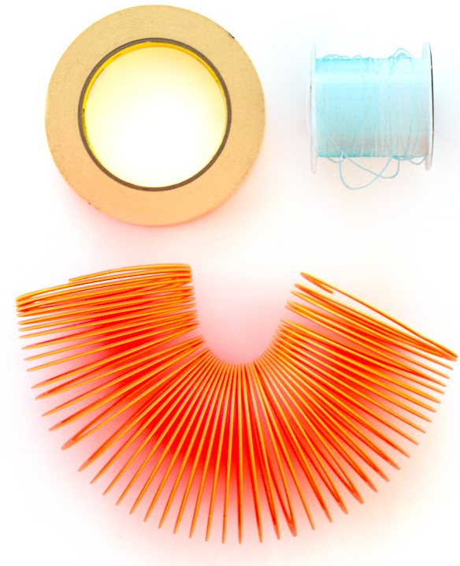
Introductory Physics: What it Could Look Like (Examples cont’d)
Core Idea: Waves and Their Applications in Technologies for Information Transfer
Science Practice #5: Developing and Using Models
Entry Point | What it could look like…
Construct a model to explain the behavior of a wave (STE Resource Guide, p.208) | Students can use a slinky to demonstrate transverse wave resonance as well as longitudinal wave resonances.
Material:
Slinky
Two chairs
About 10 feet of 20-pound test monofilament fishing line
Masking tape
Optional: substitute for nylon line, a smooth tabletop

Slide 27
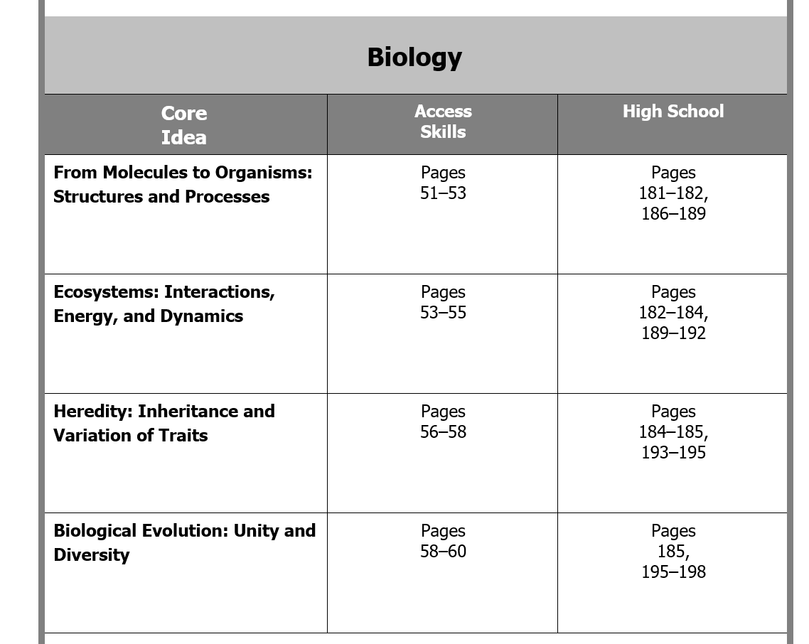
High School: Biology
Choose 3 of the 4 Core Ideas

Slide 28
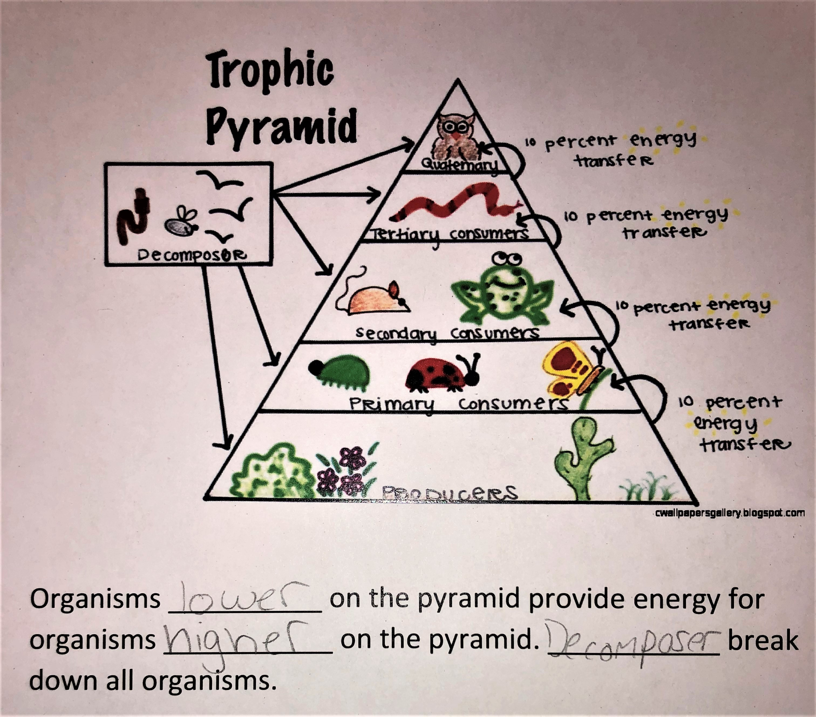
Biology: What it Could Look Like
Core Idea: Ecosystems: Interactions, Energy, and Dynamics
  Science Practice #6: Constructing Explanations and Designing Solutions
Entry Point | What it could look like…
Construct an explanation to describe the role of producers, consumers, and decomposers in an ecosystem, based on a variety of sources (e.g., model, research, investigation, simulation) (STE Resource Guide, p. 191) | Use an energy or trophic level pyramid to help explain the roles of producers, consumers, and decomposers by showing where they are located on the pyramid.

Slide 29
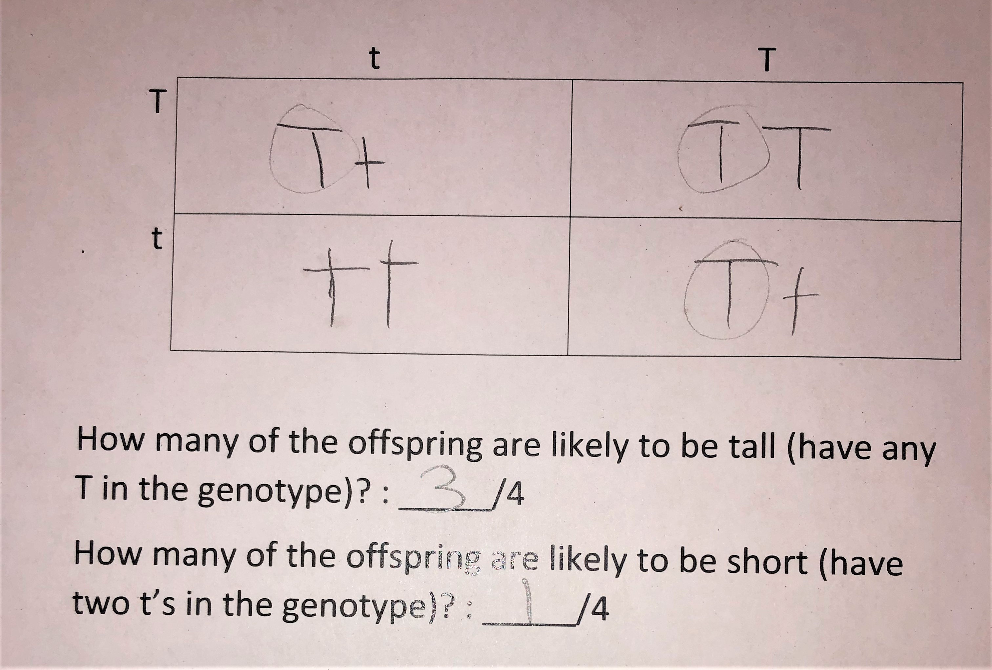
Biology: What it Could Look Like
Core Idea: Heredity: Inheritance and Variation of Traits
  Science Practice #3: Analyzing and interpreting data
Entry Point | What it could look like…
Analyze data from a Punnett square or pedigree to determine the inheritance patterns of a particular trait (STE Resource Guide, p. 193) | Use information about dominant and recessive forms of traits to create a Punnett square that predicts the genotypes and phenotypes of off- springs. For example: Height T is dominant for tall trait and t is recessive for short trait. If a short plant is crossed with a hybrid tall plant what is the likelihood that the offspring will be short?

Slide 30
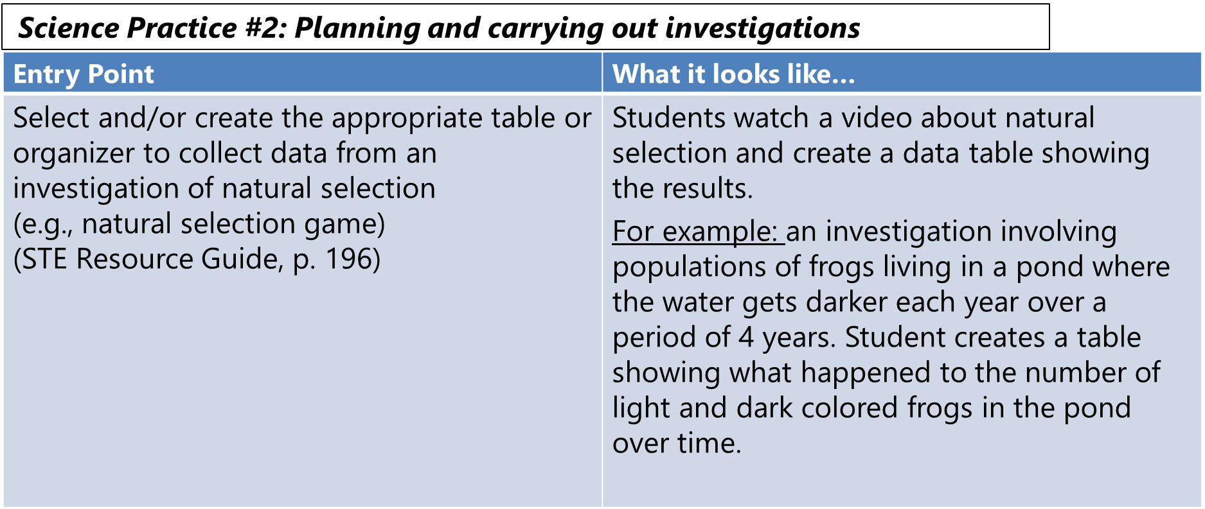
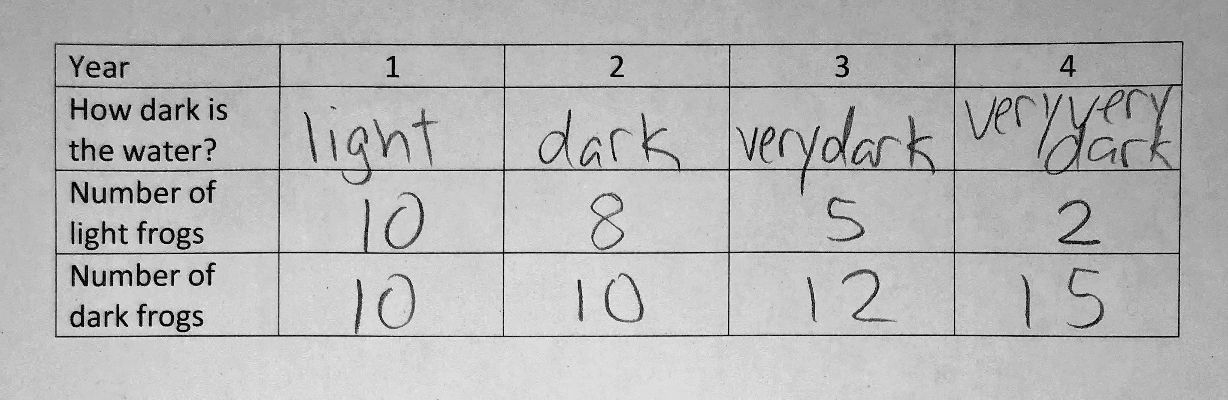
Biology: What it Could Look Like
Core Idea: Biological Evolution: Unity and Diversity
Science Practice #2: Planning and carrying out investigations

Slide 31
Entry points increase in complexity from one grade span to another within each science practice
(example)
  (Core Idea—Biological Evolution: Unity and Diversity (Practice #3, Analyzing and Interpreting Data)
    Analyze and interpret data to make sense of the process of natural selection in a plant or animal population. (Grades 6-8)
    Draw conclusions based on evidence (e.g., from an investigation) about features of animals that enable them to survive in their habitat (e.g., thick fur in a cold climate, webbed feet in frogs, protective coloration). (Grades 3-5)
    Display data using a simple graph or pictures to show living things in a local habitat (e.g., school yard). (Grades Pre-K-2)

Slide 32
Tools and Materials for Supporting the Development of a Cohesive STE Unit

Slide 33
STE Resources
To support high-quality science experiences for all students, DESE encourages educators to use and adapt a high-quality science and technology unit.
The high-quality unit supports the shifts in practice from pulling activities together from a variety of sources to a more coherent experience for students.
A planning guide was developed to guide you through the recommended process.
All resources can be found at www.mcas-alt.org/materials or in the Forms/Graphs online program.

Slide 34
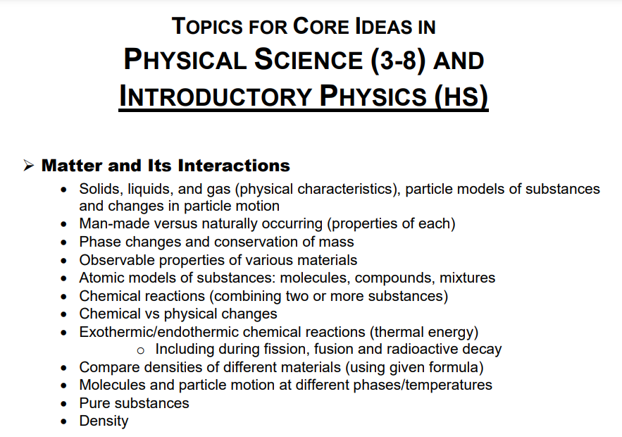
Resources: High-Quality Curriculum Units Related to Topics
Related units:
SOLID Start “Engineering Toys” (Grade 2)
SAIL “Garbage” (Grade 5)
NGSS Storylines Where Does Our Clean Water Come From and Where Does It Go After We Make It Dirty? (Grade 5)
Sprocket “Chemistry of Taste” (Grade 5)
OpenSciEd “Thermal Energy”, “Chemical Reactions & Matter” (Grades 6-8)
Why Do Some Things Get Colder (or Hotter) When They React? (High School)
CREATE for STEM “Interactions Units 1&2” (High School)

Slide 35


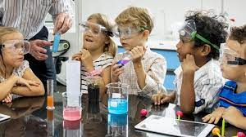

All high-quality science units are anchored on a scientific phenomenon (observable event or driving question) related to the core idea.
They are designed to be coherent to students - the order makes sense to them, and each lesson builds on the last.
“Impactful science teaching happens when we start in the lives of the children and empower them to make sense of the world in their own voice.” (Brown, 2019)

Slide 36
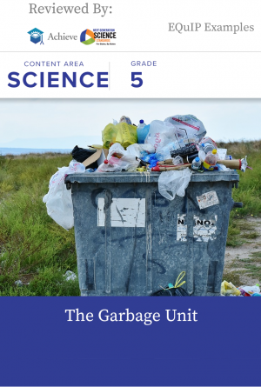
What Happens to Our Garbage?
SAIL Unit: Garbage
(Grade 5)

Slide 37
Choose how to introduce the phenomenon (driving question)
Educator’s Manual, pp. 35-39
The method you use to introduce the unit to the students will get them engaged in the topic and inspire the rest of the unit.
Introduction of the phenomenon could look like this:
Exploration of materials (Use of all senses)
Videos and images
Demonstrations ( Create our own …)
Readings or being read to (Informational texts)
Guided investigations (Teacher facilitated)
Notice and wonder protocol (Observations with guidance)

Slide 38
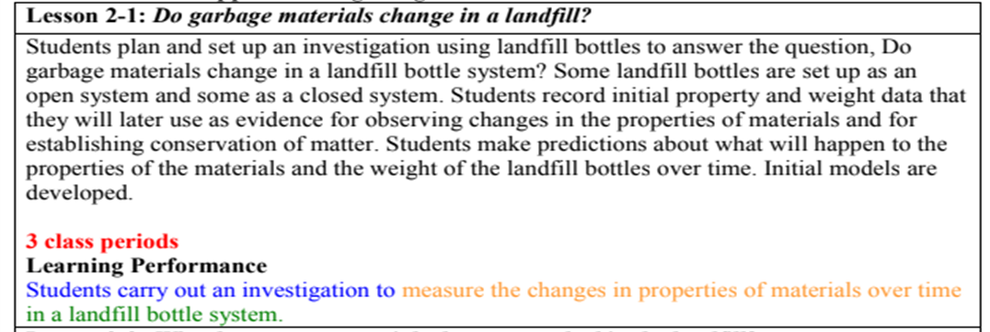
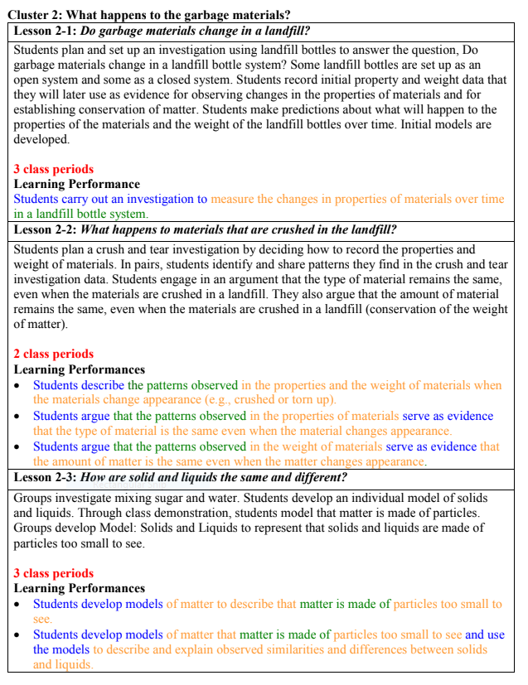
Units are designed for use over many class periods-educators can modify the duration, material, and student expectations for each lesson.

Slide 39
How can my student interact with the phenomenon?
Given support and based on students’ needs, they can interact by:
  Speaking or using their AAC device,
  Writing, keyboarding,
  Drawings, pointing to symbols or images,
  Teachers can create sentence stems: (e.g., I see… I wonder… This is like...),
  Use of media

Slide 40










Example of how your student can interact with phenomena,
Place garbage in a central location on a plastic tablecloth for all students to see.
Ask students what they notice, smell, and see.
Allow students to move the trash with tongs or gloves.
What is in our Garbage?
Notice | Wonder
I see… It is… I notice… Looks like… | Who What When Where How Why

Slide 41
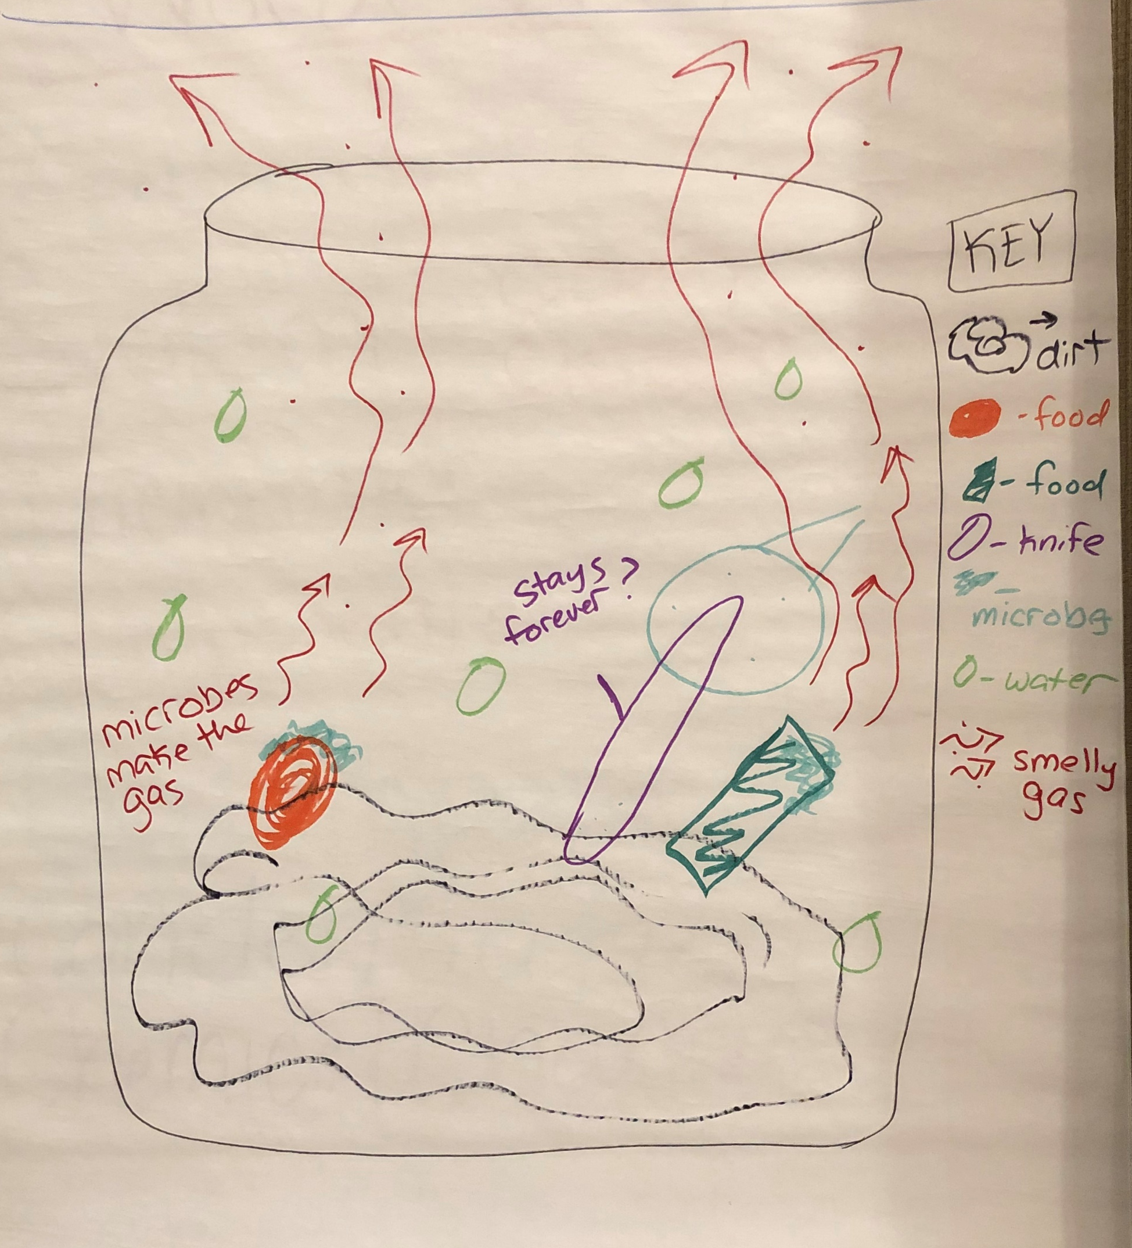
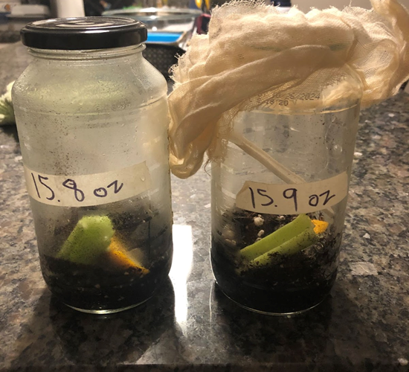
Example of Physical Science
Science Practice #5: Developing and Using Models
Evidence
Measurable Outcome
Illustrate or develop a model to show/explain phase changes between gases, liquids, and solids.
Open System

Slide 42
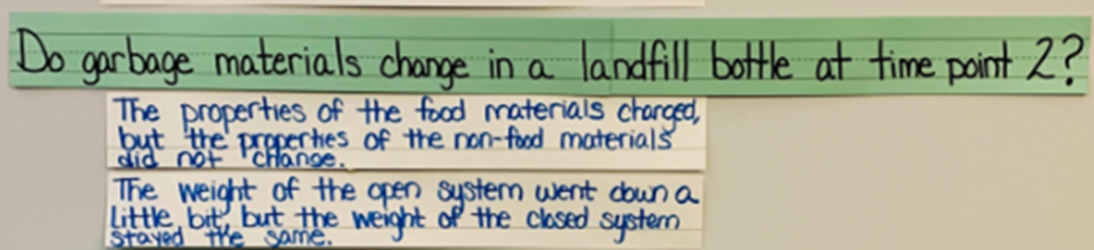
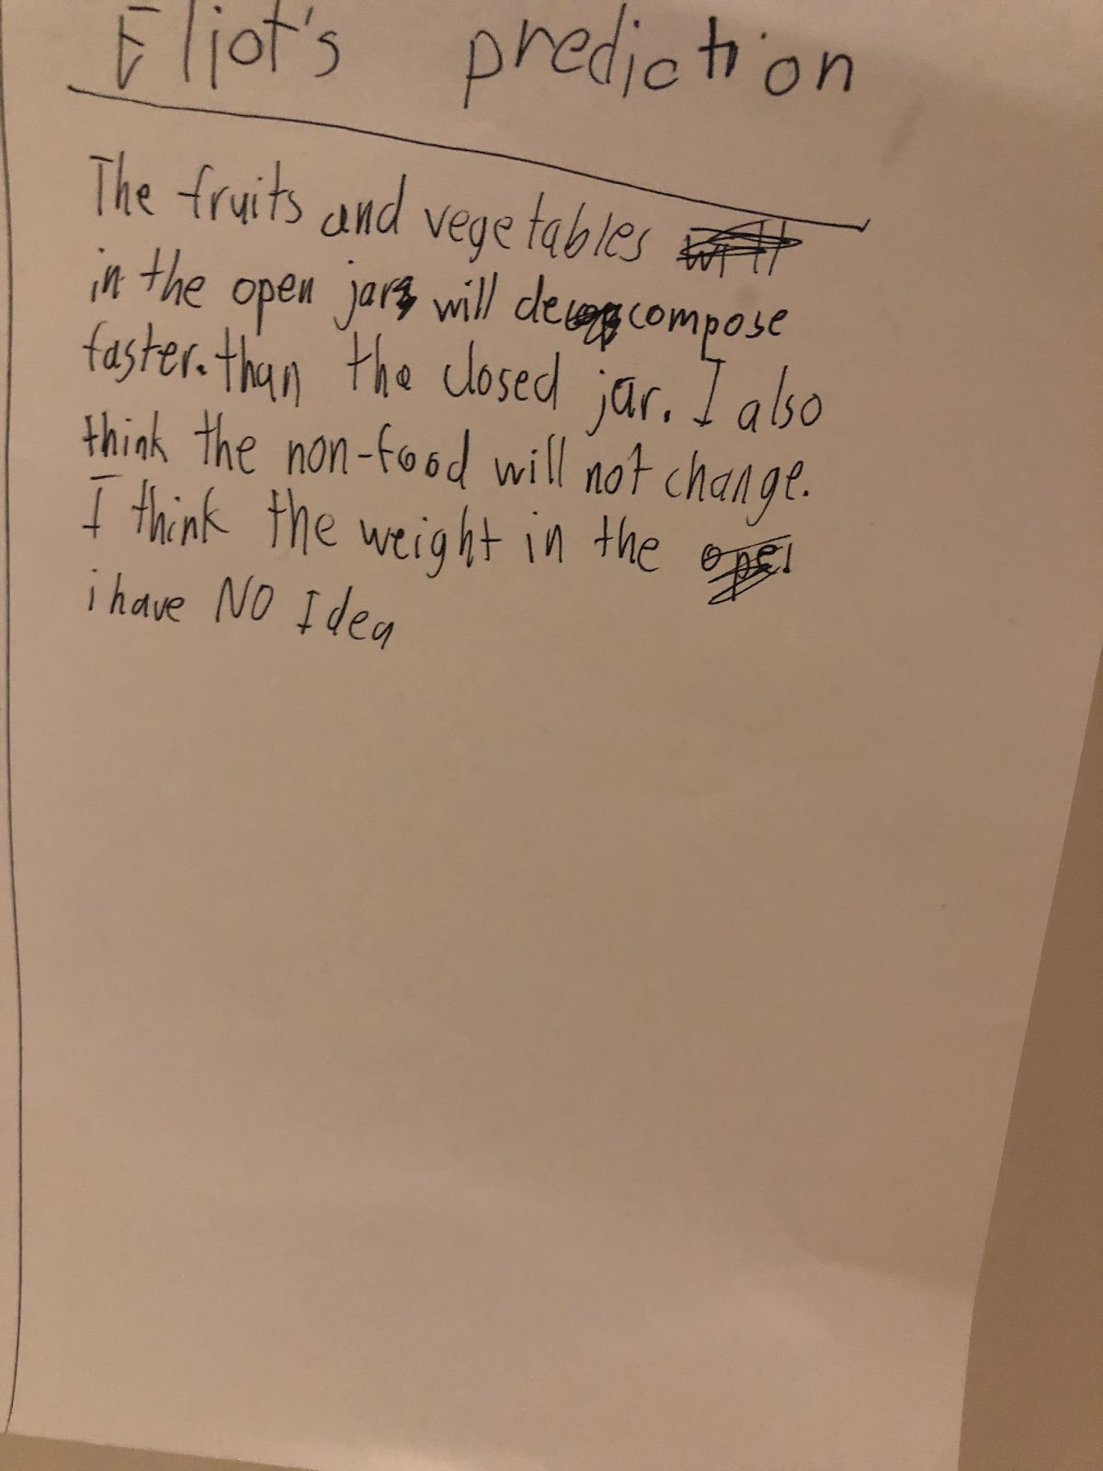
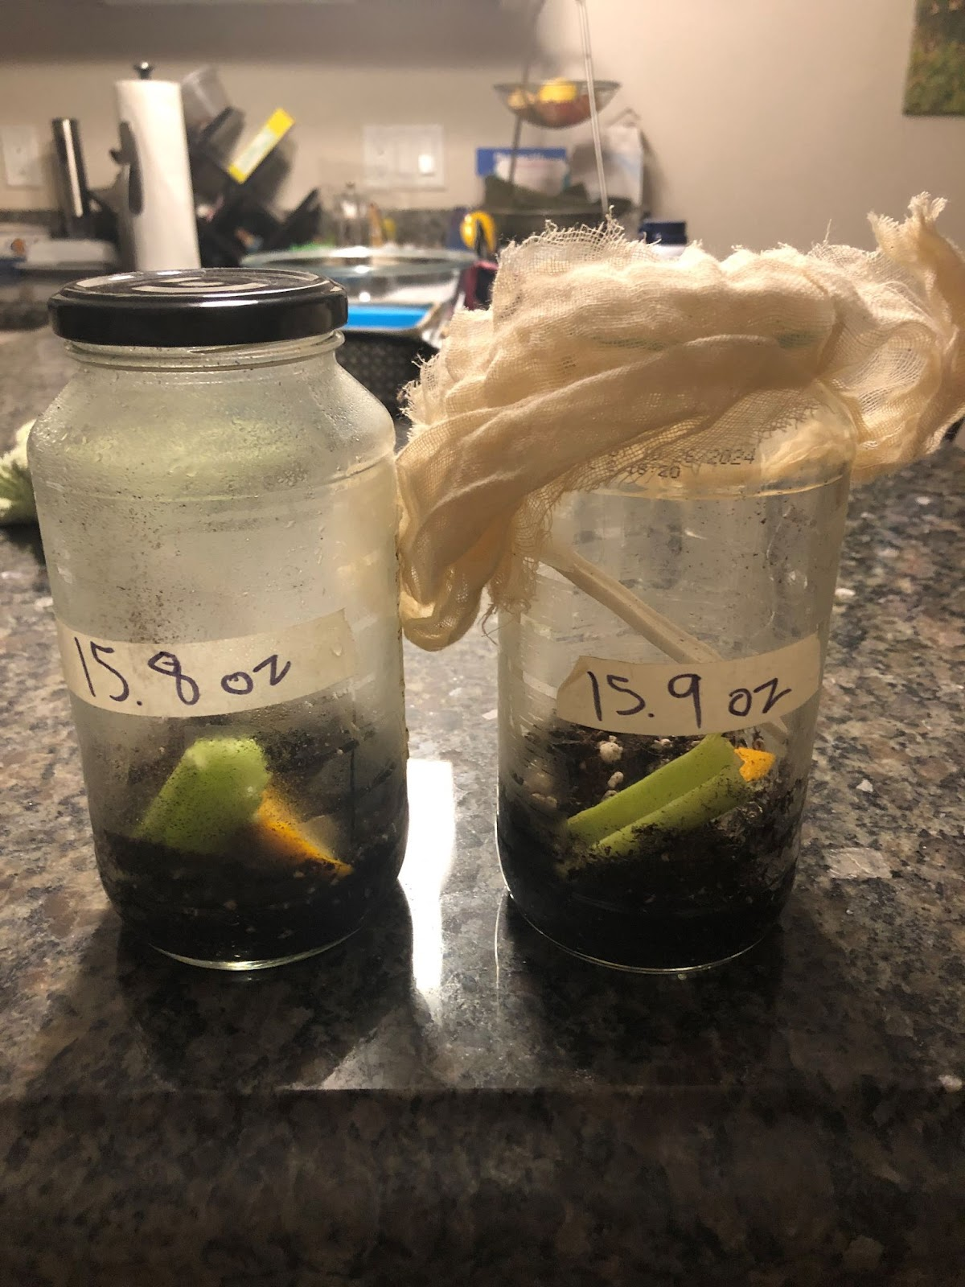

Example of Physical Science
Science Practice #3: Mathematics and Data
Evidence
Measurable Outcome
Compare predictions to the data and/or observations from an investigation
CLOSED
OPEN

Slide 43
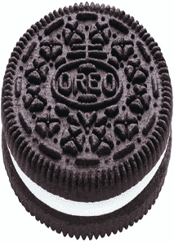
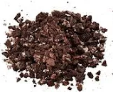
Example of Physical Science
Science Practice #7: Evidence, Reasoning, and Modeling
Evidence
Measurable Outcome
Question: When materials are crushed, do the properties (color, texture reflectivity) of the material change?
Claim (topic sentence):
Evidence: | Why did you use this data?
1.
2.
3.
Reasoning (wrap up sentence):
Use scientific evidence in support of an argument about how the properties of the material remain the same when broken into smaller pieces.

Slide 44
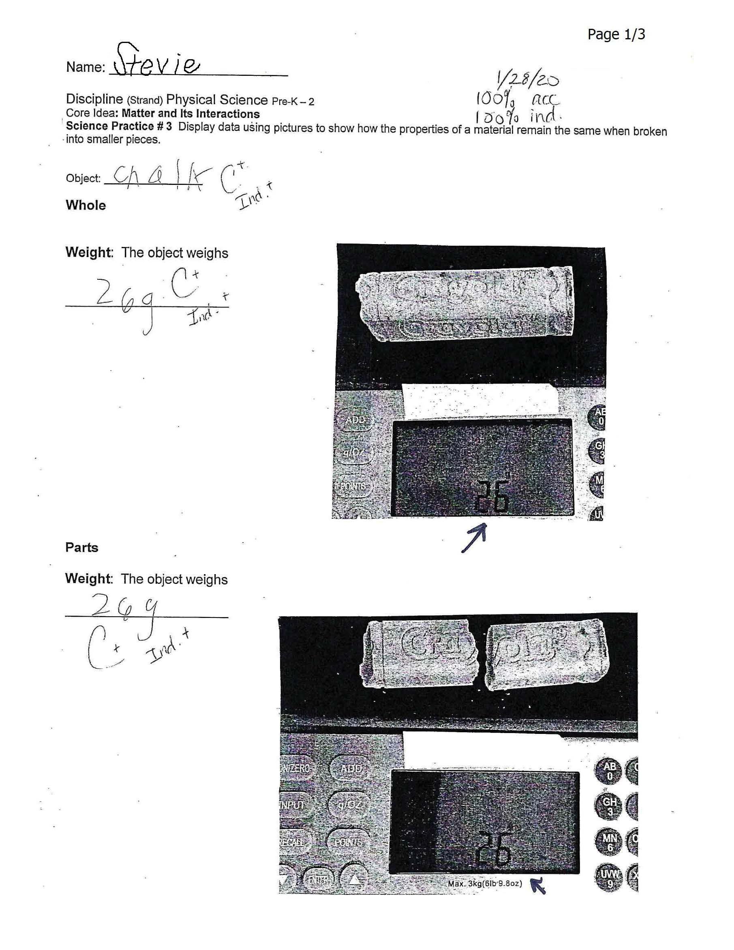
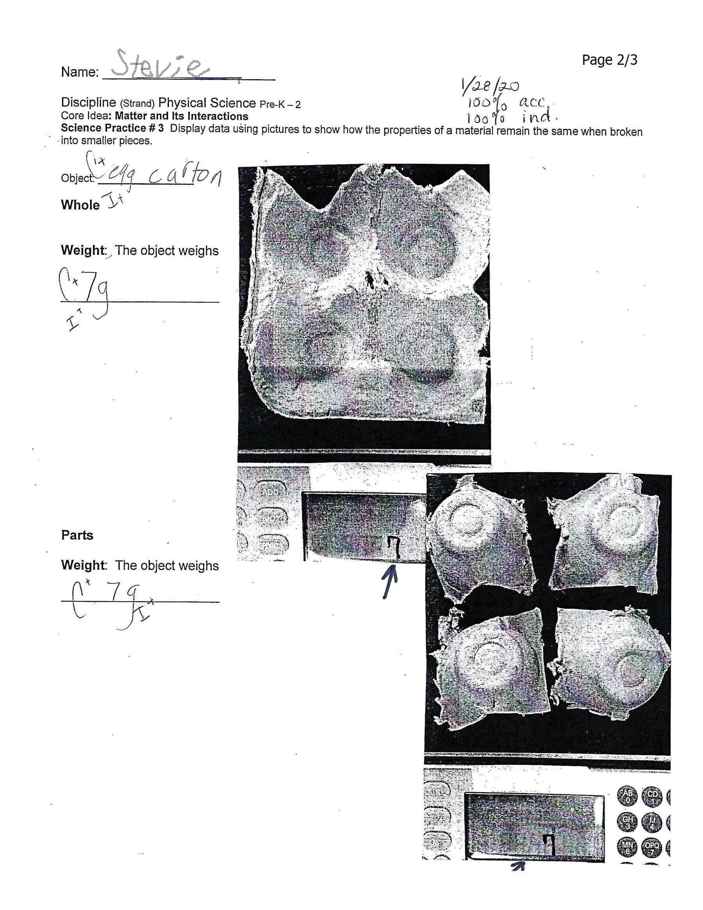
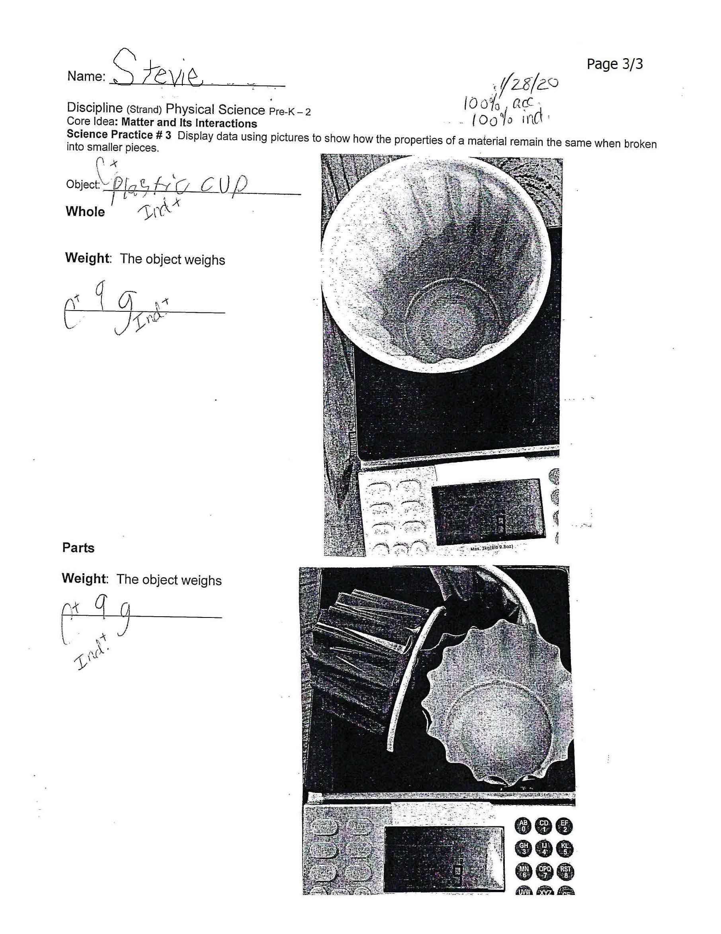
Example of Physical Science
Science Practice #3: Analyzing and Interpreting Data
Science Practice #3
Measurable Outcome
Display data using pictures to show how the properties of the material remain the same when broken into smaller pieces.
Whole
SCALE
Broken

Slide 45




THANK YOU
Debra Hand, MCAS-Alt Coordinator
781-338-3625
Debra.d.Hand@mass.gov
www.mcas-alt.org/materials
75 Pleasant Street, Malden, MA 02148

