Slide 1
Administrator’s Overview
Fall 2023
Robert Pelychaty, Manager of Inclusive Assessments
Debra Hand, MCAS-Alt Coordinator

Slide 2
1
Important Dates
2
Criteria/Guidelines for Assessment
3
MCAS-Alt Statewide Results
TOPICS
4
Supporting Teachers/Monitoring Progress
5
ESSA 1% Cap Update
6
Grade-Level and Competency Portfolios
7
Locate/Interpret MCAS-Alt Feedback Forms
8
Resources and Contacts

Slide 3
1
Important Dates for the MCAS-Alt

Slide 4
Important MCAS-Alt Dates
Ordering Materials for the MCAS-Alt
Order MCAS-Alt materials (binders, etc.): Jan. 2–12, 2024
Materials will be received in late February.
Check the shipment when received and complete Part 1 of the PCPA
Preparing for Submission
Use the online MCAS Service Center to schedule UPS pick-up by 2:30 p.m., Wednesday, March 27
Assessments must be picked up from schools by 5:00 p.m., Thursday, March 28

Slide 5
2
Criteria and Guidelines for Determining Participation in the Assessment.

Slide 6
Assessment Options for Students with Disabilities
Computer-based MCAS testing with universal accessibility features
MCAS accommodations, including paper-based testing
MCAS-Alt for Students with the Most Significant Disabilities (See criteria)
Grade-level/Competency portfolios
IEPs must list all assessment decisions, including accommodations
Alternate assessments require documented evidenced-based data.
Reminder: Assessments beyond grade 10 are optional, IEP teams should determine whether the student is expected to graduate.
If expected to graduate, students should continue to take MCAS retests, and/or submit an MCAS appeal or complete a competency portfolio.

Slide 7
A student should not take MCAS-Alt based solely on whether they…
previously failed the MCAS test.
took an alternate assessment previously (since this is an annual decision).
have not been provided instruction in the general curriculum.
were absent excessively.
have a specific disability (e.g., all students with intellectual disabilities should not automatically take the MCAS-Alt).
are enrolled a program where it is expected that students will take the MCAS-Alt.
are an English learner (EL).
require an alternative augmentative communication system.
the school’s accountability is affected by the decision.

Slide 8
Decision-Making Guide for Assessment
Question 1: Does the student meet the Massachusetts definition and all criteria of a “student with the most significant cognitive disabilities”? (next slide)
If Yes: The student is eligible for the MCAS-Alt, which is an Alternate Assessment based on Alternate Academic Achievement Standards.
Note: Simply because the student is eligible does not warrant the Team recommending the MCAS-Alt. Students taking the MCAS-Alt likely will face challenges earning their high school diploma.
If No: Proceed to question 2
Question 2: Does the student have a disability and require specific, allowable accommodations and accessibility features to demonstrate knowledge and skills on assessments?
If Yes: The student’s IEP or 504 plan should include the specific allowable accommodations and accessibility features, which should generally mirror accommodations the student receives during routine instruction. Please review the Guidance for Selecting and Evaluating MCAS Accessibility Features and Accommodations for Students with Disabilities.
If No: The student must participate in the standard MCAS assessment using available accessibility features. Accommodations may be included later if the student’s needs change.

Slide 9
Massachusetts defines “students with the most significant cognitive disabilities” as students who:
Have cognitive disabilities evidenced by significant delays in attaining age-level academic achievement standards, even with systematic, extensive individually designed instruction, related services, and modifications; and
Have cognitive disabilities that significantly impact their educational performance and ability to apply learning from one setting to another; and
Require extensive, direct individualized instruction and substantial support to achieve measurable gains on the challenging State academic content standards for the grade in which the student is enrolled; and
Perform significantly below average in general cognitive functioning and adaptive behavior. This is defined as a student functioning two or more standard deviations below the mean on commonly accepted norm-referenced assessments in both cognitive functioning and adaptive behavior (e.g., two or more adaptive skill areas such as daily living skills, communication, self-care, social skills, and academic skills).

Slide 10
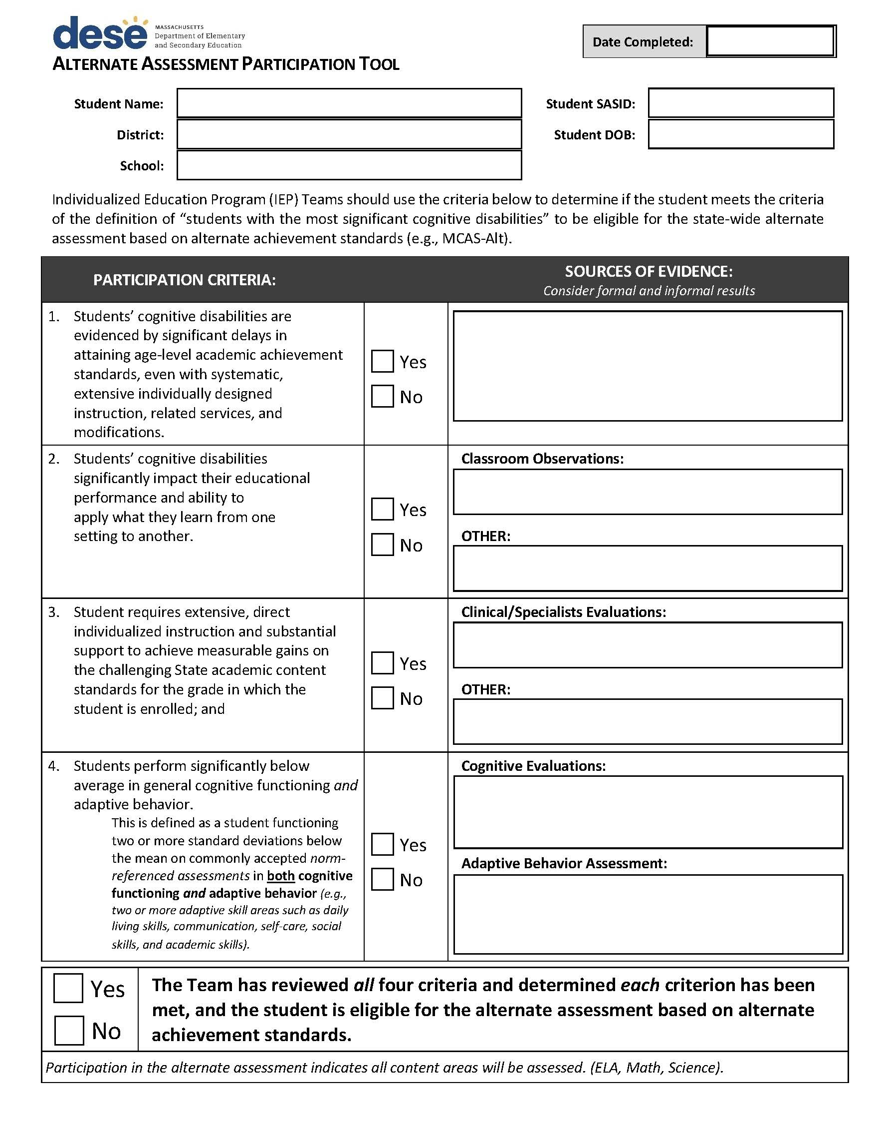
The Alternate Assessment Participation Tool is a companion document to assist IEP teams when deciding if a student is eligible to participate in the MCAS-Alt.
If eligible, the student will participate in the assessment in all content areas required for their grade.
Fill out the form online, then upload it to the MCAS-Alt File Exchange located in the Security Portal.

Slide 11
3
2023 MCAS Alt-Statewide Results

Slide 12
2019-2023 MCAS-Alt: Statewide Results (All Content Areas - All Grades)
66.87%
2019
Not
Assessed
[2020]
59.91%
58.45%
56.53%
2021
2022
26.38%
2023
25.14%
25.85%
22.05%
16.00%
12.42%
11.47%
9.14%
2.75%
2.33%
2.77%
1.75%
Incomplete
Awareness
Emerging
Progressing

Slide 13
4
Supporting Teachers and Monitoring Progress for the MCAS-Alt

Slide 14
Administrator’s Role
Principals can:
Encourage educators to start early in the school year.
Ask educators what supports are necessary.
Permit educators to attend training and review sessions in October, January, and February/March.
Support educators by:
allowing flexible scheduling, data entry, and planning time;
provide sub coverage to allow for attending training/review sessions;
Set a date for reviewing assessments. Give yourself or a designee adequate time prior to the due date in March.

Slide 15
Assist Educators Conduct the MCAS-Alt
Check in periodically with the educators. Ask to review the student work.
Identify educators who need support and identify who will provide it.
To ensure that assessments are complete and authentic, the principal or designee should:
Reviews dates and brief descriptions on the data chart.
Do the activities address the measurable outcome?
No classroom activities should be dated on non-school days.
Send reminder of deadlines to ensure completion by the submission date.
Verification form is not a consent form, it is an opportunity for parents to review their child’s work.

Slide 16
5
Every Student Succeeds Act (ESSA) 1% Cap on MCAS-Alt Participation

Slide 17
ESSA imposes a Statewide cap of 1% of all tested students on those who can take the MCAS-Alt.
MA must apply for a one-year waiver of the cap, each year that we are over 1%.
The US DOE may grant waivers for states that have at least:
95% participation of students tested in each subject,
progress in lowering the number; and
assist districts that are consistently over the 1%.
Each year is an opportunity to revisit and refine our decision-making on which students take the alternate assessments.
Are IEP teams making defensible decisions and the least dangerous assumption for each student?
Students who continue to take the alternate assessment based on alternate academic achievement standards will not earn a diploma.

Slide 18
Resources to Help Districts Meet the ESSA 1% Cap
Decision-making Guidelines
Alternate Assessment Participation Tool uploaded for each student participating in the MCAS-Alt
Sample Parent Notification Letter for students participating in the MCAS-Alt
Written notification of parents is required!
District Data on percent taking MCAS-Alt at elementary, middle, and secondary levels
Training presentation for IEP teams on meeting ESSA provisions.
Annual district training for teams is required

Slide 19
6
Grade-level and Competency Portfolios

Slide 20
Who Should Compile a Grade-level or Competency Portfolio?
A student with a significant disability can submit a grade-level or competency portfolio if they:
perform classroom work at or near grade level;
cannot demonstrate knowledge and skills on the MCAS test in that grade and subject; and
is attempting to earn an equivalent score to a student who takes the test.
See Grade-Level and Competency Portfolio Manual or visit DESE website for portfolio requirements.

Slide 21
Students may be well-suited for a grade-level or competency portfolio if…
…a student produces grade-level work in the classroom, but cannot demonstrate knowledge and skills on the MCAS test due to:
a significant emotional, behavioral, or other disability and is unable to maintain concentration to participate in standardized testing, even with accommodations;
a significant health-related disability, neurological disorder, or other complex disability and is unable to meet the demands of a prolonged test administration;
a significant motor, communication, or other disability and requires more time than is reasonable or available for testing.

Slide 22
How Should High Schools Approach the Task of Compiling a Competency Portfolio?
Determine students for whom a competency portfolio would be appropriate.
Principal and other adults familiar with the student decide whether to pursue this option.
Review submission requirements.
Identify staff who can collaborate (e.g., special educators, content teachers, curriculum coordinators).
Review MA Curriculum Frameworks, portfolio requirements, and portfolio samples posted to MCAS-Alt and Appeals web pages.
Instruct student on the standards required in the portfolio.
Collect samples of student’s work for the portfolio.
Follow submission requirements and deadlines.

Slide 23
Also, consider these options for a high school student…
Students who previously took standard MCAS tests should consider taking MCAS retests, in addition to submitting a competency portfolio
Beyond grade 10, a student can submit (or resubmit) a portfolio and take the retest.
Remember: all MCAS participation after grade 10 is optional unless the student is seeking a high school diploma.
Consider submitting a cohort MCAS Appeal, if a cohort exists.
Cohort: At least 6 other students at the school who took the same grades 10 and 11 courses as the appellant and scored Partially Meeting Expectations on the high school MCAS in the subject being appealed.

Slide 24
7
How to locate and interpret MCAS-Alt Feedback Forms

Slide 25
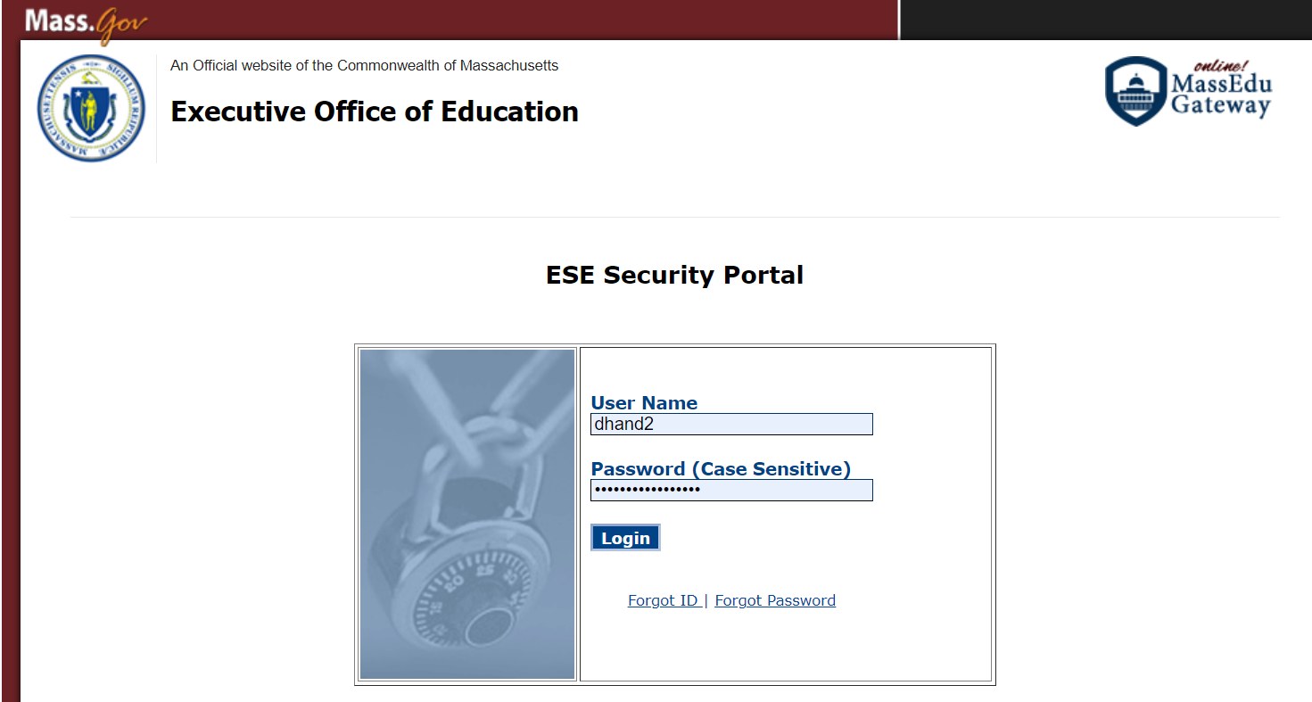
Viewing and Downloading MCAS-Alt Preliminary Results
To view the MCAS-Alt Feedback Forms (FFs), available in mid-June from the previous spring. Use the password given in January from MCAS.
Log in to the Department’s Gateway Portal
For assistance logging in, see your district or organization Directory Administrator.

Slide 26
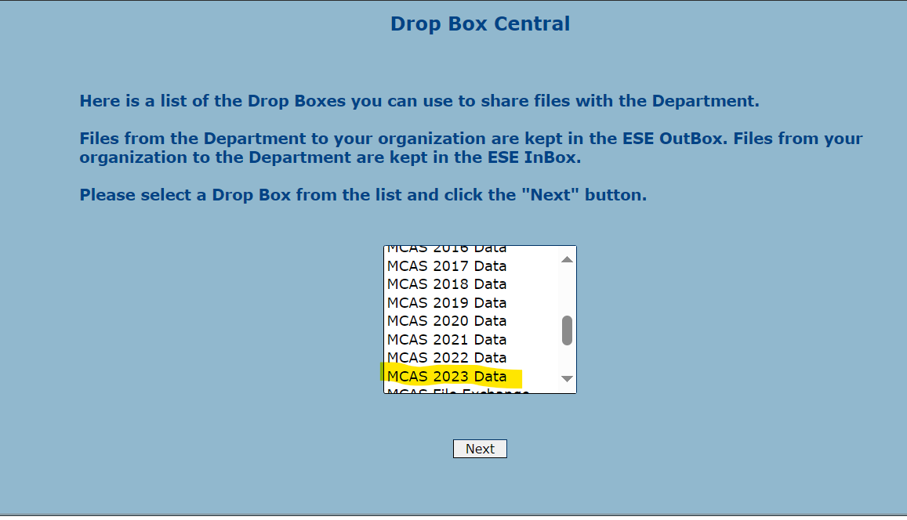
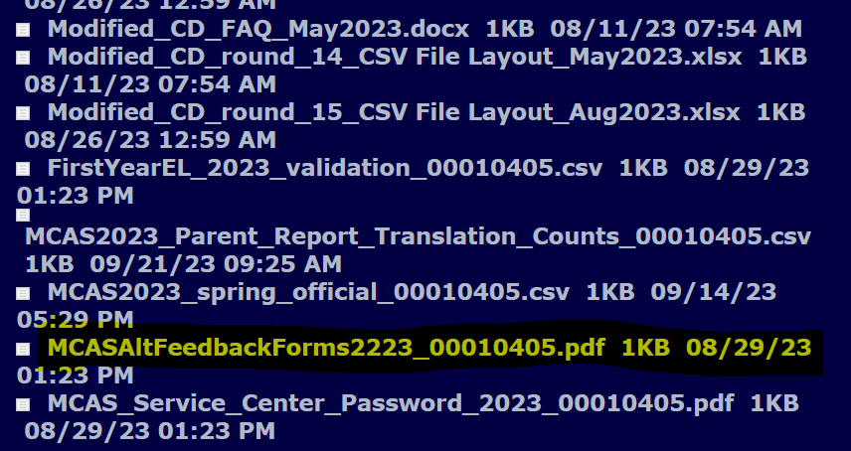
Viewing and Downloading MCAS-Alt Preliminary Results
Instructions are also found in the Principal’s Manual for the MCAS-Alt, the
SAS Update and the MCAS-Alt Newsletter.

Slide 27
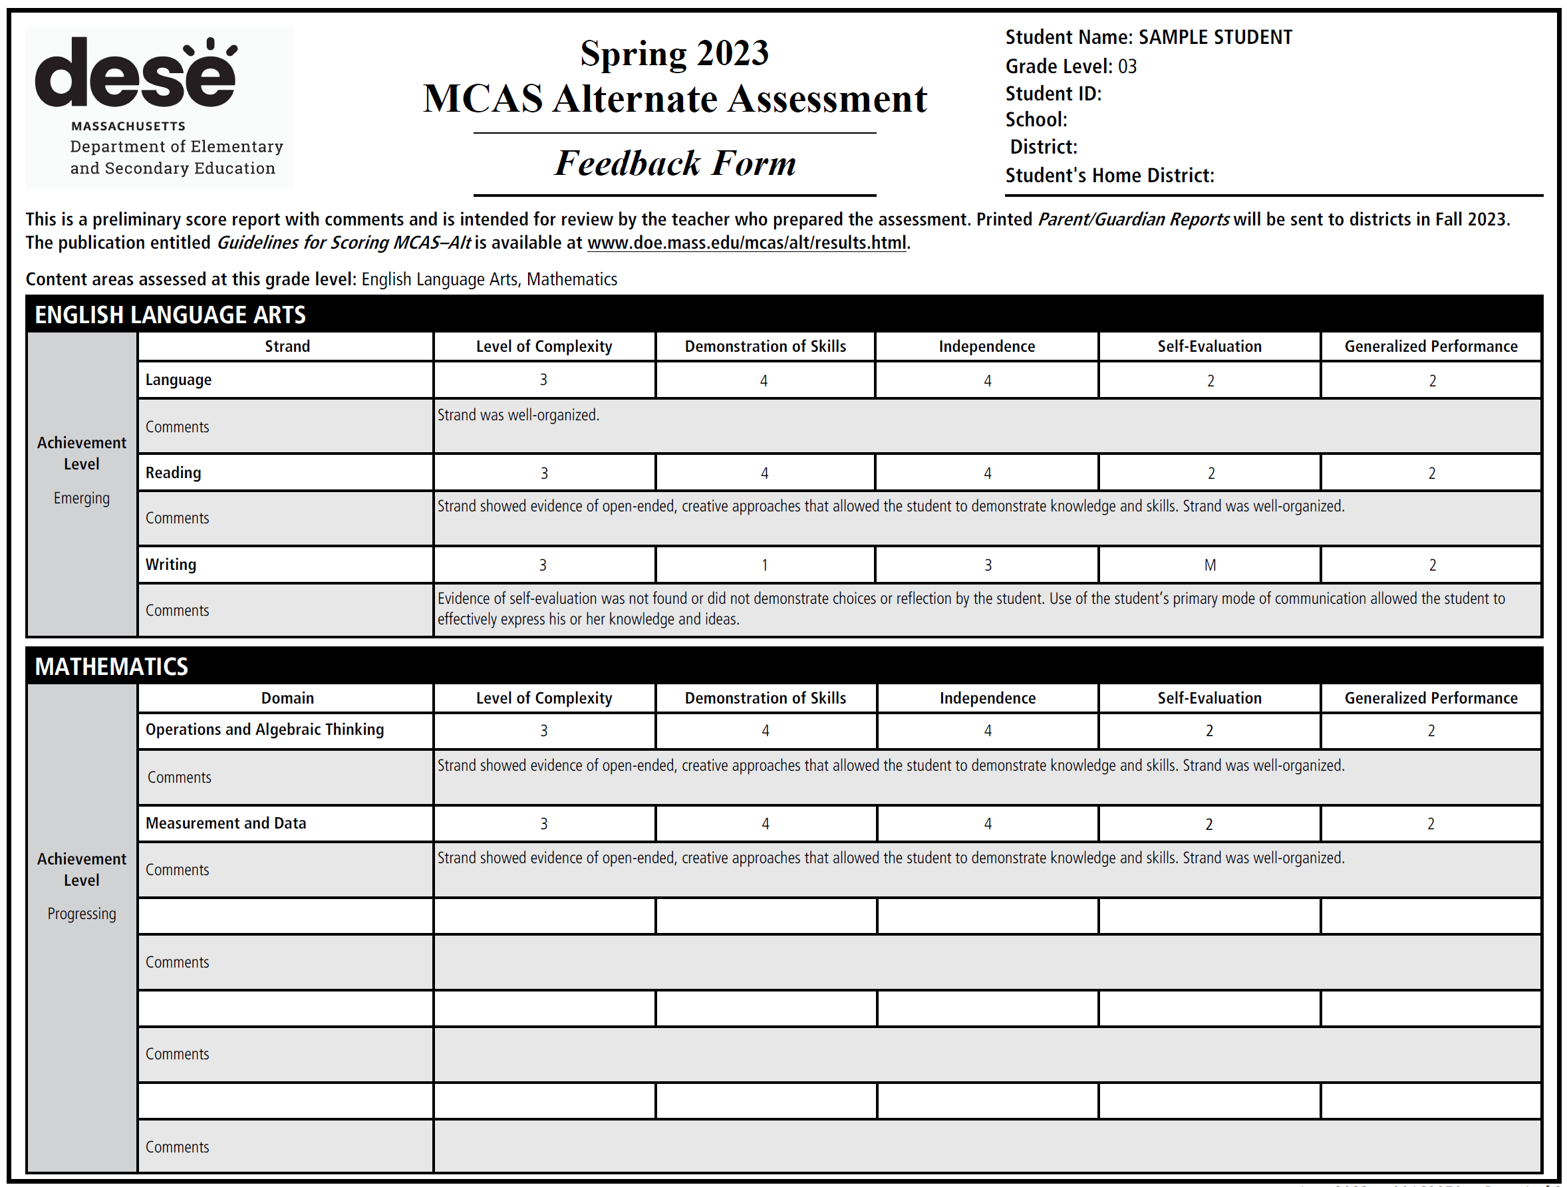

Slide 28
 | 1 | 2 | 3 | LOC 4 and 5 Not Applicable (See Grade-Level/Competency)
Level of Complexity | Portfolio strand reflects little or no basis in, or is unmatched to, curriculum framework learning standard(s) required for assessment. | Student primarily addresses motor and communication “access skills” during instruction based on curriculum framework standards in this strand. | Student addresses curriculum framework standards that have been modified below grade-level expectations in this strand.
Educator’s Manual, pp. 29-34
 | M | 1 | 2 | 3 | 4
Demonstration of Skills and Concepts (Accuracy) | The portfolio strand contains insufficient information to determine a score. | Student’s performance is primarily inaccurate and demonstrates minimal understanding in this strand (0–25% accurate). | Student’s performance is limited and inconsistent with regard to accuracy and demonstrates limited understanding in this strand (26–50% accurate). | Student’s performance is mostly accurate and demonstrates some understanding in this strand (51–75% accurate). | Student’s performance is accurate and is of consistently high quality in this strand (76–100% accurate).
Independence | The portfolio strand contains insufficient information to determine a score. | Student requires extensive verbal, visual, and physical assistance to demonstrate skills and concepts in this strand (0–25% independent). | Student requires frequent verbal, visual, and physical assistance to demonstrate skills and concepts in this strand (26–50% independent). | Student requires some verbal, visual, and physical assistance to demonstrate skills and concepts in this strand (51–75% independent). | Student requires minimal verbal, visual, and physical assistance to demonstrate skills and concepts in this strand (76–100% independent).
Self-Evaluation | Evidence of planning, self-correction, task- monitoring, goal-setting, and reflection was not found in the student’s portfolio in this content area. | Student infrequently plans, self-corrects monitors, sets goals, and reflects in this content area — only one example of self-evaluation was found in this strand. | Student plans, self-corrects monitors, sets goals, and reflects in this content area — multiple examples of self-evaluation were found in this strand.
Generalized Performance |  | Student demonstrates knowledge and skills in one context or uses one approach and/or method of response and participation in this strand. | Student demonstrates knowledge and skills in multiple contexts or uses multiple approaches and/or methods of response and participation in this strand.

Slide 29
ELA: Demonstration of Skills and Concepts (Accuracy)
This rubric area measures the degree to which the student gave the correct or desired response(s) during a task or activity.
M | 1 | 2 | 3 | 4
The portfolio strand contains insufficient information to determine a score. | Student’s performance is primarily inaccurate and demonstrates minimal understanding in this strand (0–25% accurate). | Student’s performance is limited and inconsistent with regard to accuracy and demonstrates limited understanding in this strand (26–50% accurate). | Student’s performance is mostly accurate and demonstrates some understanding in this strand (51–75% accurate). | Student’s performance is accurate and is of consistently high quality in this strand (76–100% accurate).

Slide 30
ELA: Independence
This rubric area measures the frequency with which prompts were used to assist the student in responding to a task, activity, or assignment.
M | 1 | 2 | 3 | 4
The portfolio strand contains insufficient information to determine a score. | Student requires extensive verbal, visual, and physical assistance to demonstrate skills and concepts in this strand (0–25% independent). | Student requires frequent verbal, visual, and physical assistance to demonstrate skills and concepts in this strand (26–50% independent). | Student requires some verbal, visual, and physical assistance to demonstrate skills and concepts in this strand (51–75% independent). | Student requires minimal verbal, visual, and physical assistance to demonstrate skills and concepts in this strand (76–100% independent).

Slide 31
ELA: Demonstration of Skills / Independence
A score of “M” is given when a portfolio strand contains insufficient information to be scored.

Slide 32
ELA: Demonstration of Skills / Independence
Comment on MCAS-Alt Feedback Form:
“All skills listed in the measurable outcome were not addressed during each activity on the data chart”
“All skills listed in the measurable outcome were not addressed on at least two (2) pieces of evidence.”
Prior to submitting an appeal, the teacher needs to review the copy of the assessment:
Does the entry point contain more than one skill?
If yes, did the educator assess both skills, on 8 data points and in both pieces of student evidence?

Slide 33
How MCAS-Alt Results are Reported
Scores used to report results of students who take the MCAS-Alt:
Awareness
Students demonstrate very little understanding of standards and require extensive prompting and assistance. Their performance is mostly inaccurate.
Emerging
Students demonstrate a very basic understanding of a limited number of standards below grade-level expectations. Their performance is limited and inconsistent.
Progressing
Students demonstrate a partial understanding of selected standards below grade-level expectations. Steadily learning knowledge and skills. Performance is mostly accurate and requires minimal prompting and assistance.
Incomplete
Insufficient evidence and information to determine an achievement level.

Slide 34
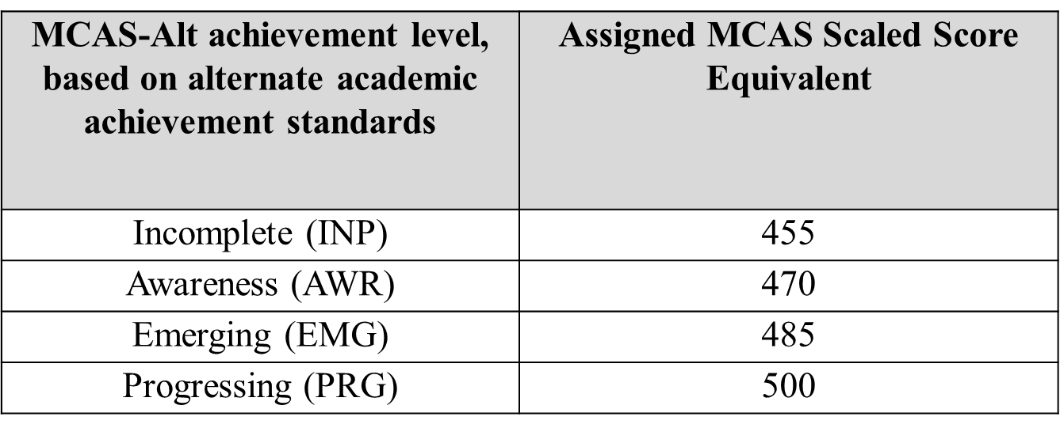
How MCAS-Alt Results are Reported:
MCAS-Alt results will be included in the accountability system, together with the results of students who took the standard MCAS tests.
For school accountability, schools do receive the following MCAS Scaled Score Equivalent:

Slide 35
A score of Progressing on MCAS-Alt is not “Passing”
A score of Progressing means the student is making progress:
is steadily learning new knowledge, skills, and concepts
requires minimal prompting and assistance
performance is basically accurate
…but is still achieving below grade-level expectations.
Progressing does not mean a student has achieved the score needed for a Competency Determination in high school (i.e., Partially Meeting Expectations).
MCAS-Alt scores are included at the Not Meeting Expectations level in school/district results

Slide 36
8
Resources and Contacts

Slide 37
Resource and Contact Information
MCAS-Alt Website:
www.doe.mass.edu/mcas/alt
Student Assessment Update:
www.doe.mass.edu/mcas/updates.html
MCAS Service Center:
mcas@cognia.org
Robert Pelychaty, Manager of Inclusive Assessment
Robert.Pelychaty@mass.gov
Debra Hand, MCAS-Alt Coordinator
Debra.D.Hand@mass.gov

