Slide 1
MCAS Grade-Level and Competency Portfolio Assessments
The Office of Student Assessment Services
Fall, 2023

Slide 2
Presenters
Robert Pelychaty, Manager of Inclusive Assessment
Kevin Froton, Cognia Program Manager

Slide 3
Logistics for This Session
Use the Q&A feature to ask a question.
  Some questions may be covered during the course of the presentation.
  We will answer some questions at the end of this session.
  After the session, we will email questions and answers to participants.
  Email questions about individual records or specific questions about your school/district to mcas@doe.mass.edu instead of asking here.
Use the thumbs-up icon to “upvote” someone else’s question.
This session is being recorded and will be available in about a week in the MCAS Resource Center, along with the slides.
  Slides were also emailed out beforehand and are being posted in the chat.
Click the “CC” to enable closed captioning (if needed).

Slide 4
Today’s Agenda
Who should be considered for a grade-level or competency portfolio
What is a grade-level portfolio
What is a competency portfolio
Requirements
Process and how to compile a grade-level or competency portfolio

Slide 5
Who Should be Considered for a Grade-Level or Competency Portfolio?
A student with significant and complex disabilities who:
  perform classroom work at or near grade-level;
  cannot demonstrate knowledge and skills on the MCAS test in that grade and subject;
  is attempting to earn a passing score on the MCAS test, such as partially meeting expectations or a high performance level.
    NOTE: A score of Progressing on the MCAS-Alt is not a “passing score” for the purpose of earning a CD.

Slide 6
Examples of Student Profiles that may be Appropriate for the Grade-Level or Competency Portfolio.
A student with a complex disability should be considered if they produce grade-level work in the classroom, but has, for example:
  a significant emotional, behavioral, or other disability and is unable to maintain concentration to participate in standard testing, even with accommodations;
  a significant health-related disability, neurological disorder, or other complex disability and is unable to meet the demands of a prolonged test administration;
  a significant motor, communication, or other disability and requires more time than is reasonable or available for testing

Slide 7
What is a “Grade-Level” Portfolio (grades 3–8)?
A collection of work samples at grade-level expectations produced by a student in grades 3−8 that includes:
Work samples only; no data charts are required
Multiple work samples that together demonstrate all aspects of the required standards
  Each work sample should address one standard (for .
  Grade-level Work Description forms should accompany each work sample.
  For each subject:
  Mathematics—A total of 10 standards must be documented in the student’s work.
  ELA—3 standards each in Reading-Literature and Reading-Informational text; plus four (4) writing samples (one in each of three text types, and one selected by student)
  STE—A total of 9 standards (3 in each of 3 selected disciplines)

Slide 8
What is a High School Competency Portfolio?
A collection of specific student work that is comparable in depth, breadth, and difficulty to a student who has achieved the Competency Determination (CD) in that subject by scoring
  Work samples only; no data charts are required
  Multiple work samples that together demonstrate all aspects of the required standards
  If initial submission does not achieve a passing score, the portfolio may be resubmitted each year with additional work.
    A cumulative collection
    Otherwise, MCAS/MCAS-Alt are not required after grade 10.
    Requirements are described in the MCAS Grade-Level and Competency Portfolio Manual and on the MCAS Grade-Level and Competency web page.
    Feedback Forms are provided to the school with comments from reviewers.

Slide 9
Competency Portfolio Requirements for
ELA and Mathematics
Requirements for ELA and Mathematics competency portfolios are based on the 2017 Curriculum Frameworks:
ELA—produce four (4) essays, plus two (2) short responses, based on grade-10 texts (multiple essays and short responses cannot be based on the same text):
  Each essay and short response must:
  include multiple drafts that are written entirely by the student, not rewritten by the teacher and indicate a progression of the student’s thinking in each successive draft
  Responses should not consist of plot summaries, multiple-choice worksheets, short-answer tests, or quizzes.
Mathematics—work samples documenting all aspects of 15 standards (or clusters of standards) from all five conceptual categories.

Slide 10
Science Competency Portfolio Requirements
Competency portfolio requirements for Introductory Physics and Biology:
General requirements, based on the 2016 STE Curriculum Frameworks:
Biology—A total of 8 standards (5 required and 3 discretionary) selected across the core ideas.
Introductory Physics—A total of 7 standards (5 required and 2 discretionary) selected across the core ideas.
See new MCAS Grade-Level and Competency Portfolio Manual specific STE requirements.
Work samples must…
  Be completed by the student must demonstrate all aspects of standards selected for the discipline;
  not be corrected by the teacher and submitted as the student’s own work;
  demonstrate the student’s thinking and problem-solving indicating the process used to solve each problem (i.e., show all student work); and
  Not included simple multiple-choice, matching, or fill-in-the-blank worksheets.

Slide 11
Cover Sheets for Grade-Level and Competency Portfolios

Slide 12
Example of Grade-Level Work Description and Work Sample

Slide 13
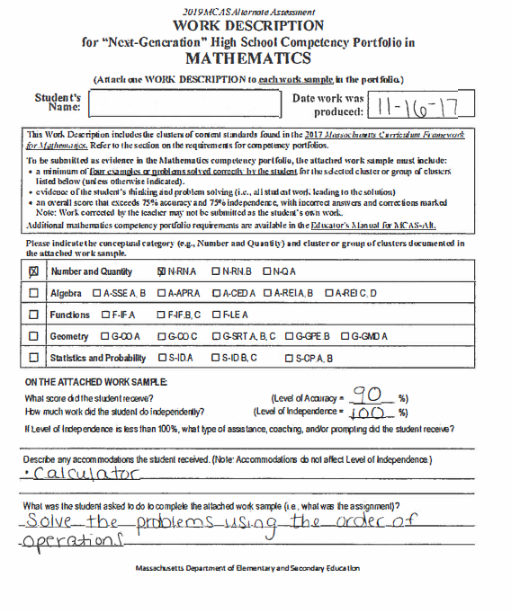
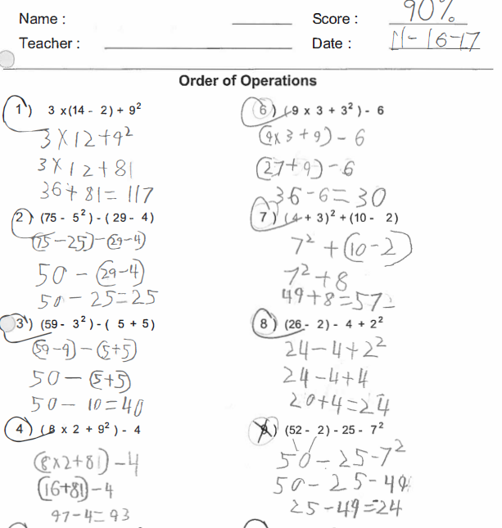
Example of Competency Work Description and Work Sample

Slide 14
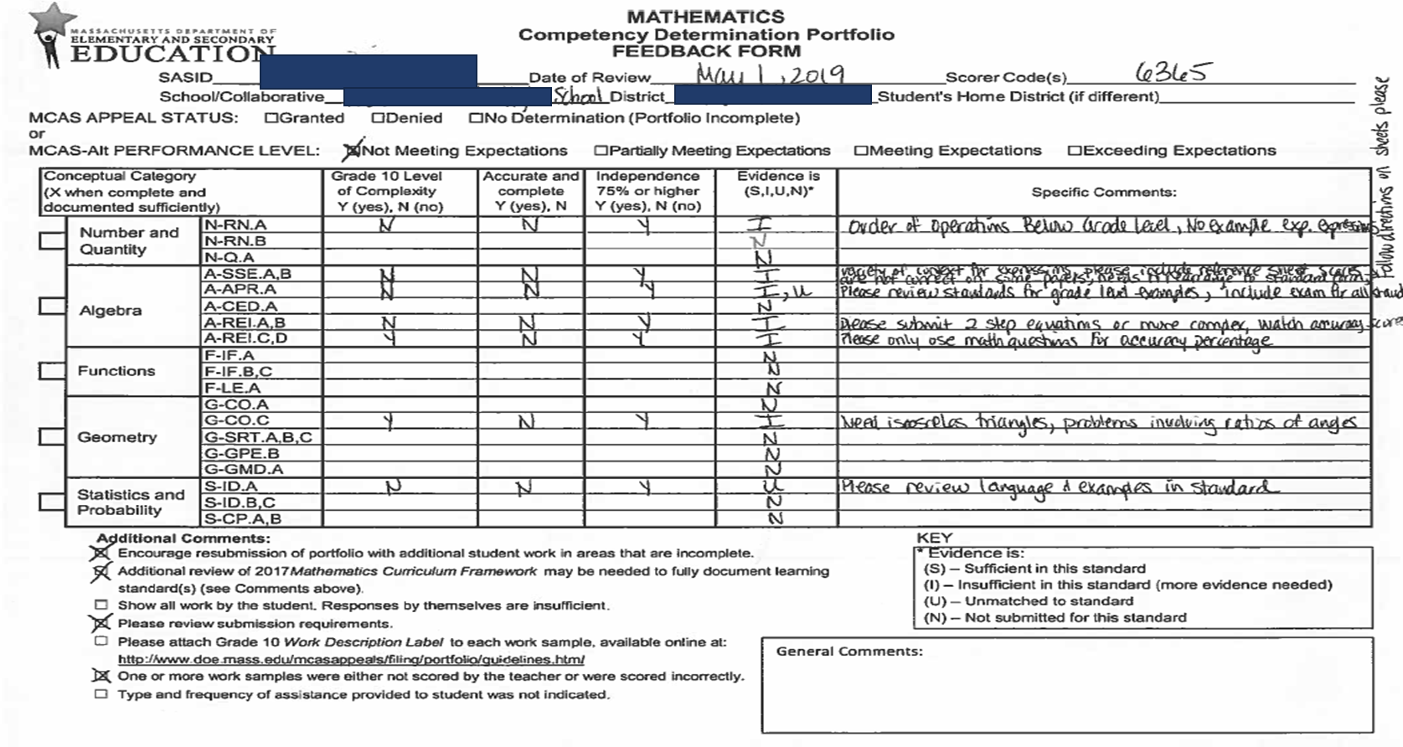
Feedback Form Example

Slide 15
How are portfolios scored?
Content experts will review portfolios for the following characteristics:
Are all required strands and standards submitted?
Does the work address all aspects of each standard?
Is work at grade-level complexity?
Are student’s responses accurate? (>75%)
Is work produced independently? (>75%)
    Acceptable prompts—Redirecting student’s attention; reminding student to show work, include correct units, round to nearest 10th
    Unacceptable prompts—Model or show sample problems on board or at top of worksheet; provide step-by-step supports to solve a problem
The answer alone isn’t enough.
  Show all work: include drafts with edits, steps in solving problems, final version or solution.
  Complete Work Description forms.

Slide 16
Process and Resources to complete a portfolio
Determine the student(s) for whom a competency or GL portfolio would be appropriate.
Principal and other adults familiar with the student decide whether to pursue this option.
Review the portfolio submission requirements.
Identify staff who can collaborate (e.g., special educators, content teachers, curriculum coordinators).
Review MA Curriculum Frameworks, portfolio requirements, and the MCAS Grade-Level and Competency Portfolio web page.
Instruct student(s) on the standards required for the portfolio.
Collect samples of student’s work guided by the required standards.
Be aware of submission deadlines.

Slide 17




THANK YOU
The Office of Student Assessment Services
781-338-3625
mcas@doe.mass.edu
www.doe.mass.edu/mcas
75 Pleasant Street, Malden, MA 02148

