Slide 1
MCAS-Alt Update 2024
Robert Pelychaty, Manager of Inclusive Assessments, DESE
Debra Hand, MCAS-Alt Coordinator, DESE
Kevin Froton, Senior Project Manager, Cognia

Slide 2
Questions During Today’s Presentation
Audience members are muted.
Please type your question in the “Q and A” and we will respond in writing as soon as we are able.
Also, feel free to reach out to us after the presentation with questions about unique circumstances or specific students.
by email at mcas@doe.mass.edu, or
by phone at 781-338-3625.

Slide 3
1
Updates and Reminders for 2024
TODAY’S AGENDA
2
Ensuring Appropriate Designation of Students for MCAS-Alt
3
Completing Quality Alternate Assessments
4
Website and Contact Information

Slide 4
MCAS - Alt Virtual Training Sessions
Open to All:
ELA Writing
September 29 (10:00 – 11:30 a.m.)
October 4 (1:00 – 3:00 p.m.) (includes Writing for Access Skills )
Science and Tech/Eng (STE) (grades 5, 8, and high school):
September 29 (1:00 –2:30 p.m.)
October 4 (10:00 – 11:30 a.m.)
Access Skills (all grades)
October 16 (1:30 – 3:00 p.m.)
Administrators and Supervisors should attend:
Administrators Overview for MCAS-Alt
September 26 (1:30 – 3:00 p.m.)
October 12 (9:30 – 11:00 a.m.)

Slide 5
1
Updates and Reminders for 2024 MCAS-Alt

Slide 6
Date to Remember:
School administrators must order MCAS-Alt materials:
January 2−12, 2024
Binders and submission materials received in schools:
Last week of February
Administrators must open the shipment; review its contents and fill out the PCPA part 1. Additional materials can be ordered if needed.
MCAS-Alt binders must be shipped by: 5 p.m., Thursday, March 28, 2024
Preliminary results: MCAS-Alt Feedback Forms posted in mid-June

Slide 7
What’s New for 2024
Revised Educator’s Manual and Resource Guides
Math domains are linked to lower grade levels
High school Science and Technology/Engineering (STE) content available: Introductory Physics or Biology
Defined criteria for students eligible to participate in the alternate assessment.
Alternate Assessment Participation Tool for IEP teams

Slide 8
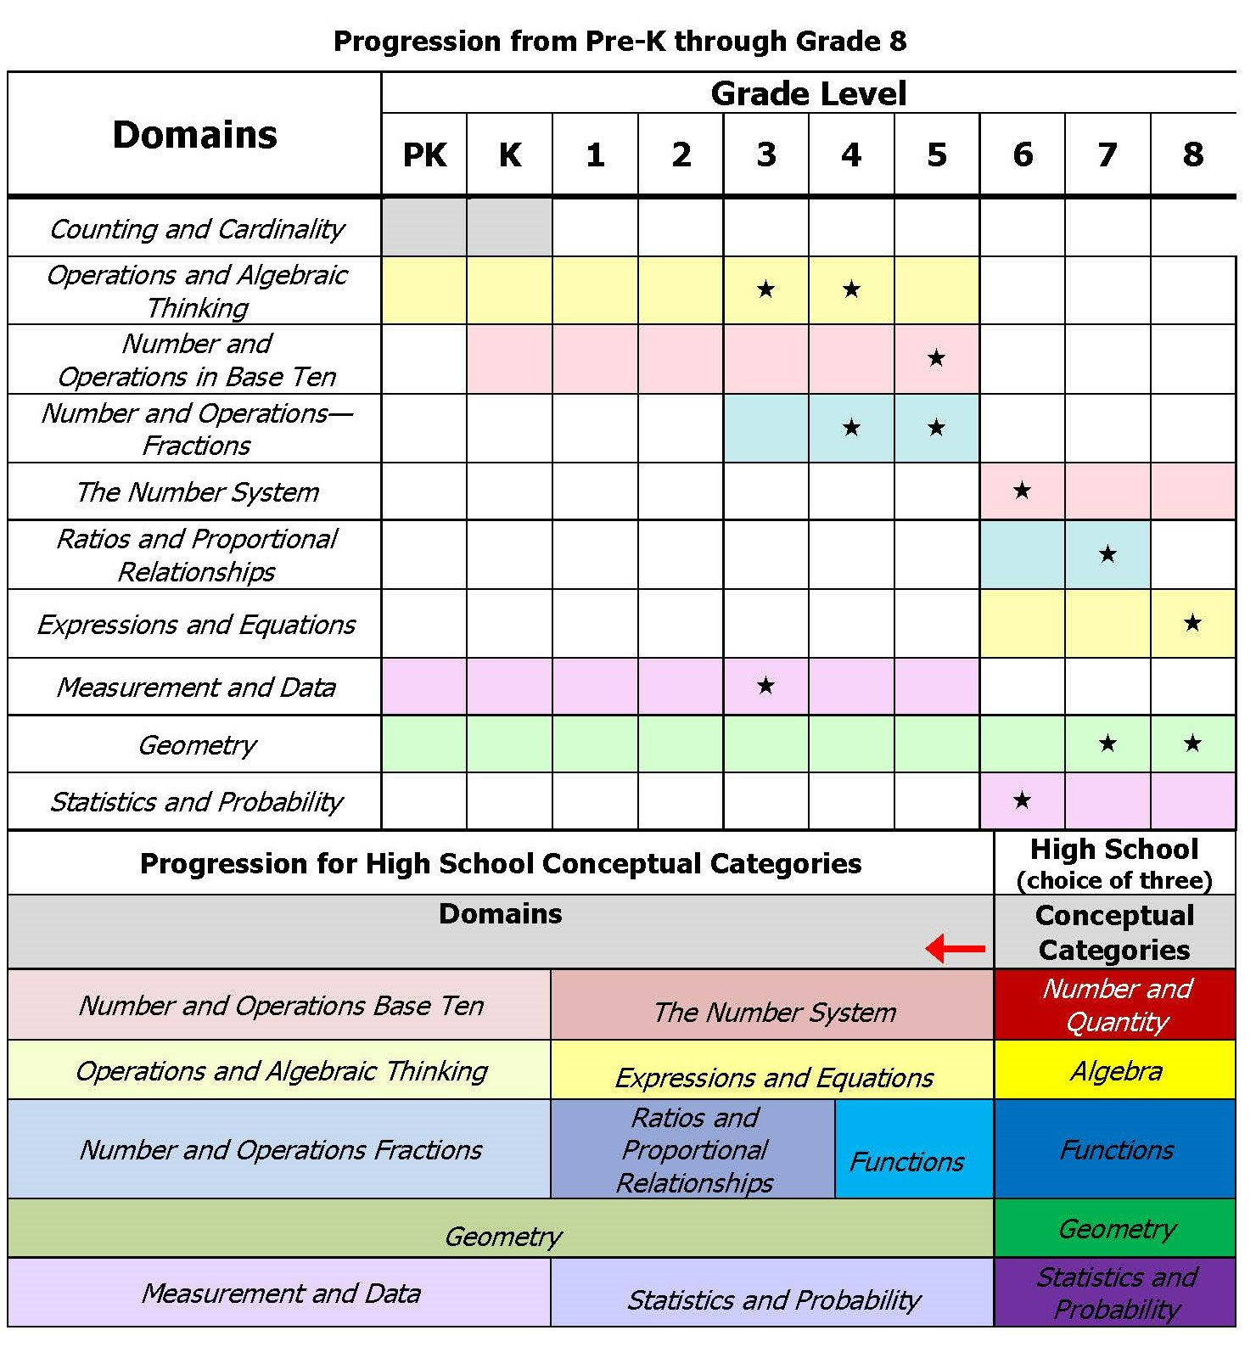
If spiraling to a lower grade level in a different domain always start at the most challenging level.
Forms and Graphs online application will
only allow access to acceptable domains.
Complete the Mathematics Skills Survey for your student’s grade and select the most complex entry point that challenges your student.

Slide 9
Reminders for 2024
New name, same function:
Teacher-scribed work sample > teacher-documented work sample
Resource Guides to the Massachusetts Curriculum Frameworks for Students with Disabilities > Alternate Academic Achievement Standards based on the Massachusetts Curriculum Frameworks
Appeal results are mailed to schools in July- check with administrators

Slide 10
2
Ensuring Appropriate Designation of Students for MCAS-Alt

Slide 11
Statewide Assessment Participation Requirements
All students must participate in MCAS testing for their grade level. It is not a question of whether students with disabilities participate, but how they will participate. All students who are educated with Massachusetts public funds, including students with disabilities, English learners, and English learners with disabilities, are required by state and federal laws to participate in statewide assessments.

Slide 12
Participation Guidelines
Question 1: Does the student meet the Massachusetts definition of a “student with the most significant cognitive disabilities”?
If YES, the student is eligible for the MCAS-Alt based on Alternate Academic Achievement Standards. See the MCAS-Alt website for further directions. Students taking the MCAS-Alt likely will face challenges earning their high school diploma. Note: Simply because the student is eligible does not warrant the Team recommending participation in the MCAS-Alt.
If NO, proceed to question 2
Question 2: Does the student have a disability and require specific and allowable accommodations and accessibility features to demonstrate knowledge and skills on assessments?
If YES, the student’s IEP or 504 plan should include the specific allowable accommodations and accessibility features, which should generally mirror accommodations the student receives during routine instruction. Please review the Guidance for Selecting and Evaluating MCAS Accessibility Features and Accommodations for Students with Disabilities.
If NO, the student must participate in the standard MCAS assessment using available accessibility features. Accommodations may be included later if the student’s needs change.

Slide 13
Criteria for Students with the Most Significant Cognitive Disabilities
Massachusetts defines “students with the most significant cognitive disabilities” as students who:
have cognitive disabilities evidenced by significant delays in attaining age-level academic achievement standards, even with systematic, extensive individually designed instruction, related services, and modifications; and
have cognitive disabilities that significantly impact their educational performance and ability to apply learning from one setting to another; and
require extensive, direct individualized instruction and substantial support to achieve measurable gains on the challenging State academic content standards for the grade in which the student is enrolled; and
perform significantly below average in general cognitive functioning and adaptive behavior. This is defined as a student functioning two or more standard deviations below the mean on commonly accepted norm-referenced assessments in both cognitive functioning and adaptive behavior (e.g., two or more adaptive skill areas such as daily living skills, communication, self-care, social skills, and academic skills).

Slide 14
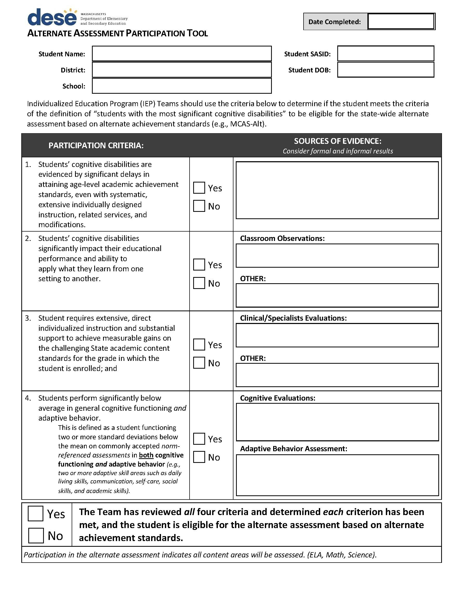
The Alternate Assessment Participation Tool is a companion document to assist IEP teams when deciding if a student is eligible to participate in the MCAS-Alt. If eligible, the student will take the assessment in all content areas required for their grade.
Fill out the form online, then upload it to the MCAS-Alt File Exchange located in the Security Portal. See the instructions printed on the form.

Slide 15
3
Completing Quality Alternate Assessment

Slide 16
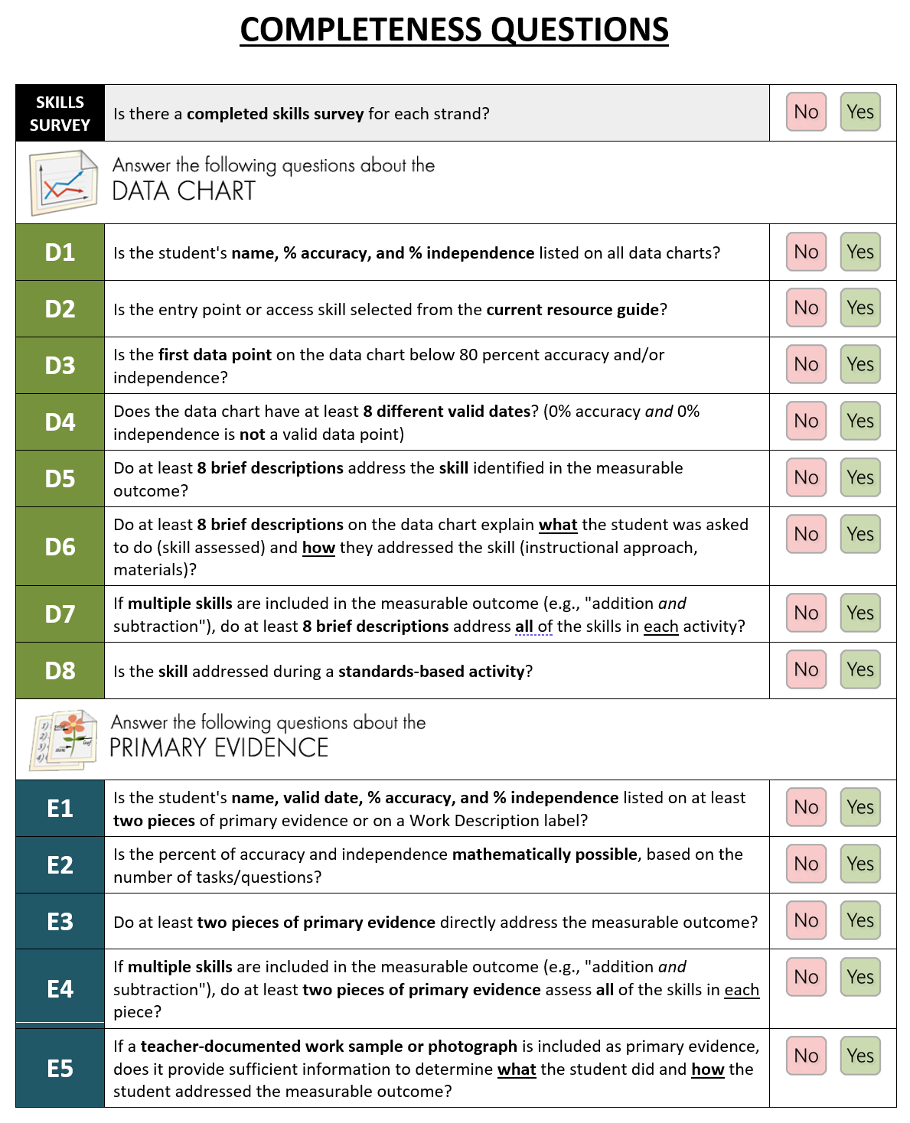
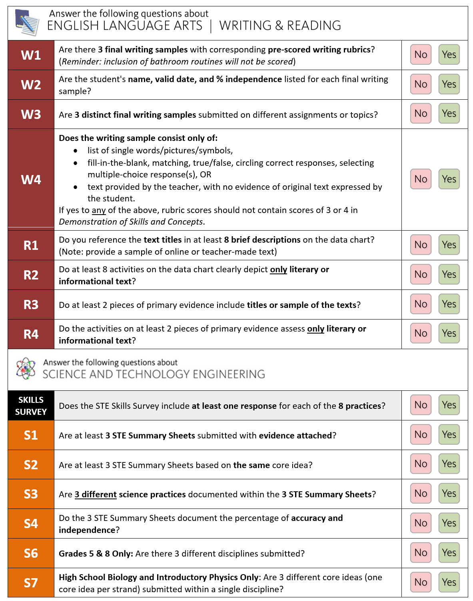
Checking for Completeness before Submission

Slide 17
Use all Resources Available
Math and STE resources are available in Forms and Graphs under the Table of Contents:
Mathematics Glossary: updated to assist educators with unfamiliar math concepts frequently found in the resource guide.
STE topics and Instructional Material related to each core idea.
Plus, high-quality curriculum units related to the core idea are available at different levels
The National Center on Accessible Educational Materials for Learning at CAST provides technical assistance, coaching, and resources to increase the availability and use of accessible educational materials, including texts and technologies for learners with disabilities. Check with your special education director.

Slide 18
Example of STE Earth and Space Core Idea,
Related topics, and high-quality units
Core Idea: Earth and Human Activity
Natural resources
Renewable and non-renewable resources (energy)
Examples of ways humans reduce their impact on the Earth’s resources and environment (e.g., composting, recycling)
Preparations for severe weather
Climate Change/Global warming
Reducing severe weather impact
High-Quality Related units:
SOLID Start “Ever-Changing Environments” (KG)
“Engineering Toys” (gr. 2)
NGSS Storylines “Where does our clean water come from and where does it go after we make it dirty?” (gr. 5)
OpenSciEd “Earth’s Resources & Human Impact” (gr. 6-8)
TOPICS
Links to Units

Slide 19
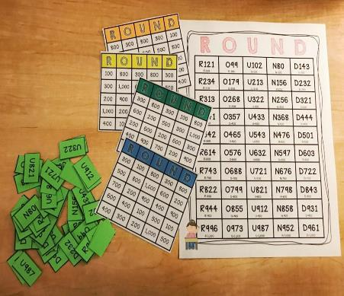
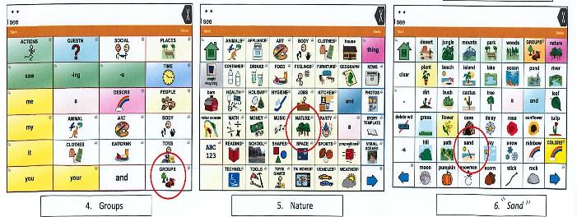
Give Supporting documentation (Optional)
Shows or describes the context of the learning activity but is not considered a final product.
Mathematics
Materials used to play ‘rounding’ BINGO
ELA-Writing (iPad app)
Sample of boards/vocabulary available to students for writing samples.

Slide 20
Contact Information
MA Department of Elementary and Secondary Education – Student Assessment (781-338-3625)
Debra Hand – MCAS-Alt Coordinator
Debra.d.hand@mass.gov
Robert Pelychaty – Manager of Inclusive Assessments
Robert.pelychaty@mass.gov
General Inquiries – mcas@doe.mass.edu
MCAS-Alt DESE Web Page – www.doe.mass.edu/mcas/alt
Educator Materials – profile.measuredprogress.org/MCAS-Alt
Forms and Graphs Technical Support – 866-834-8880

